Slide 1
A Critical Perspective on Measurement: MIMIC Models to Identify and Remediate Racial (and Other) Forms of Bias
Matthew A. Diemer & Aixa D. Marchand
Presented to the Society for Research on Educational Effectiveness
Friday, May 20 at 2:00PM - 3:30PM ET

Slide 2
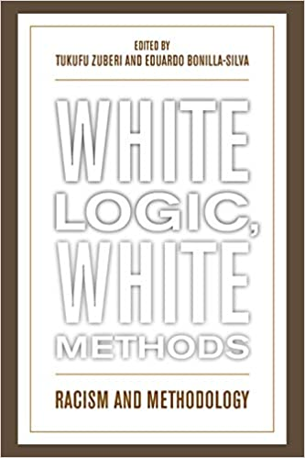
Problematic History of Quantitative Methods
Zuberi and Bonilla-Silva (2008) in White Logic, White Methods: Racism & Methodology, document this problematic history. A brief overview:
  "Francis Galton was a key intellectual power behind the modern statistical revolution in the social sciences....Galton used statistical analysis to make general statements regarding the superiority of different classes within England and of the European-origin race, statements that were consistent with his eugenic agenda.“ (p. 128)
(See also Briggs, 2021)

Slide 3
Problematic History of Quantitative Methods
Sir Francis Galton (1822-1911):
  Was a statistician and founder of psychometrics who developed the correlation coefficient
  Founded the ideology and scientific practice of eugenics
Galton’s work was then carried on by the eugenicist, Karl Pearson (1857-1936), who further developed the comparative method of the Pearson correlation coefficient in order to prove the intellectual superiority of the Aryan race. This has been well documented (Dixon-Román, 2019, p. 95)
Mid-1990s saw the Bell Curve & modern-day attempts to establish (White) racial superiority, using quantitative methods (much of this measurement-focused)
So, should we ‘throw the baby out with the bathwater’ and abandon quantitative methods (including psychometrics) if we want to center race, conduct anti-racist research, and/or maintain a critical perspective?

Slide 4
Equity-Oriented or Anti-Racist Measurement
“It remains difficult to utilize the statistical tools created by eugenicists to study race & ethnicity in ways that do not lead to perpetuating that inequality.” (Viano & Baker, 2020, p. 304)
And: “Positivistic statistical analyses have been central to the oppression of minoritized communities historically (Zuberi, 2001)
But: "Using racialized census, survey or other social data is not in and of itself problematic....statistical research can go beyond racial reasoning [including but not limited to justifying racial stratification] if we dare to apply the methods to the data appropriately.“ (Zuberi & Bonilla Silva, 2008)
What we reject, however, is the idea that these analytical procedures can simply be reduced to the “master’s tools” (Cokley & Awad, 2013)

Slide 5
Equity-Oriented or Anti-Racist Measurement
“The oft-cited quote “The Master’s Tools Will Never Dismantle the Master’s House” by Audre Lorde (1984) has been misinterpreted and used as a rationale for not utilizing quantitative methodology because of the belief that these methods are inherently oppressive (Unger, 1996)
Instead, Lorde was chastising White feminists for failing to recognize the differences among women based on social class, sexual identity, race and age, not advocating that women (or other oppressed groups) should not use quantitative methods.” (Cokely & Awad, 2013, p. 28)
“Quantitative methods are well placed to chart the wider structures, within which individuals live their everyday experiences, and to highlight the structural barriers and inequalities that differently racialized groups must navigate.” (Gilborn et al., 2018, p. 160)
[These approaches] “will not dismantle systemic racism, however, it is a tool to begin to reimagine the role that research and data can play in an anti-racist society.” (Castillo & Gilborn, 2022, p. 3)

Slide 6
Equity-Oriented or Anti-Racist Measurement
Instead, we will demonstrate how they can be used for critical, progressive social purposes. (Cabrera & Chang, 2019, p. 74)
  Notable example: “It is important to note that the statistical analyses played a central role in the overturning of A.R.S. 15 112, in part, because Dr. Cabrera temporarily took leave of his traditional roles as an educational advocate and instead played the role of objective social scientist. This was extremely difficult, but it was important to allow that statistics to be utilized by attorneys to utilize them for legal goals” (p. 91, ibid)
Why rigor matters: If you don’t argue scientifically, those who you disagree with will, and your views will not be heard (Wilson, 1990; see also Randall, 2021)
Equity, justice, race, gender, and other issues can be ‘heard’ in different way by using sophisticated methods to examine them

Slide 7
A Brief Annunciation: Crit Quant
A more general critical approach to quantitative methods, in solidarity with but not as paradigmatic or aligned with CRT as QuantCRiT (Stage, 2007)
CritQuant = “to what extent educational research can offer critiques of our world that allow us to transform it” (Baez, 2007, p. 18; echoes of Freire)
“Quantitative criticalist[s]…use quantitative methods to represent educational processes and outcomes to reveal inequities and to identify perpetuation of those that were systematic. The term also included researchers who question models, measures, and analytical practices, in order to ensure equity when describing educational experiences.” (Stage & Wells, 2015, p. 1) – see also (p. 1273, Jang, 2018).
In other words, what questions are asked & how they are posed as more important than specific methods
For more work in this area see Randall, 2021, p. 88, Table 1 for anti-racist extensions in measurement

Slide 8
CritQuant: Core Elements
1. Knowing methods in order to critique, deconstruct, and reformulate them:
  “[Alexander McQueen] learned the precision and skill in tailoring suits that later helped him deconstruct them without losing structure or integrity of the garment. This approach of mastering the rules well enough to know how to break them stayed with me.” (Hernandez, 2018, p. 93)
2. Deep understanding of critical theory AND methods (Randall, 2021; Stage, 2007)
3. Numbers & quantitative methods don’t have more inherent truth or rigor:
  “This does not mean that critical race theorists should dispense with quantitative approaches but that they should adopt a position of principled ambivalence, neither rejecting numbers out of hand nor falling into the trap of imagining that numeric data have any kind of enhanced status, value, or neutrality.” (Gilborn et al., 2018, p. 174)
4. Subjective & positional perspective:
  Scholarship & methods are political; no such thing as value-free or objective inquiry (or culture- or context-free measurement, Randall, 2021)
5. Researcher self-reflexivity across the research enterprise (Suzuki et al., 2021)

Slide 9
CritQuant: Possibilities
Let’s continue to use quantitative methods & not “throw the baby out with the bathwater”…
“Quantitative methods are well placed to chart the wider structures, within which individuals live their everyday experiences, and to highlight the structural barriers and inequalities that differently racialized groups must navigate.” (Gilborn et al., 2018, p. 160)
Lincoln and Guba (1985, well-known qualitative scholars) concluded that: “there are many opportunities for the naturalistic investigator to utilize quantitative data—probably more than appreciated” (as cited in Hernández, 2015, p. 199)
“Quantitative methods can be, have been, and should be used by scientists (along with other methods) to achieve the goals of social justice.” (Cokley & Awad, 2013, p. 27)

Slide 10

A Grounding Example of CritQuant:
Construct Bias: Apples, Oranges,
& Piggly Wiggly
Imagine a scale at PriceChopper, Star Market, & Piggly Wiggly, or your favorite grocery store.
You (omnisciently) put 10 lbs of apples on that scale, it reads 10 lbs.
You (omnisciently) put 10 lbs of oranges on that scale, it reads 7 lbs (?)
This scale exhibits construct bias in how it measures oranges. From the perspective of the scholar Janet Helms, oranges are not measured with fairness (putting aside what experiences & perspectives of being an orange lead to this).
So: For example, if the weight of oranges is used to predict some other thing → amount of juice extracted from the fruit → then we will not have fairness in how weight measurements are used
Which would an example of predictive bias (or, problem with predictive validity)
“biased tests yield score variance that reflects construct-irrelevant group differences, while good tests yield score variance that reflects construct-relevant group differences (e.g., high understanding of math concepts or high levels of experienced anxiety).” [quoting previous student’s HW]

Slide 11
Helms Individual-Differences (HID) Fairness Model
Race/ethnicity cannot be manipulated and is not a “variable”
  Janet Helms–argues race is only a social construct, not a biological reality, but yet also has profound social implications
Model Summary: Psychological factors associated with race/ethnicity cause differences in test scores
What are these psychological factors?
  Examples include: Stereotype threat, impact(s) that feeling like a test is biased against you/your group, immersion (pro-Black and anti-White attitudes), racial identity status
Social/structural factors, such as White supremacy in item wording & content, vital but not within the purview of individual test-takers (Randall, 2021) → this is racism in the test construction process
Note: Some characterize this as construct bias & Helms characterizes this as ‘fairness’ → similar, but not the same

Slide 12
Helms Individual-Differences (HID) Fairness model (II)
Using race/ethnicity group membership (e.g., White vs African American) is only a rough proxy for these racial/ethnic psychological factors
If we include race-based psychological factors in our models, then we do more to achieve fairness in testing (& we pay more attention to consequential validity)
Ex: Enter Immersion status (pro-Black and anti-White attitudes), in 1st step of regression, then racial group in 2nd
Or: - .23 correlation btw Black Racial Identity & Cognitive, Ability, or Knowledge Scales (CAKS; p. 853, Table 1) → ‘Construct irrelevant-variance’ in CAKS scores
---THIS CORRELATION SHOULD BE ZERO---
Because we have evidence of construct-irrelevant variance in a measure (CAKS, mechanical aptitude for females was aptitude + stereotype threat), then we have construct bias → or, (un)fairness

Slide 13
A ‘Validity Strategy’ to Address Fairness
MIMIC models: “I suggest as one of the ‘pragmatic strategies for identifying or removing unfairness from individual test takers’ scores if construct-irrelevant variance is discovered” (Helms, 2006, p. 846)
→ if that construct-irrelevant variance is group-based measurement error
→ this is a way of assessing construct bias
i.e., “Random error variance or factors that are wholly unrelated to individual differences in the trait measured by the test” (Frisby, 1999, p. 264)
MIMIC models would identify items that exhibit bias, in that they function differently across groups or one dimension of test fairness

Slide 14
A ‘Validity Strategy’ to Address Fairness
On the other hand, MIMIC models reify racial/ethnic categorization, and would only address issues of fairness inasmuch as categorizing race captures, or measures, dimensions of racial/ethnic socialization, cultural practice, etc., that contribute to group differences on tests (from Helms’ perspective)
    Further, race as a category fails to capture structural racism, inequitable policing, anti-Blackness, etc.
    MIMIC models would only measure racial/ethnic differences by proxy, via categorizing race/ethnicity
    MIMICs do not capture the “racial or cultural psychological attribute” (e.g., stereotype threat, immersion [pro-Black and anti-White attitudes]) that contribute construct-irrelevant variance to scores
This is therefore more of a ‘validity strategy’ than a ‘fairness strategy’ to use the terminology from the Helms (2006)

Slide 15
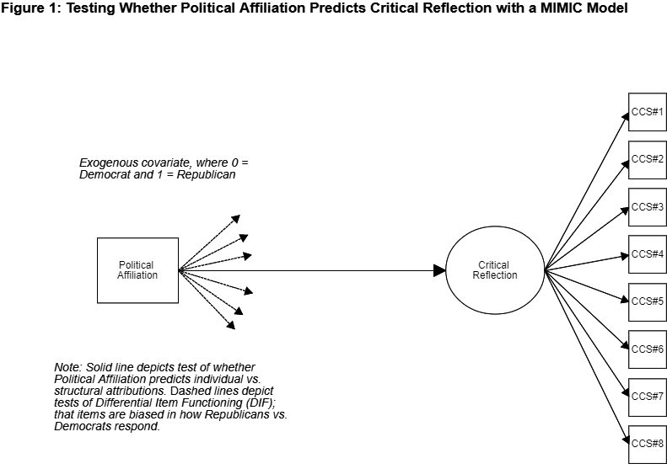
Sample MIMIC
We are used to seeing circles predict boxes (on the R side of this diagram), here we instead have boxes predicting circles on L side of diagram [not “LHS/RHS” equation]
Paths from exogenous covariates to indicators only suggested here…
Model addresses this prompting: “Will specific identity groups be particularly disadvantaged by the ways in which the construct is being defined?” (Randall, 2021, p. 88)
Motivation: Critiques of CC scholarship

Slide 16
MIMIC Models: Conceptual Basis
In education & in psychology, we often want to answer questions like the following:
  How do background characteristics (also called exogenous covariates, which are traditionally 0 or 1 in the MIMIC method) relate to differences on latent factors or observed indicators?
  Also stated:
    How does an exogenous covariate predict individual differences on a latent construct?
    How does an exogenous covariate predict responses to an individual item?
  For ex: How does gender predict scores on an expressive language measure? How does gender predict responses to the individual items that comprise the expressive language measure (i.e., are the items biased?)
    For ex: How do “low achievers” and “high achievers” differ when measuring X and Y?

Slide 17
MIMIC Models: Conceptual Basis
MIMIC [Multiple Indicators and Multiple Causes] models are CFAs with exogenous covariate(s) and are well-suited to answer these questions
MIMIC models also afford probing:
  Latent mean differences (which, because measurement error is parceled out, are more precise comparisons than t-tests of observed means)
  Differential item functioning (does group membership predict differential responding to an item)
    Differential Item Functioning, or DIF, is an important aspect of Item Response Theory (IRT)
    Parameterization of DIF etc similar in IRT vs MIMIC approaches

Slide 18
Technical Specifications of MIMICs
MIMIC models are a way of testing moderation
  A moderator variable “alters the direction or strength of the relation between a predictor and an outcome” (Frazier, Tix & Barron, 2004).
      Here, the moderating variable is group membership of some kind → does group membership predict latent mean differences or differential item functioning (DIF)?
SEM = very powerful & flexible analytic framework. MIMIC models = an SEM analysis that capitalizes on flexibility
MIMIC models (traditionally) use dichotomous exogenous covariates → dummy code or dichotomize non-dichotomous variables
MIMIC models are carried out with the entire sample, in contrast to multi-group CFA , which fits the same CFA model to each group, separately
Although MIMIC models are a variant of CFA models, there are no special considerations with regard to identification & estimation for MIMIC models

Slide 19
What do MIMICs Establish?
Strong Invariance (a.k.a. Scalar invariance) → presuppose configural (same ‘configuration’ of boxes to circles’) & metric (same ‘metric’ of loadings across groups’) invariance
Unstandardized intercepts between groups are constrained to be equal
Two people from different groups with the same level on a certain factor (or, latent variable) have the same score on a given indicator
Scalar Invariance:
  Practical example: men and women with equal levels of depression self-report the same amount of binge eating
Vs Scalar Variance (or, non-invariance):
  At the same level of depression, women binge-eat twice per week and men binge-eat 4 times per week, even though the slopes (increases as depression increases) may be the same

Slide 20
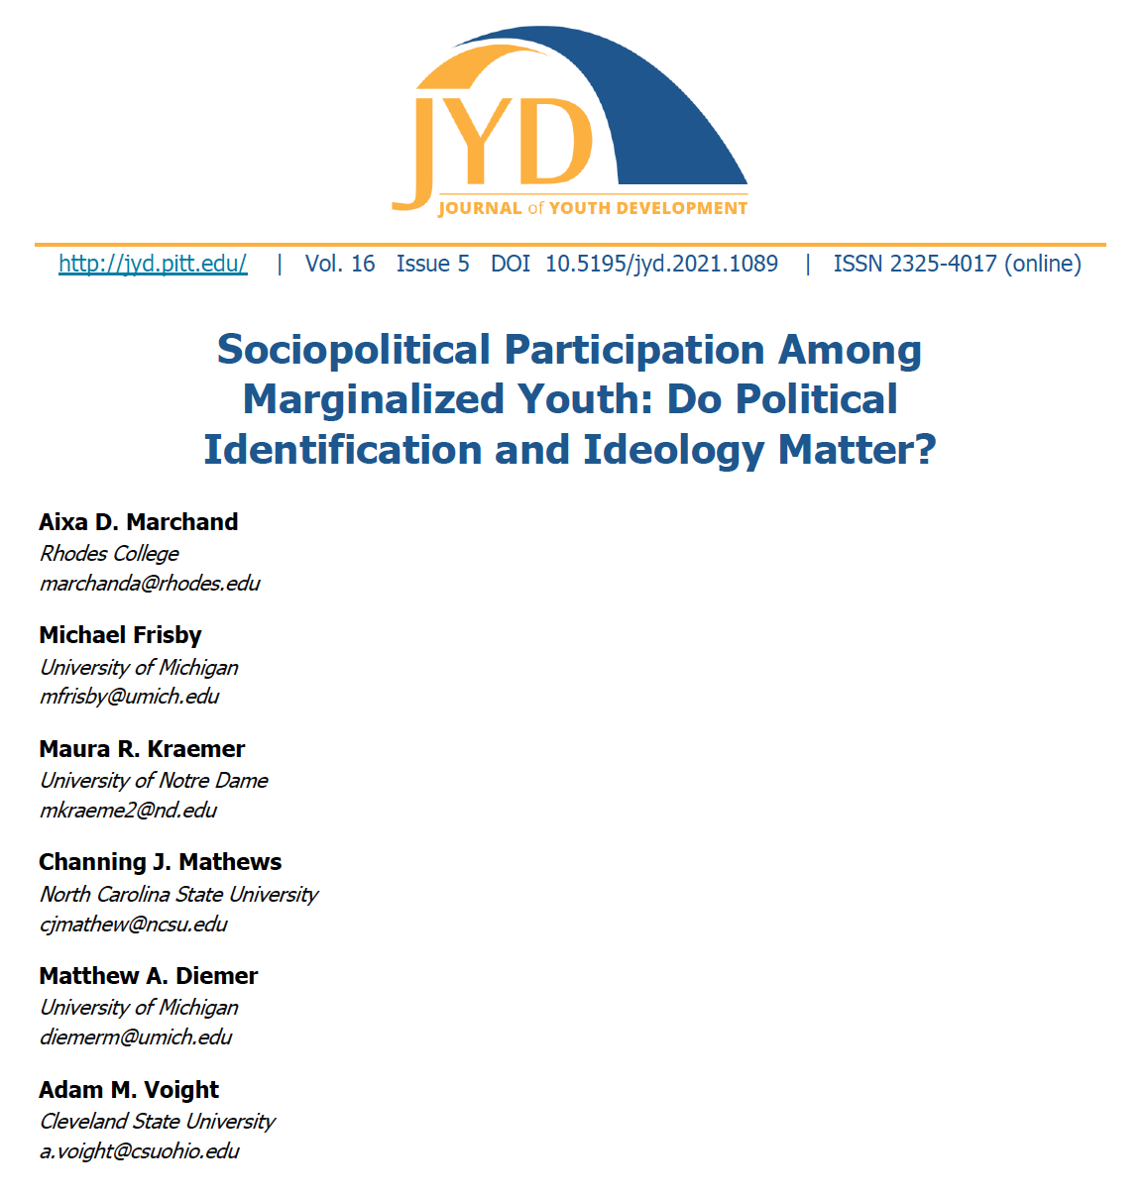
Empirical Example
Aim: test if youth who vary in political ideology (i.e., conservative, liberal) and political identification (i.e., Republican, Democrat) participate at different levels and whether this measurement of sociopolitical participation is biased

Slide 21
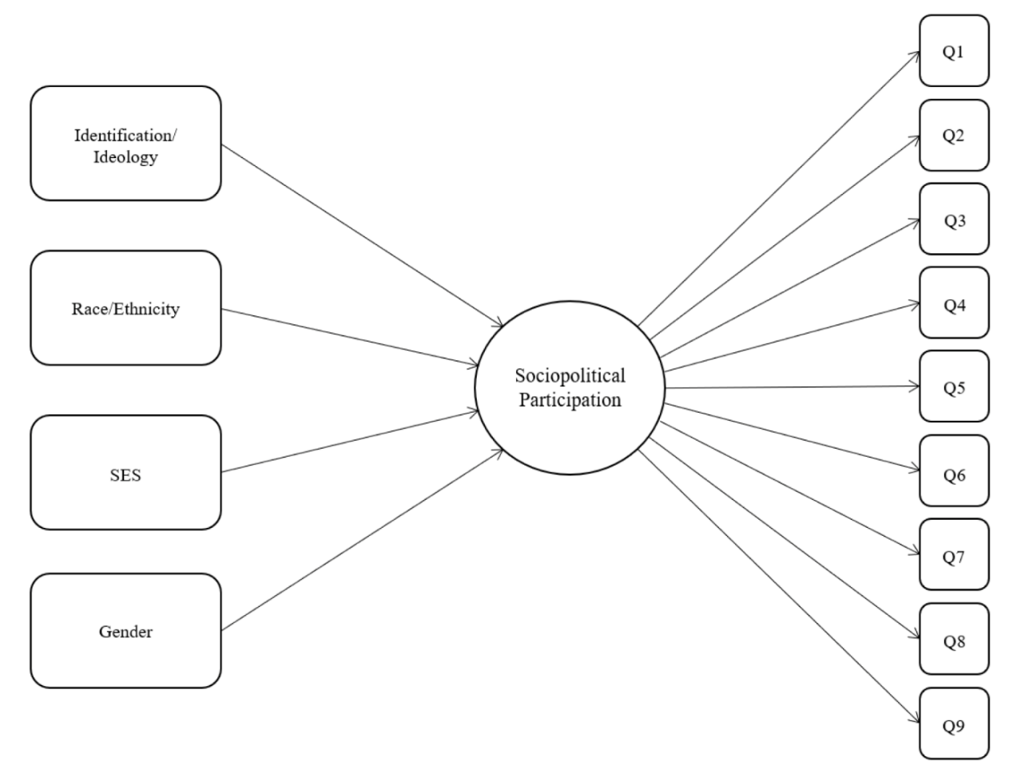
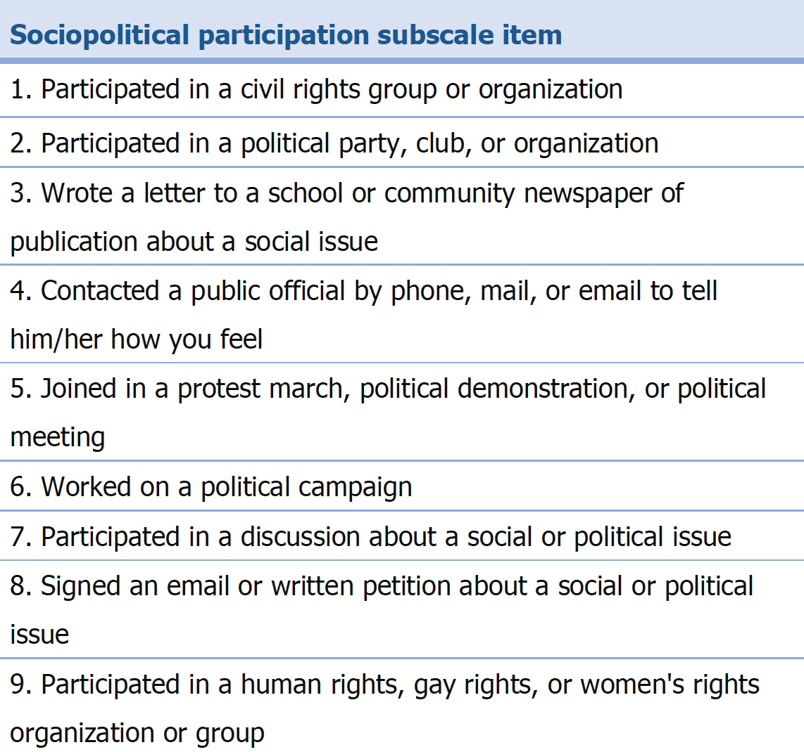
Empirical Example

Slide 22
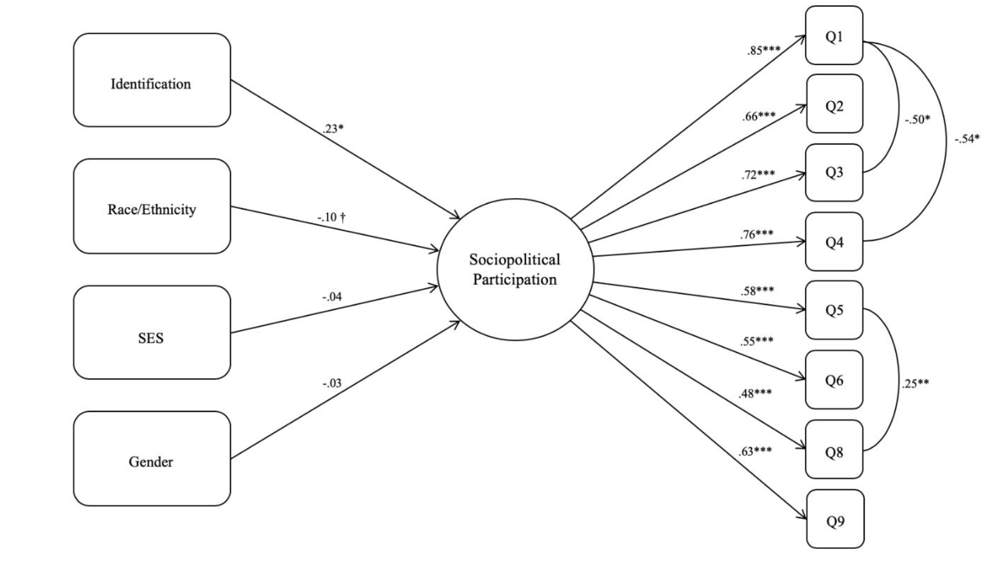
Empirical Example

Slide 23
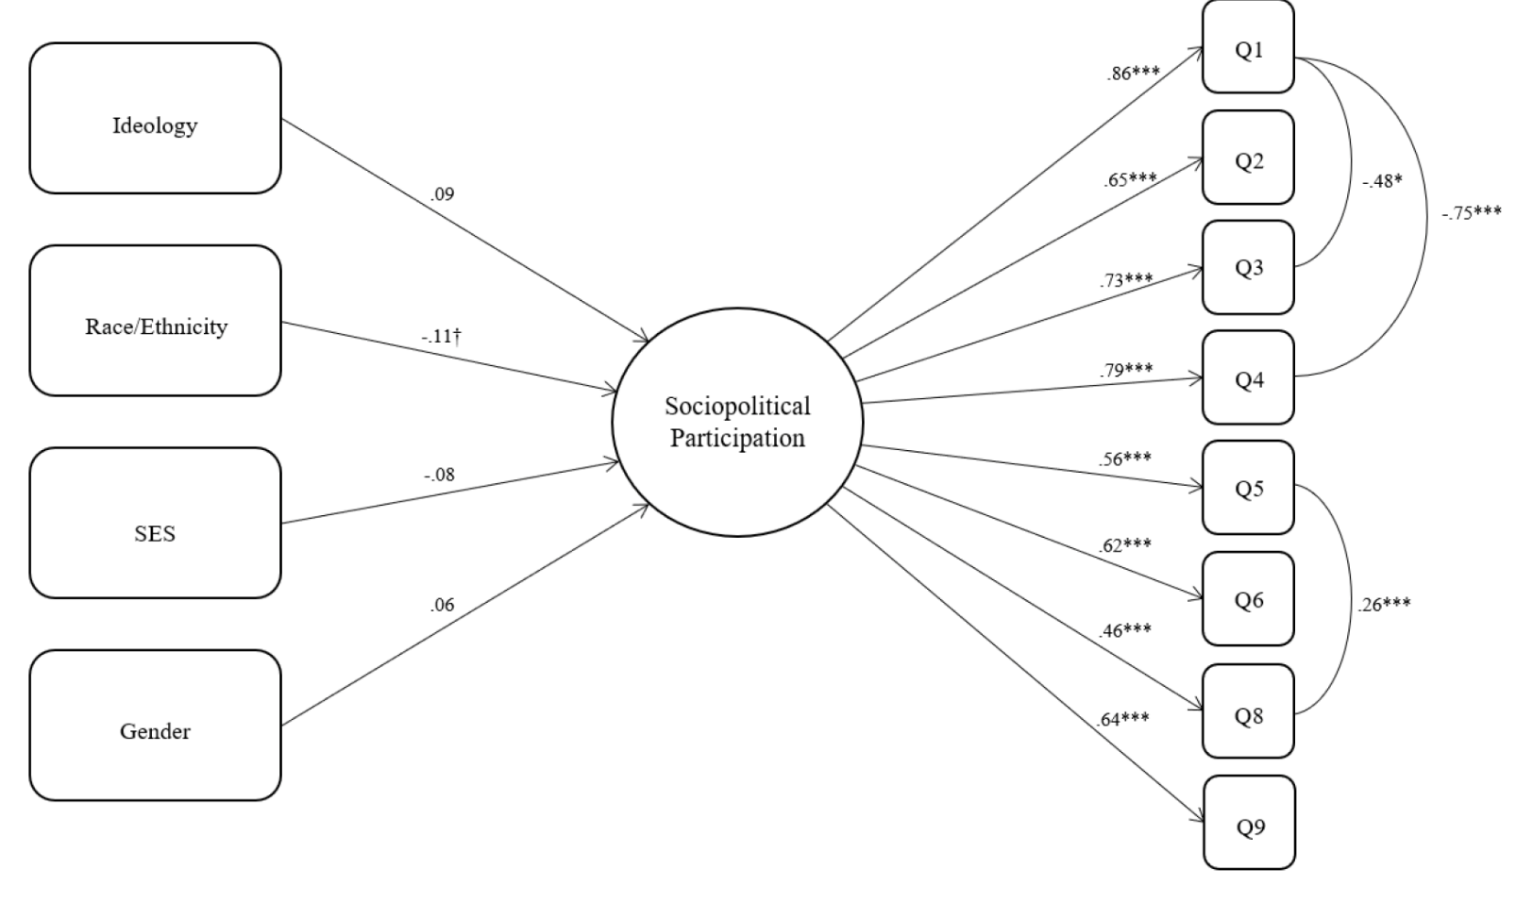
Empirical Example
.43*

Slide 24
Empirical Example: Conclusions
Identified no DIF in any items
  If so, we would have seen DIF modeled as a direct line from one of the exogenous covariate to an individual item
  Suggests that within our sample this measure of sociopolitical participation is not biased by political ideology, party identification, or the other covariates tested such as race/ethnicity, gender, and SES
Found slight effect in identification and marginal effect in race/ethnicity
  Small association with sociopolitical participation suggesting a trend that Republican identifying youth participate slightly more frequently than those who identify as Democrat
If sociopolitical participation was indeed biased by left-leaning ideology, then we would expect the its measurement to exhibit DIF in ideology and identification
Suggests that diverse populations of youth across different political perspectives are engaged in the political system through their sociopolitical participation at similar levels and that the items aren’t biased towards on ideology or political party

Slide 25
Summary:
Affordances of MIMICs
Simple, yet effective, strategy to detect, remediate, or eliminate biased items
Also affords testing for item bias while statistically adjusting for latent mean differences
Efficient in detecting bias in latent means (levels) and DIF (items biased across groups)
  More precise than ANOVAs because measurement error parceled out
  DIF in MIMICs concordant with DIF in IRT methods
Note: MIMIC models do not establish Measurement Invariance (MI), which is a more intensive & stepwise process
Can adjust for item bias when estimated full SEMs
MIMICS sound intimidating…but are not that complicated to estimate and interpret
    Also: Easier & require lower N than full measurement invariance (MI) testing
    “unlike multigroup factor analysis…, several covariates can be incorporated into the MIMIC model without subdividing the sample” (Gallo et al., 1994, p. 252)

Slide 26
MIMICs: Limitations
Cannot formally declare measurement invariance (intercepts tested, but not the slopes, which are factor loadings}
Group membership is modeled as a dichotomy, when it’s [much] more than that
  While mindful that: “It follows that every attempt to ‘measure’ the social in relation to ‘race’ can only offer a crude approximation that risks fundamentally misunderstanding and misrepresenting the true nature of the social dynamics that are at play” (Gilborn et al., 2018; Helms et al., 2005)
  “The multifaceted nature of race and ethnicity suggests that when race is operationalized as a stable, homogenous entity (e.g., a simple dummy or categorical variable like “1” if white, “0” if nonwhite), any statistical association will typically offer little or no insight as to which elements are the key mechanisms of action—be it fear of an out-group, neighborhood effects, or some other factor.” (Sen & Wasow, 2016, p. 517)
MIMICs oversimplify racial/ethnic identification, intersectional identities, etc. into a 0 or 1
Some advances on intersectional measurement (Russell, Szendey & Kaplan, 2021), yet measures that are fully intersectional are rare (exception: Buchanan, 2016, Racialized Sexual Harassment Scale)

Slide 27
MIMICs: Limitations
One point of synthesis btw Helms’ HID model & MIMICs:
Measure racial identity status and (mean or median) split participants into two groups, such as “low” and “high” levels of Immersion (pro-Black and anti-White attitudes) or racial identity status (or, stereotype threat – perhaps measured physiologically)
OR: high & low scores on the MIBI → perhaps split on private regard or nationalist profile
But making a continuous scale dichotomous is anathema in the measurement field, so?
  Our methodology is lagging behind our conversations and theorizing about equity & justice

Slide 28
Summary: CritQuant
Critical theory and intersectionality theory outpace our quantitative enactment of those theories
  Stated another way, our theorizing outpaces our methodological specification of theory
More innovation in the quantitative space is needed….is it agent-based modeling? A move away from the linear model? Bayesian approaches? None of which are a ‘silver bullet’ → what to keep?
Humbly, the CritQuant approach taken here was to combat longstanding & legitimate critiques of a construct grounded in critical theory (i.e., critical consciousness)
This MIMIC/quantitative approach provided a unique form of evidence to counter claims that critical consciousness/the CCS are biased against conservatives or Republicans
  As well as along social identity axes, such as race/ethnicity (as a binary, which is a limitation), gender (again, as a binary), and social class
Quantitative approaches to critical consciousness acknowledge the political and subjective nature of inquiry, maintain reflexivity, and consider quant evidence one form of evidence (not THE form of evidence) to support claims
Here, harnessing quantitative methods to advance critical consciousness theory = CritQuant

Slide 29
Resources for Further Study
Conceptual basis of MIMICs:
  Kano, Y. (2001). Structural equation modeling with experimental data. In R. Cudeck, S. du Toit, and D. Sörbom (Eds.), Structural equation modeling: Present and future (pp. 381-402). Lincolnwood, IL: Scientific Software International.
  Kaplan, D. (2000). Structural equation modeling. Thousand Oaks, CA: Sage.
  Advanced extension of MIMIC models: Kaplan, D. (1999): An extension of the propensity score adjustment method for the analysis of group differences in MIMIC models, Multivariate Behavioral Research, 34:4, 467-492
  Controlling for differences identified in a MIMIC: Aiken, L.S., Stein, J.A. & Bentler, P.M. (1994). Structural equation analyses of clinical subpopulation differences and comparative treatment outcomes: Characterizing the daily lives of drug addicts. Journal of Consulting and Clinical Psychology, 62(3), 488-499.
Empirical example of MIMIC model in instrument validation:
  Duffy, R.D., Diemer, M.A., Perry, J.C. & Laurenzi, C., Torrie, C. (2012). The construction and initial validation of the Work Volition Scale. Journal of Vocational Behavior, 80(2), 400-411.
Empirical example of MIMIC:
  Diemer, M.A., Voight, A.M., Marchand, A.D. & Bañales, J. (2019). Political identification, political ideology, & perceptions of inequality among marginalized youth. Developmental Psychology special issue: “Children’s and Adolescents’ Understanding and Experiences of Economic Inequality: Implications for Theory, Research, Policy and Practice” 55(3), 538-549.
  Marchand, A. D., Frisby, M., Kraemer, M. R., Mathews, C. J., Diemer, M. A., & Voight, A. M. (2021). Sociopolitical Participation Among Marginalized Youth: Do Political Identification and Ideology Matter?. Journal of Youth Development, 16(5), 41-63.

Slide 30
Reference List
Baez, B. (2007). Thinking critically about the “critical”: Quantitative research as social critique. New Directions for Institutional Research, 2007(133), 17–23. https://doi.org/10.1002/ir.201
Briggs, D. C. (2021). Historical and Conceptual Foundations of Measurement in the Human Sciences: Credos and Controversies. Routledge.
Buchanan, N. T. (2016, October 20). Racialized Sexual Harassment: Living at the intersections of race, gender and victimization [Webinar]. In M. Paludi (chair), Sexual harassment: 25 years of research, legislation, court cases and prevention strategies. http://media.wp.excelsior.edu/shrm_ in-honor-of-the-25th-anniversary-of-anita-hilltestimony/
Cabrera, N. L., & Chang, R. S. (2019). Stats, Social Justice, and the Limits of Interest Convergence: The Story of Tucson Unified’s Mexican American Studies Litigation. Association of Mexican American Educators Journal, 13(3), 72-96.
Castillo, W., & Gillborn, D. How to “QuantCrit:” Practices and Questions for Education Data Researchers and Users.
Cokley, K., & Awad, G. H. (2013). In defense of quantitative methods: Using the “master’s tools” to promote social justice. Journal for Social Action in Counseling & Psychology, 5(2), 26-41.
Dixon‐Román, E. (2020). A haunting logic of psychometrics: Toward the speculative and indeterminacy of blackness in measurement. Educational Measurement: Issues and Practice, 39(3), 94-96.
Frazier, P. A., Tix, A. P., & Barron, K. E. (2004). Testing moderator and mediator effects in counseling psychology research. Journal of counseling psychology, 51(1), 115.

Slide 31
Reference List
Frisby, C. L. (1999). Culture and test session behavior: Part I. School Psychology Quarterly, 14(3), 263.
Gallo, J. J., Anthony, J. C., & Muthén, B. O. (1994). Age differences in the symptoms of depression: A latent trait analysis. Journal of Gerontology, 49(6), P251-P264.
Gillborn, D., Warmington, P., & Demack, S. (2018). QuantCrit: Education, policy, ‘Big Data’ and principles for a critical race theory of statistics. Race Ethnicity and Education, 21(2), 158–179. https://doi.org/10.1080/13613324.2017.1377417
Helms, J. E. (2006). Fairness is not validity or cultural bias in racial-group assessment: A quantitative perspective. American Psychologist, 61(8), 845.
Helms, J. E., Jernigan, M., & Mascher, J. (2005). The meaning of race in psychology and how to change it: a methodological perspective. American Psychologist, 60(1), 27.
Hernández, E. (2015). What Is “Good” Research? Revealing the Paradigmatic Tensions in Quantitative Criticalist Work. New Directions for Institutional Research, (163), 93–101. https://doi.org/10.1002/ir.20088
Jang, S. T. (2018). The Implications of Intersectionality on Southeast Asian Female Students’ Educational Outcomes in the United States: A Critical Quantitative Intersectionality Analysis. American Educational Research Journal, 55(6), 1268–1306. https://doi.org/10.3102/0002831218777225
Randall, J. (2021). Color-neutral” is not a thing: Redefining construct definition and representation through a justice-oriented critical antiracist lens. Educational Measurement: Issues and Practice, 40(4), 82-90.

Slide 32
Reference List
Russell, M., Szendey, O., & Kaplan, L. (2021). An Intersectional Approach to DIF: Do Initial Findings Hold across Tests?. Educational Assessment, 26(4), 284-298.
Sen, M., & Wasow, O. (2016). Race as a bundle of sticks: Designs that estimate effects of seemingly immutable characteristics. Annual Review of Political Science, 19.
Stage, F. (Ed.) (2007). Using Quantitative Data to Answer Critical Questions: New Directions for Institutional Research. Jossey-Bass.
Stage, F. K., & Wells, R. S. (Eds.) (2015). New scholarship in critical quantitative research, part 1: Studying institutions and people in context. New Directions for Institutional Research, 158.
Suzuki, S., Morris, S. L., & Johnson, S. K. (2021). Using QuantCrit to advance an anti-racist developmental science: applications to mixture modeling. Journal of Adolescent Research, 36(5), 535-560.
Unger, R.K. (1996). Using the master’s tools: Epistemology and empiricism. In S. Wilkinson (Ed.), Feminist social psychologies: International perspectives(pp.165-181). Buckingham, England: Open University Press.
Viano, S., & Baker, D. J. (2020). How Administrative Data Collection and Analysis Can Better Reflect Racial and Ethnic Identities. Review of Research in Education, 44(1), 301–331. https://doi.org/10.3102/0091732X20903321Wilson, 1990
Zuberi, T. (2001). Thicker than blood: How racial statistics lie. U of Minnesota Press.
Zuberi, T., & Bonilla-Silva, E. (Eds.). (2008). White logic, white methods: Racism and methodology. Rowman & Littlefield Publishers.

Slide 33
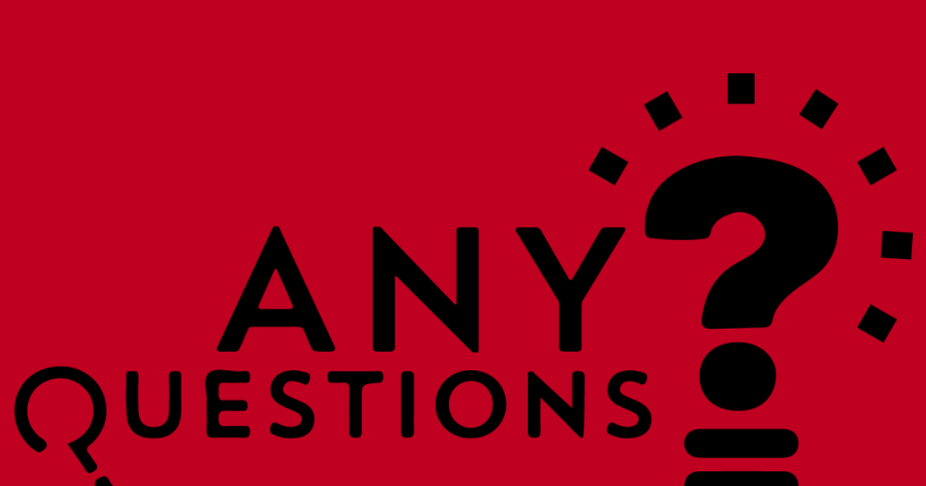

Thank You
Matthew A. Diemer
  diemerm@umich.edu
  @ProfDiemer
Aixa D. Marchand
  marchanda@rhodes.edu
  @AixaMarchand

