Slide 1

Rural Student Summer Melt
Prepared by Katelyn Caton (SREE 2019 Summer Fellow)
Funded by Ascendium
Coordinated by SREE
September 4, 2019

Slide 2

Summer Melt
“Summer melt” is defined as students who are accepted to and agree to attend a college or university in the spring of their senior year of high school, but who fail to enroll or attend the institution in the following fall
Some populations are more likely to experience summer melt than others
Several causes have been identified across high-risk populations as reasons for melting
  Finances and parental support are most influential factors in college attendance

Slide 3

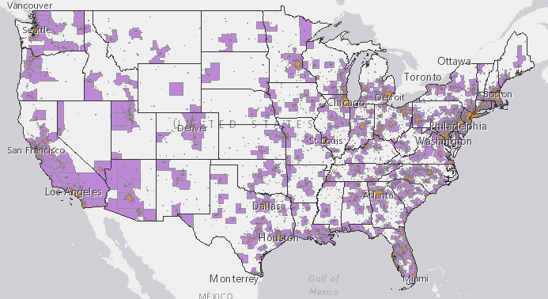
Rural Students
Rural students make up nearly 19% of all K-12 public school students
More likely to be low-income and to graduate without being considered “college ready”
Graduate at higher rates and with higher GPAs than non-rural students
Additional challenges
  Lower average educational attainment levels
  Strong community culture and connection to hometown
  Travel farther to attend college or university

Slide 4
Socioeconomic Factors Impacting Rural Areas

Slide 5
Directions for Future Summer Melt Research
Clear gaps in literature exist
  Few comparisons between rural and ruban students
  Rural-specific reasons for student summer melt tend to be understudied, or only studied in specific settings
Future research should move to help close these gaps and better understand rural-specific issues

Slide 6
Current Interventions
Text Message Campaigns
  Have been proven effective at both institutional and state levels
Peer or Near-Peer Mentors
Rural-Specific Interventions
  Texas A&M AgriLife Program Representatives
  Rural-specific text message-based initiatives have been shown to be effective in West Virginia

Slide 7
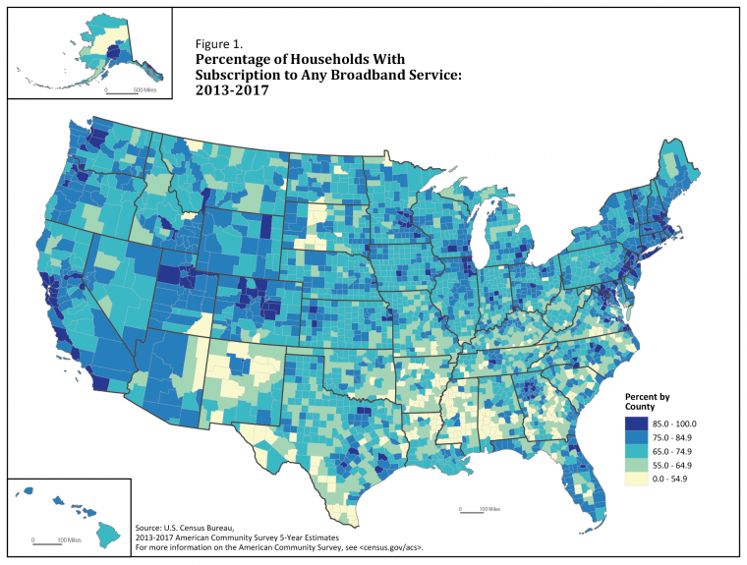
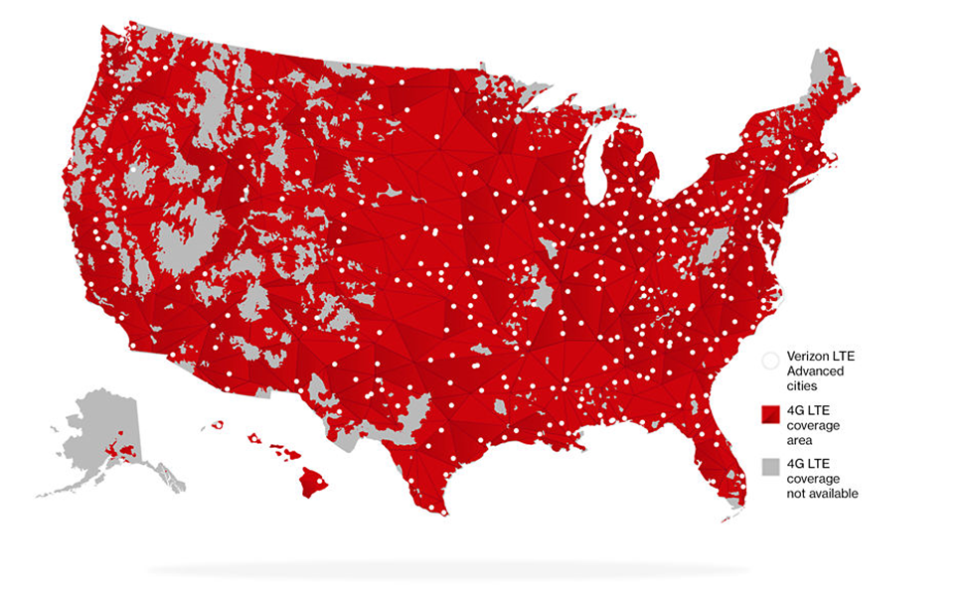
Future Interventions
Multi-pronged approaches should be used to ensure students are being reached
Rural-specific interventions should be undertaken by both states and institutions
  State-level
    Longitudinal student databases
    Earlier interventions
  Institutional-level
    Peer-aged mentors
    Maintaining connections between rural students and hometowns

Slide 8
Conclusions
There are many opportunities for better understanding and preventing summer melt in rural student populations
  Research
  Interventions
Reducing rural student summer melt can help increase the percentage of rural students who attend college
  Benefits students and larger rural community
  Important not to forget about rural students
  Urban interventions may not work in rural areas

Slide 9
5 Actions to Take in Wisconsin
Begin
Begin a state-wide text message campaign for all college-intending high school seniors
Utilize
Utilize state-wide longitudinal data sets to identify areas where high school graduation rates are high, but college attendance is low
Offer
Offer college access information and resources beginning in middle school to all public-school students, especially those in rural areas
Provide on
Provide on-campus peer mentors to incoming rural students to help build their campus community and ease transition
Encourage
Encourage universities to begin their own interactive text message campaigns to provide students specific pre-enrollment information

Slide 10

Thank you!

