Slide 1
What would it take to Change your Inference? Quantifying the Discourse about Causal Inferences in the Social Sciences Combined Frameworks
2020 Kenneth A. Frank
#konfoundit
Motivation
Statistical inferences are often challenged because of uncontrolled bias. There may be bias due to uncontrolled confounding variables or non-random selection into a sample. We will answer the question about what it would take to change an inference by formalizing the sources of bias and quantifying the discourse about causal inferences in terms of those sources. For example, we will transform challenges such as “But the inference of a treatment effect might not be valid because of pre-existing differences between the treatment groups” to questions such as “How much bias must there have been due to uncontrolled pre-existing differences to make the inference invalid?”
Approaches
In part I we will use Rubin’s causal model to interpret how much bias there must be to invalidate an inference in terms of replacing observed cases with counterfactual cases or cases from an unsampled population. This generates statements such as “One would have to replace qqq% of the cases with cases with no effect to invalidate the inference.” In part II, we will quantify the robustness of causal inferences in terms of correlations associated with unobserved variables or in unsampled populations. This generates statements such as “An omitted variable would have to be correlated at rrr with the treatment and outcome to invalidate the inference.” Calculations for bivariate and multivariate analysis will be presented using an app: http://konfound-it.com as well as macros in STATA and R and a spreadsheet for calculating indices [KonFound-it!].
Format
The format will be a mixture of presentation, individual exploration, and group work. Participants may include graduate students and professors, although all must be comfortable with basic regression and multiple regression. Participants should bring their own laptop, or be willing to work with another student who has a laptop. Participants may choose to bring to the course an example of an inference from a published study or their own work, as well as data analyses they are currently conducting.
Notes:
Participants will learn to quantify the robustness of statistical and causal inferences from quantitative analyses. They will learn how to generate statements such as “To invalidate the inference XX% of the estimate must be due to bias” or “To invalidate the inference about the effect of a treatment on an outcome an omitted variable would have to be correlated at ZZ with the treatment and with the outcome.” Participants will learn calculate the specific quantities using the KonFoundit app (konfound-it.com/), Excel spreadsheet or STATA macros. The techniques can be applied to concerns about internal and external validity in participants’ own analyses or to inferences in the literature.

Slide 2

https://msu.edu/~kenfrank/research.htm

Slide 3
Motivation
Inferences uncertain
  it’s causal inference not determinism
Do you have enough information to make a decision?
Instead of “you didn’t control for xxx”
  Personal: Granovetter to Fernandez
What would xxx have to be to change your inference
  Promotes scientific discourse
  Informs pragmatic policy

Slide 4
overview
Replacement Cases Framework (40 minutes to reflection)
  Thresholds for inference and % bias to invalidate and inference
  The counterfactual paradigm
  Application to concerns about non-random assignment to treatments
  Application to concerns about non-random sample
  Reflection (10 minutes)
  Examples of replacement framework
  Internal validity example: Effect of kindergarten retention on achievement
  (40 minutes to break)
  External validity example: effect of Open Court curriculum on achievement
  Review and Reflection
  Extensions
  Extensions of the framework
  Exercise and break (20 minutes)
Correlational Framework (25 minutes to exercise)
How regression works
  Impact of a Confounding variable
  Internal validity: Impact necessary to invalidate an inference
  Example: Effect of kindergarten retention on achievement
  Exercise (25 minutes)
  External validity (30 minutes)
  combining estimates from different populations
  example: effect of Open Court curriculum on achievement
Conclusion (10 minutes)
Notes:
Quick Examples (20 minutes)
Replacement Cases Framework (45 minutes)
Thresholds for inference and % bias to invalidate and inference
The counterfactual paradigm
Application to concerns about non-random assignment to treatments
Application to concerns about non-random sample
Reflection (10 minutes)
Examples of replacement framework (25 minutes)
Internal validity example: Effect of kindergarten retention on achievement
External validity example: effect of Open Court curriculum on achievement
Review and Reflection (15 minutes)
Extensions of the framework (20 minutes)
Break (20 minutes)
Correlational Framework (30 minutes)
How regression works
Impact of a Confounding variable
Internal validity: Impact necessary to invalidate an inference
Example: Effect of kindergarten retention on achievement
Exercise (25 minutes)
External validity (15 minutes)
combining estimates from different populations
example: effect of Open Court curriculum on achievement
Exercise (10 minutes)
Conclusion (10 minutes)

Slide 5
Quick Survey
Can you make a causal inference
from an observational study?

Slide 6
Answer: Quantifying the Discourse
Can you make a causal inference
from an observational study?
Of course you can. You just might be wrong.
It’s causal inference, not determinism.
But what would it take for the inference
to be wrong?

Slide 7
I: Replacement of Cases Framework
How much bias must there be to invalidate an inference?
  Concerns about Internal Validity
    What percentage of cases would you have to replace with counterfactual cases (with zero effect) to invalidate the inference?
  Concerns about External Validity
    What percentage of cases would you have to replace with cases from an unsampled population (with zero effect) to invalidate the inference?

Slide 8
What Would It Take to Change an Inference? Using Rubin’s Causal Model to Interpret the Robustness of Causal Inferences
Abstract
We contribute to debate about causal inferences in educational research in two ways. First, we quantify how much bias there must be in an estimate to invalidate an inference. Second, we utilize Rubin’s causal model (RCM) to interpret the bias necessary to invalidate an inference in terms of sample replacement. We apply our analysis to an inference of a positive effect of Open Court Curriculum on reading achievement from a randomized experiment, and an inference of a negative effect of kindergarten retention on reading achievement from an observational study. We consider details of our framework, and then discuss how our approach informs judgment of inference relative to study design. We conclude with implications for scientific discourse.
Keywords: causal inference; Rubin’s causal model; sensitivity analysis; observational studies
Frank, K.A., Maroulis, S., Duong, M., and Kelcey, B. 2013. What would it take to Change an Inference?: Using Rubin’s Causal Model to Interpret the Robustness of Causal Inferences. Education, Evaluation and Policy Analysis. Vol 35: 437-460.
http://epa.sagepub.com/content/early/recent
Notes:
Maybe put unpublished version on website

Slide 9
% bias necessary to invalidate the inference
{
}
Notes:
Robustness refers to alternatve world with different sample or control variables. It’s a counterfactual world.

Slide 10

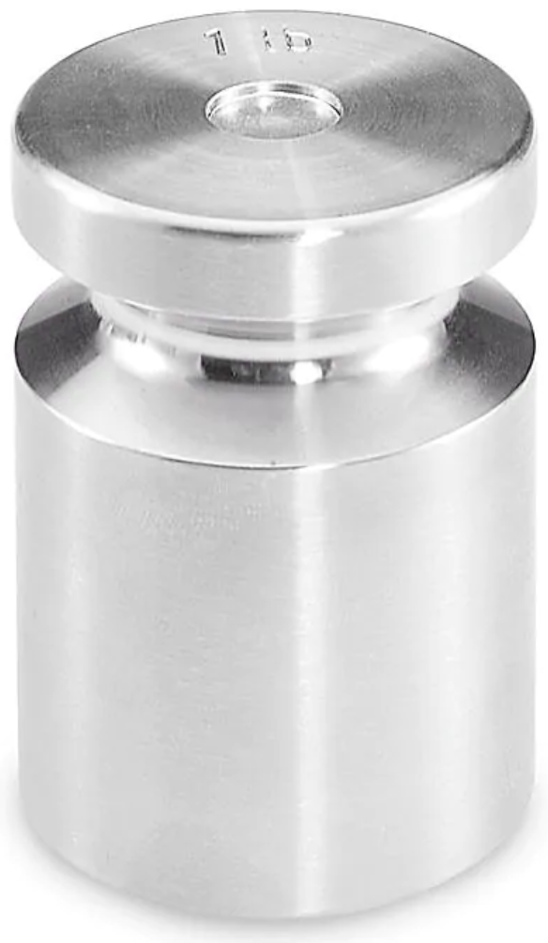

Threshold as Point of Indifference with Respect to Evidence
Concerns about Bias
Evidence
Threshold
Return on Investment

Slide 11
Quantifying the Discourse: Formalizing
Bias Necessary to Invalidate an Inference
δ =a population effect,
=the estimated effect, and
δ# =the threshold for making an inference
An inference is invalid if: (1)
An inference is invalid if the estimate is greater than the threshold while the population value is less than the threshold.
Defining bias as -δ, (1) implies an inference is invalid if and only if:
Expressed as a proportion of the estimate, inference invalid if:

Slide 12
The Full Algebra for Exceeding a Threshold

Slide 13
δ#
% bias necessary to invalidate the inference
{
}
δ#

Slide 14
Interpretation of % Bias to Invalidate an Inference
% Bias is intuitive
Relates to how we think about statistical significance
  Better than “highly significant” or “barely significant”
But need a framework for interpreting

Slide 15
Sensitivity vs Robustness
Sensitivity of estimate assess how estimates change as a result of alternative analyses
  Different covariates
  Different sub-samples
  Different estimation techniques
Robustness of the inference quantifies what it would take to change an inference based on hypothetical data or conditions
  Unobserved covariates
  Unobserved samples

Slide 16
Framework for Interpreting % Bias to Invalidate an Inference: Rubin’s Causal Model and the Counterfactual
I have a headache
I take an aspirin (treatment)
My headache goes away (outcome)
Q) Is it because I took the aspirin?
We’ll never know – it is counterfactual – for the individual
This is the Fundamental Problem of Causal Inference
Notes:
Holland 1986 JASA.

Slide 17
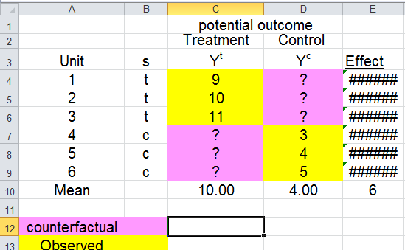
Approximating the Counterfactual with Observed Data
But how well does the observed data approximate the counterfactual?
Difference between counterfactual values and observed values for the control implies the treatment effect of 1
8
9
10
1
1
1
3
4
5
6
4.00
9
is overestimated as 6 using observed control cases with mean of 4

Slide 18
Using the Counterfactual to Interpret % Bias to Invalidate the Inference: Replacement with Average Values
How many cases would you have to replace with zero effect counterfactuals to change the inference?
Assume threshold is 4 (δ# =4):
1- δ# /
=1-4/6=.33 =(1/3)
6
6
6
7
7
0
0
0
7
7
7
3
4
5
7
4
9
5
6
The inference would be invalid if you replaced 33% (or 1 case) with counterfactuals for which there was no treatment effect.
New estimate=(1-% replaced) +%replaced(no effect)=
(1-%replaced) =(1-.33)6=.66(6)=4
Notes:
Note paired t for counterfact data not relevant because counterfact data are constant – no correlation between pairs, so no correction in standard error of paired t.

Slide 19
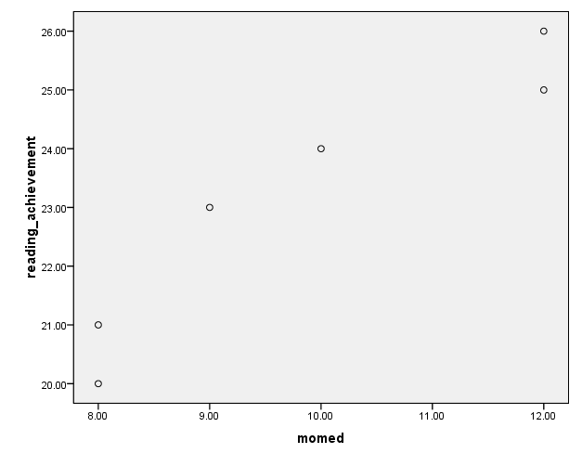
Case replacement and the null hypothesis
* *
* **
* * *
O Sample
* *
* **
* * *
* *
* **
* * *
.
* *
* **
* * *
* Null hypothesis population
* *
* **
* * *
* *
* **
* * *
* *
* **
* * *
How many O would you have to replace with * to change the inference?
Y
* *
* **
* * *
* *
* **
* * *
H₀
* *
* **
* * *
* *
* **
* * *
* *
* **
* * *
.
* *
* **
* * *
X
Notes:
B0=11.3, B1=1.2

Slide 20
Which Cases to Replace?
Think of it as an expectation: if you randomly replaced 1 case, and repeated 1,000 times, on average the new estimate would be 4
Assumes constant treatment effect
conditioning on covariates and interactions already in the model
Assumes cases carry equal weight

Slide 21
% bias necessary to invalidate the inference
{
}
δ#
To invalidate the inference, replace 33% of cases with counterfactual data with zero effect

Slide 22
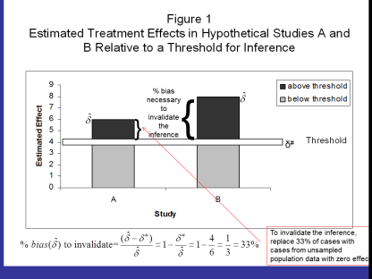
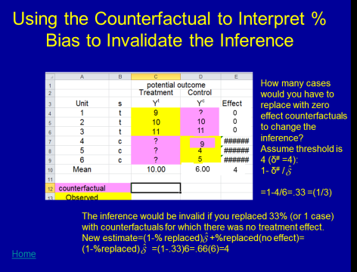
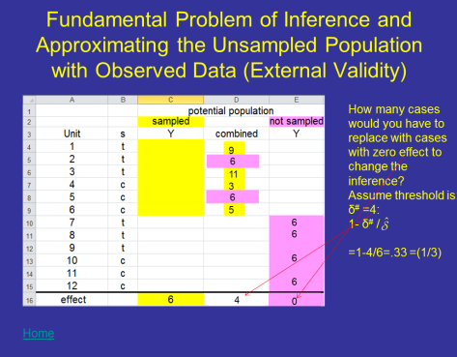
Review & Reflection
Review of Framework
  Pragmatism → thresholds
  How much does an estimate exceed the threshold → % bias to invalidate the inference
  Interpretation: Rubin’s causal model
    internal validity: % bias to invalidate → number of cases that must be replaced with counterfactual cases (for which there is no effect)
Reflect
  Which part is most confusing to you?
  Is there more than one interpretation?
  Discuss with a partner or two

Slide 23
Example of Internal Validity from Observational Study :
The Effect of Kindergarten Retention on Reading and Math Achievement
1. What is the average effect of kindergarten retention policy? (Example used here)
  Should we expect to see a change in children’s average learning outcomes if a school changes its retention policy?
  Propensity based questions (not explored here)
2. What is the average impact of a school’s retention policy on children who would be promoted if the policy were adopted?
Use principal stratification.
Hong, G. and Raudenbush, S. (2005). Effects of Kindergarten Retention Policy on Children’s Cognitive Growth in Reading and Mathematics. Educational Evaluation and Policy Analysis. Vol. 27, No. 3, pp. 205–224
Notes:
Hong, G. and Raudenbush, S. (2005). Effects of Kindergarten Retention Policy on Children’s Cognitive Growth in Reading and Mathematics. Educational Evaluation and Policy Analysis. Vol. 27, No. 3, pp. 205–224
See page 208.

Slide 24
Data
Early Childhood Longitudinal Study Kindergarten cohort (ECLSK)
  US National Center for Education Statistics (NCES).
Nationally representative
Kindergarten and 1st grade
  observed Fall 1998, Spring 1998, Spring 1999
Student
  background and educational experiences
  Math and reading achievement (dependent variable)
  experience in class
Parenting information and style
Teacher assessment of student
School conditions
Analytic sample (1,080 schools that do retain some children)
  471 kindergarten retainees
  7,168 promoted students

Slide 25
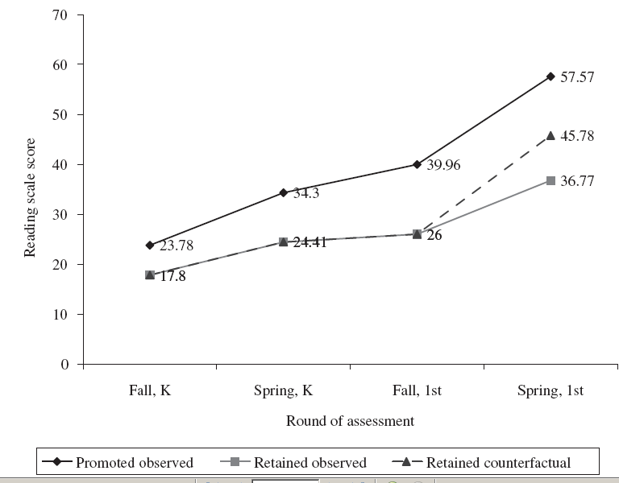
Estimated Effect of Retention on Reading Scores
(Hong and Raudenbush)

Slide 26
Possible Confounding Variables
(note they controlled for these)
Gender
Two Parent Household
Poverty
Mother’s level of Education (especially relevant for reading achievement)
Extensive pretests
  measured in the Spring of 1999 (at the beginning of the second year of school)
  standardized measures of reading ability, math ability, and general knowledge;
  indirect assessments of literature, math and general knowledge that include aspects of a child’s process as well as product;
  teacher’s rating of the child’s skills in language, math, and science

Slide 27
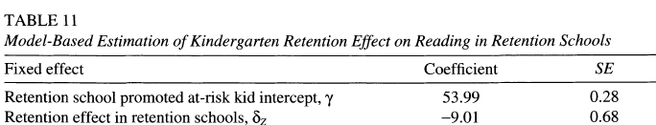
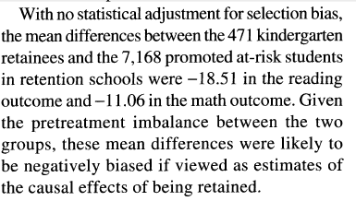
Obtain df, Estimated Effect and Standard Error
Estimated effect
( ) = -9.01
Standard
error=.68
n=7168+471=7639; df > 500,
t _{critical}=-1.96
Page 215
From: Hong, G. and Raudenbush, S. (2005). Effects of Kindergarten Retention Policy on Children’s Cognitive Growth in Reading and Mathematics. Educational Evaluation and Policy Analysis. Vol. 27, No. 3, pp. 205–224

Slide 28
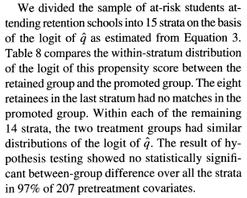
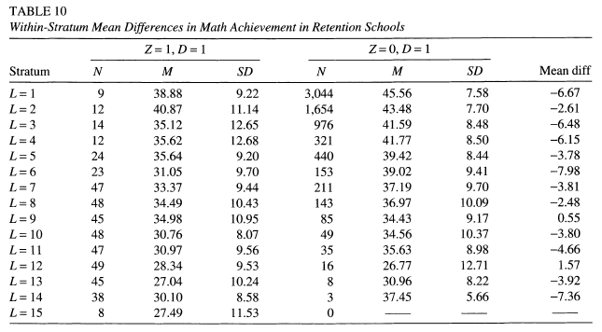
# of covariates
Page 215
Df used in model=207+14+2=223
Add 2 to include the intercept and retention

Slide 29
Calculating % Bias to Invalidate the Inference
1) Calculate threshold δ#
Estimated effect is statistically significant if:
|Estimated effect| /standard error > |t_{critical} |
  |Estimated effect| > |t_{critical} |x standard error= δ #
  |Estimated effect| > 1.96 x .68 = 1.33= δ #
2) Record =|Estimated effect|= 9.01
3) % bias to invalidate the inference is
1- δ #/ =1-.1.33/9.01=.85
85% of the estimate would have to be due to bias to invalidate the inference
You would have to replace 85% of the cases with counterfactual cases with 0 effect of retention on achievement to invalidate the inference

Slide 30
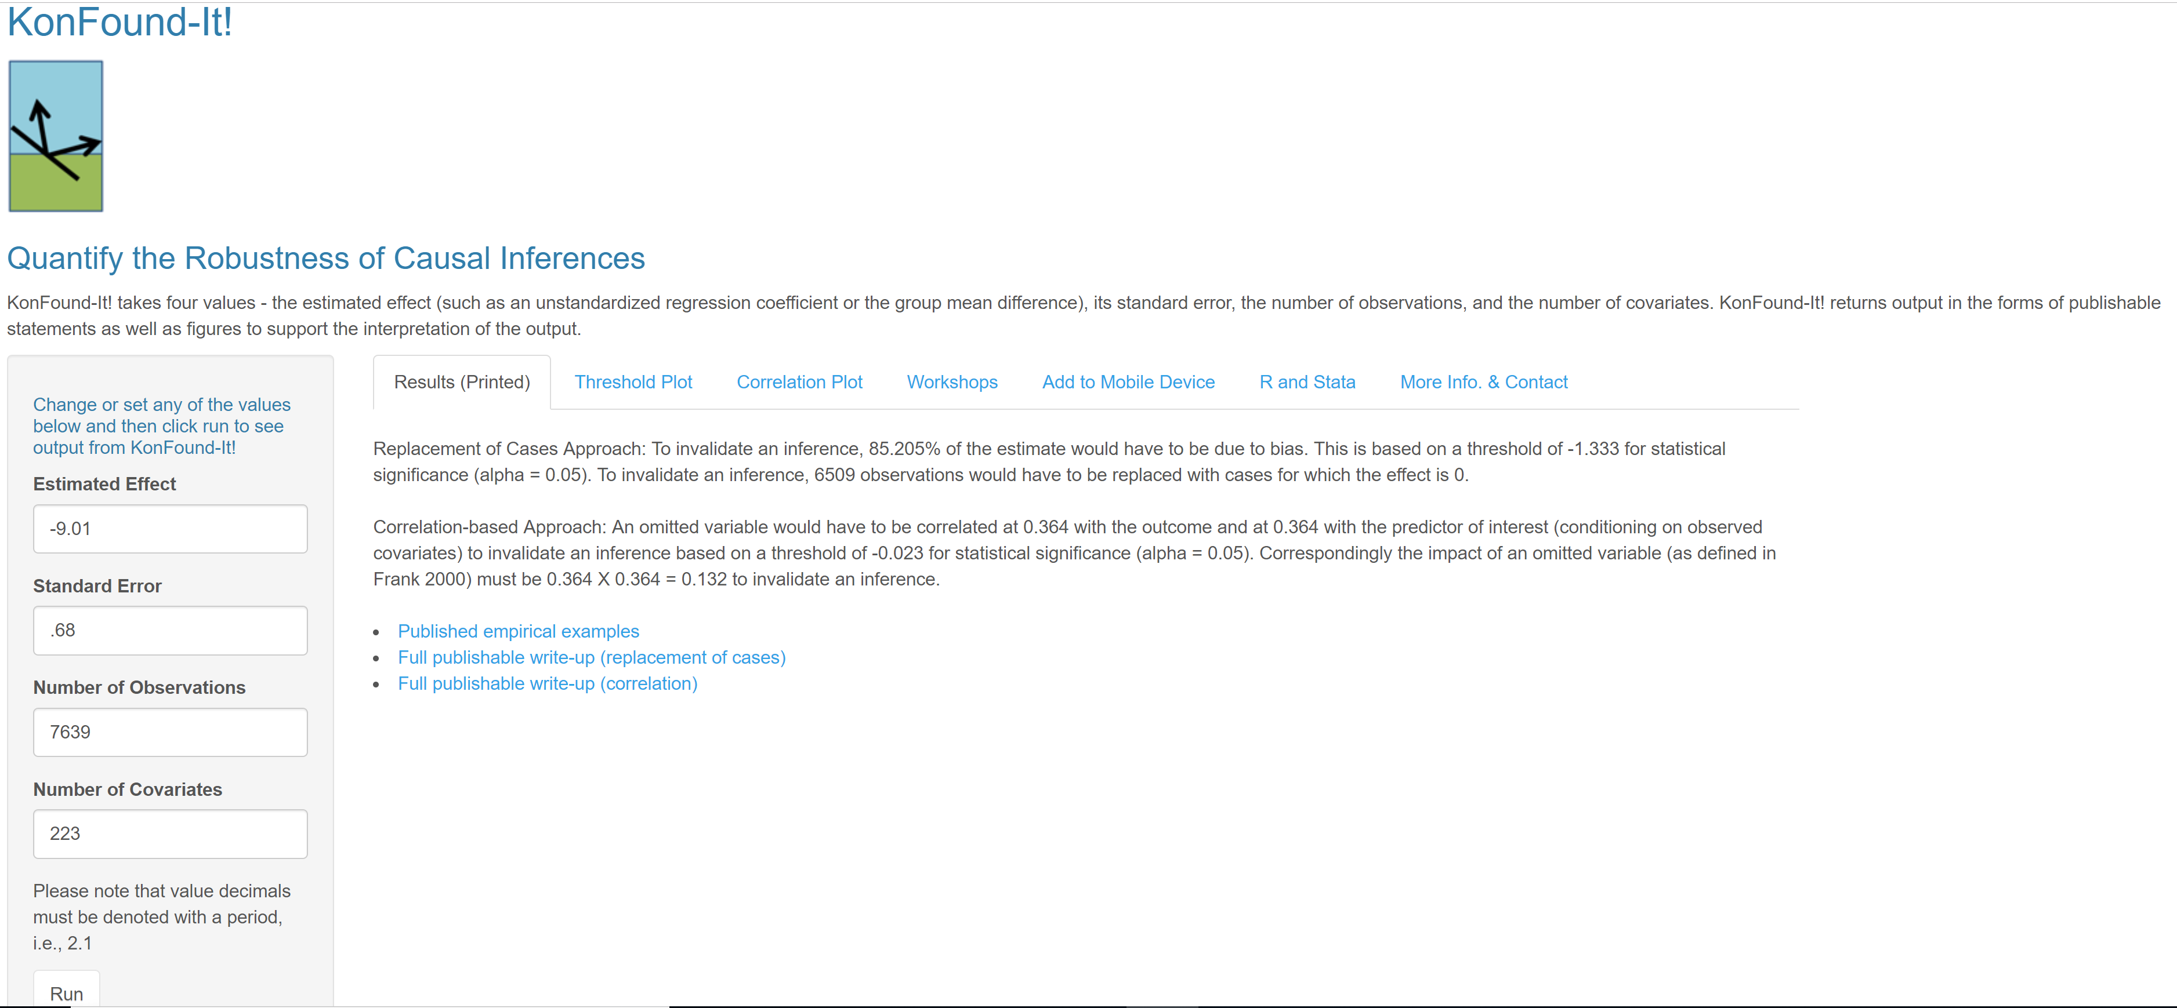
In R Shiny app KonFound-it!
(konfound-it.com/)
-9.01
.68
7639
223
Take out your phone and try it!!!

Slide 31
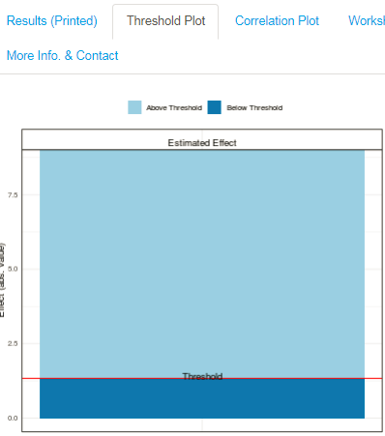
% Bias necessary to invalidate inference
=
=1-1.33/9.01=85%
85% of the estimate must be due to bias to invalidate the inference.
85% of the cases must be replaced with null hypothesis cases to invalidate the inference
Estimated Effect
δ# Threshold

Slide 32
Using the Counterfactual to Interpret % Bias to Invalidate the Inference: Replacement with Average Values
How many cases would you have to replace with zero effect counterfactuals to change the inference?
Assume threshold is 4 (δ# =4):
1- δ# /
=1-4/6=.33 =(1/3)
6
6
6
7
7
0
0
0
7
7
7
3
4
5
7
4
9
5
6
The inference would be invalid if you replaced 33% (or 1 case) with counterfactuals for which there was no treatment effect.
New estimate=(1-% replaced) +%replaced(no effect)=
(1-%replaced) =(1-.33)6=.66(6)=4

Slide 33
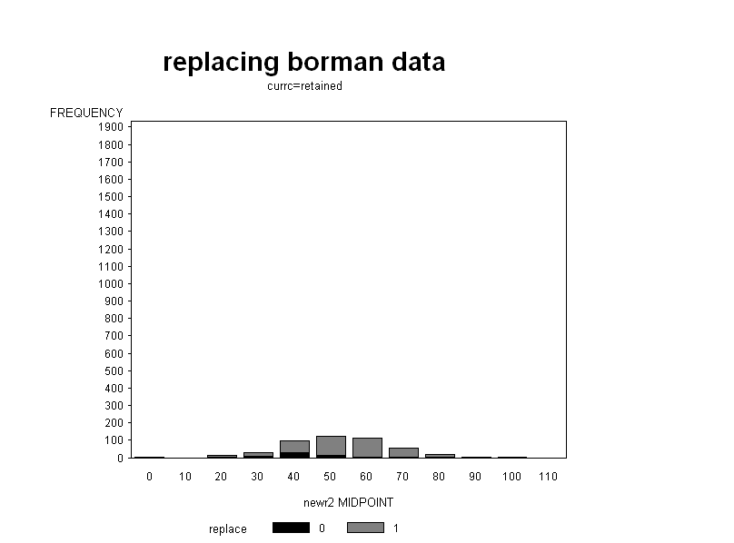
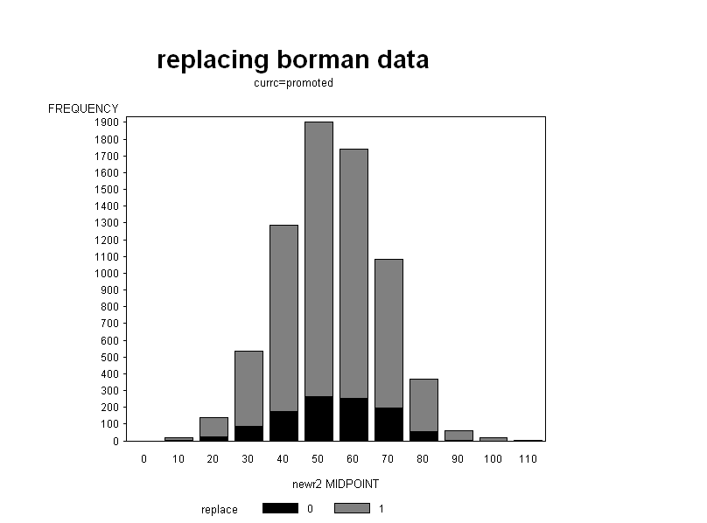
Example Replacement of Cases with Counterfactual Data to Invalidate Inference of an Effect of Kindergarten Retention
Counterfactual:
No effect
Retained
Promoted
Original cases that were not replaced
Replacement counterfactual cases with zero effect
Original distribution
Notes:
The retained group shifts more because the counterfactual data were assigned the mean of the overall data, which is dominated by the promoted group.

Slide 34
Interpretation
1) Consider test scores of a set of children who were retained that are considerably lower (9 points) than others who were candidates for retention but who were in fact promoted. No doubt some of the difference is due to advantages the comparable others had before being promoted. But now to believe that retention did not have an effect one must believe that 85% of those comparable others would have enjoyed most (7.2) of their advantages whether or not they had been retained.
This is even after controlling for differences on pretests, mother’s education, etc.
2a) The inference is invalid if we replace 85% cases with cases in which an omitted variable is perfectly correlated with kindergarten retention.
2b) The inference is invalid if we replace 85% of the cases with cases in which an omitted variable is perfectly correlated with the achievement.
3) Could 85% of the children have manifest an effect because of unadjusted differences (even after controlling for prior achievement, motivation and background) rather than retention itself?

Slide 35
Which Cases to Replace?
Graphics are rigged to make p =.06
Generally: thought experiment of repeating replacement 1,000 times. Average of new estimates will be at the threshold for inference
If data are weighted (sample weights, IPTW, HLM, Logistic), then if you remove a unit with case weight of 3, then you replace with a unit with a case weight of 3

Slide 36
Evaluation of % Bias Necessary to Invalidate Inference
50% cut off– for every case you remove, I get to keep one
Compare bias necessary to invalidate inference with bias accounted for by background characteristics
  1% of estimated effect accounted for by background characteristics (including mother’s education), once controlling for pretests
  e.g. estimate of retention before controlling for mother’s education is -9.1, after controlling for mother’s education it is -9.01, a change of .1 (or about 1% of the final estimate). The estimate would have to change another 85% to invalidate the inference.
  More than 85 times more unmeasured bias necessary to invalidate the inference
Compare with % bias necessary to invalidate inference in other studies:
  Use correlation metric
  Adjusts for differences in scale

Slide 37
% Bias Necessary to Invalidate Inference based on Correlation to Compare across Studies
t taken from HLM: =-9.01/.68=-13.25
n is the sample size
q is the number of parameters estimated
Where t is critical value for df>200
% bias to invalidate inference=1-(-.023)/(-.152)=85%
Accounts for changes in regression
coefficient and standard error
Because t(r)=t(β)

Slide 38
r
% bias necessary to invalidate the inference
{
r
}
r#

Slide 39
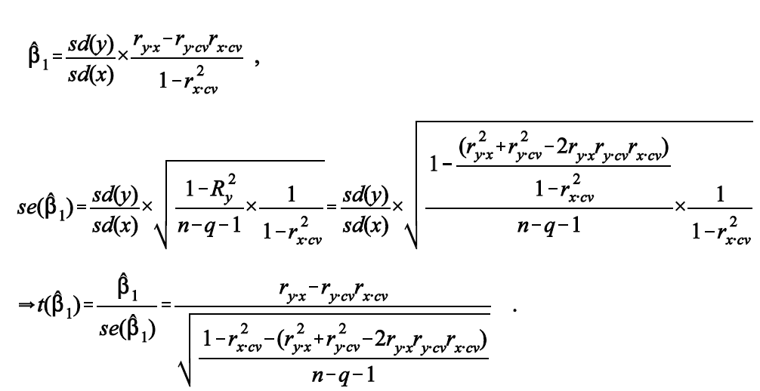
r Accounts for Changes in R² and Changes in Standard error: T(r) = T(β/se(β)).
So if we work in the correlation metric it inherently accounts for changes in R².
Good to use for comparison across studies or comparison with bias accounted for by observed covariates within study
For comparison, see Oster, E. (2019). Unobservable selection and coefficient stability: Theory and evidence. Journal of Business & Economic Statistics, 37(2), 187-204.

Slide 40
The Impact of a Confounding Variable: Accounting for the dual relationships associated with an alternative factor, linear relationships
r_{x∙y}
Retention
X
r_{xy|cv}
Achievement
Y
r_{cv∙x}
Each correlation is weighted in proportion to the size of the other
r_{cv∙x}r_{cv∙y}
r_{cv∙y}
Mother’s education
CV
Attends to relationship with outcome:
oster 2019
Notes:
40
Need to modify to show new values

Slide 41
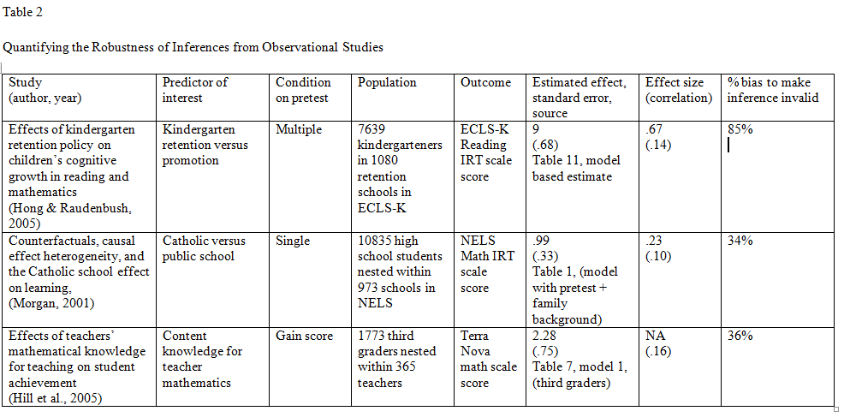
Compare with Bias other Observational Studies
85%
34%
36%

Slide 42
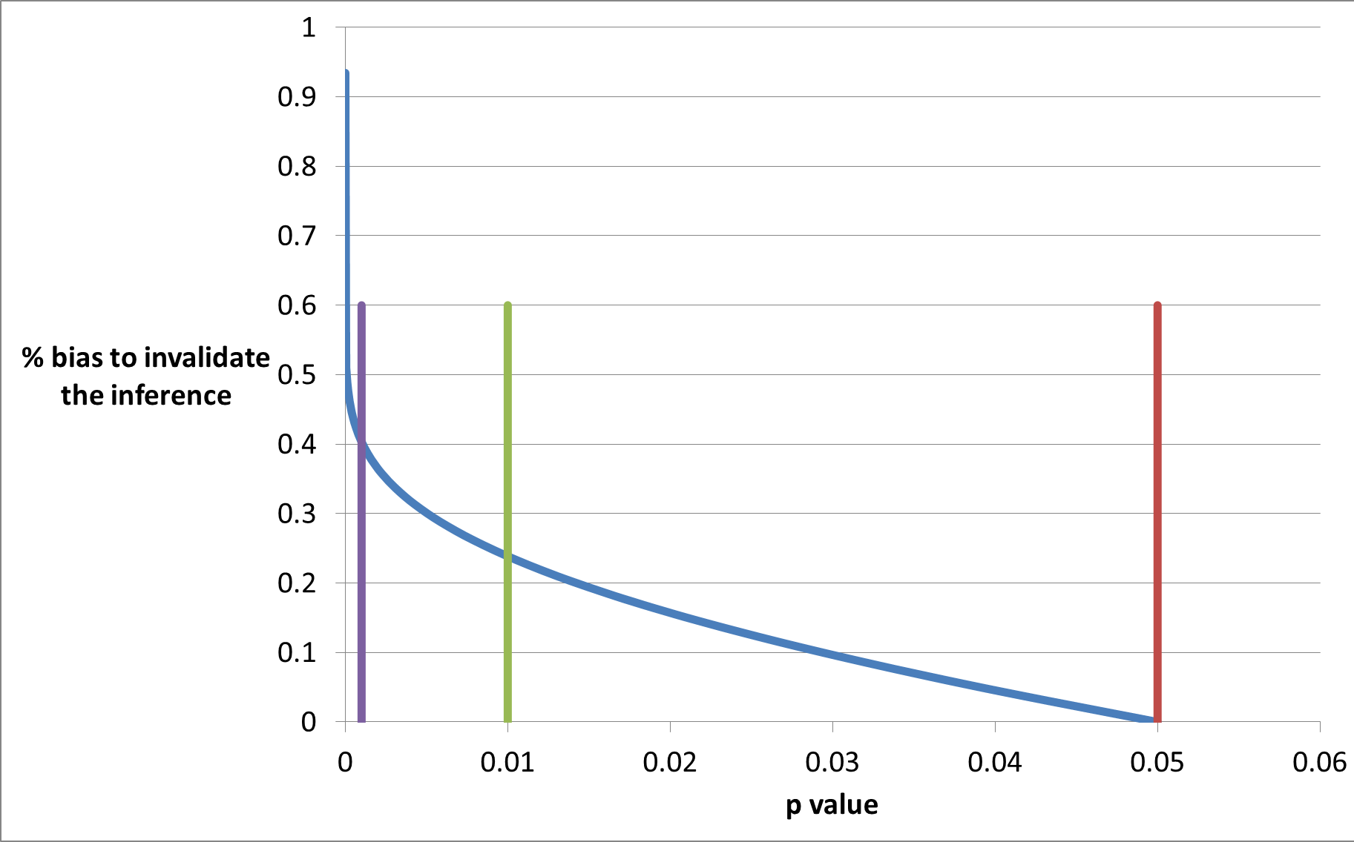
% Bias to Invalidate versus p-value: a better language?
Kindergarten Retention
% bias to invalidate inference
***
Catholic Schools
**
*
P value
Df=973 based on Morgan’s analysis of Catholic school effects,
Functional form not sensitive to df

Slide 43
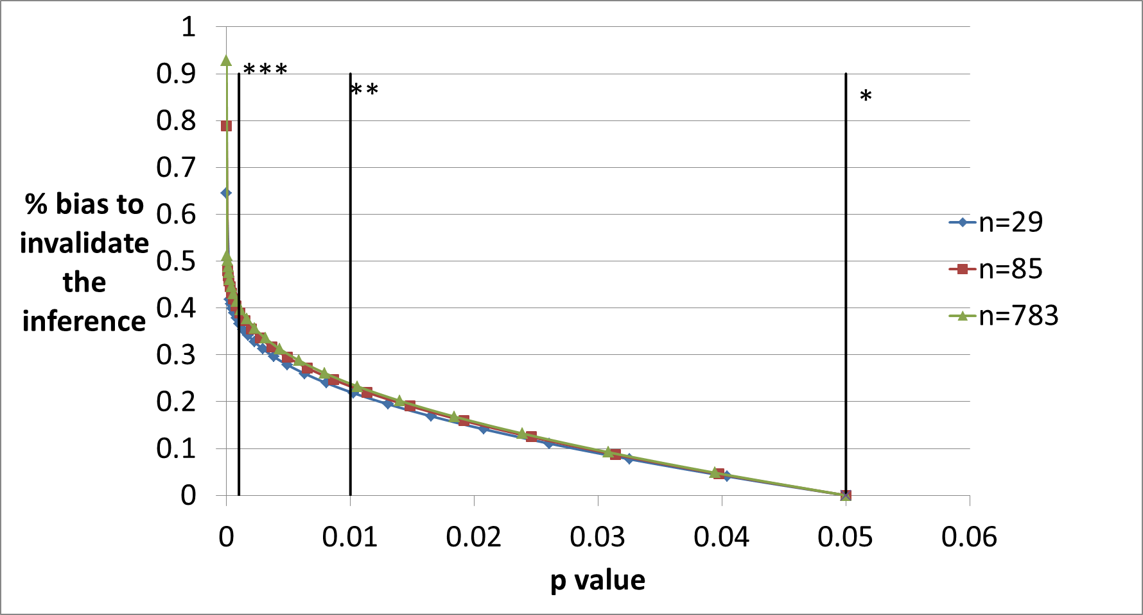
Not very Sensitive to Sample Size

Slide 44
Beyond *, **, and ***
P values
  sampling distribution framework
  Must interpret relative to standard errors
  Information lost for modest and high levels of robustness
% bias to invalidate
  counterfactual framework
  Interpret in terms of case replacement
  Information along a continuous scale
Notes:
Rosenbaum, P. R. (2005). Sensitivity analysis in observational studies. Encyclopedia of statistics in behavioral science, 4, 1809-1814.

Slide 45
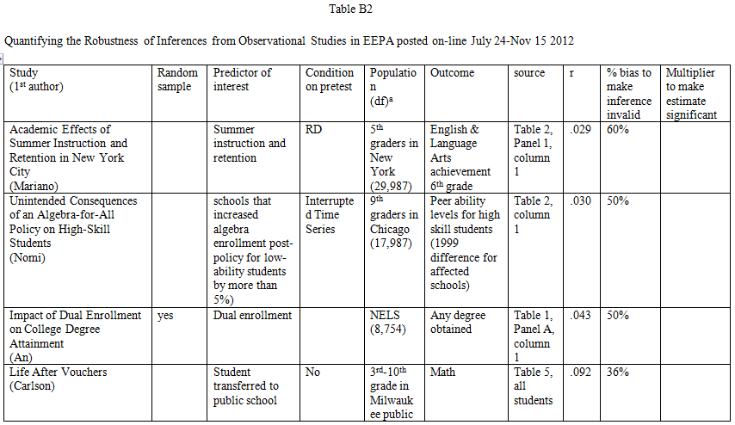
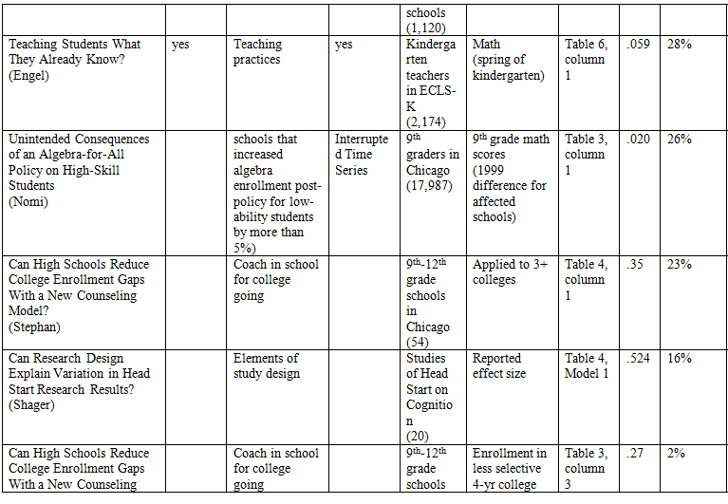
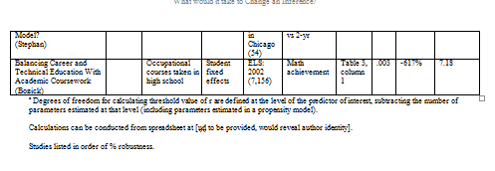

Slide 46
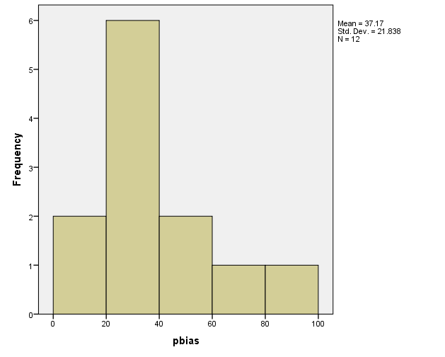
% Bias to Invalidate Inference for Observational Studies
On-line EEPA July 24-Nov 15 2012
Kindergarten retention effect

Slide 47
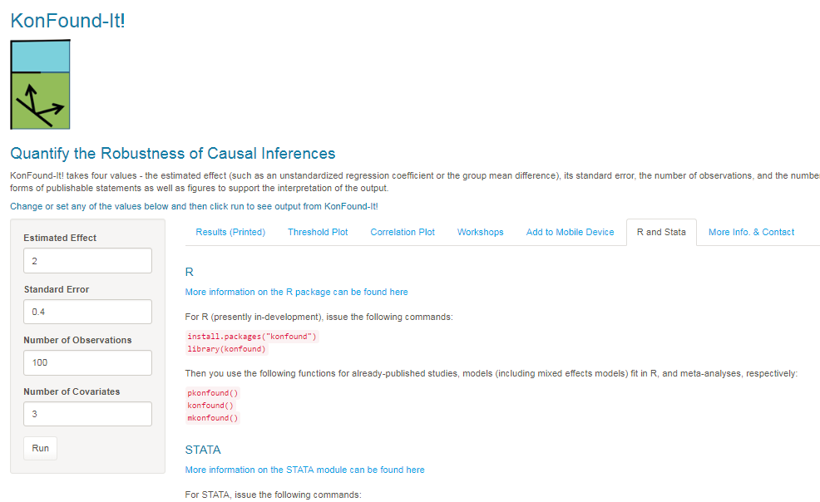
Konfound-it.com
R and STATA

Slide 48
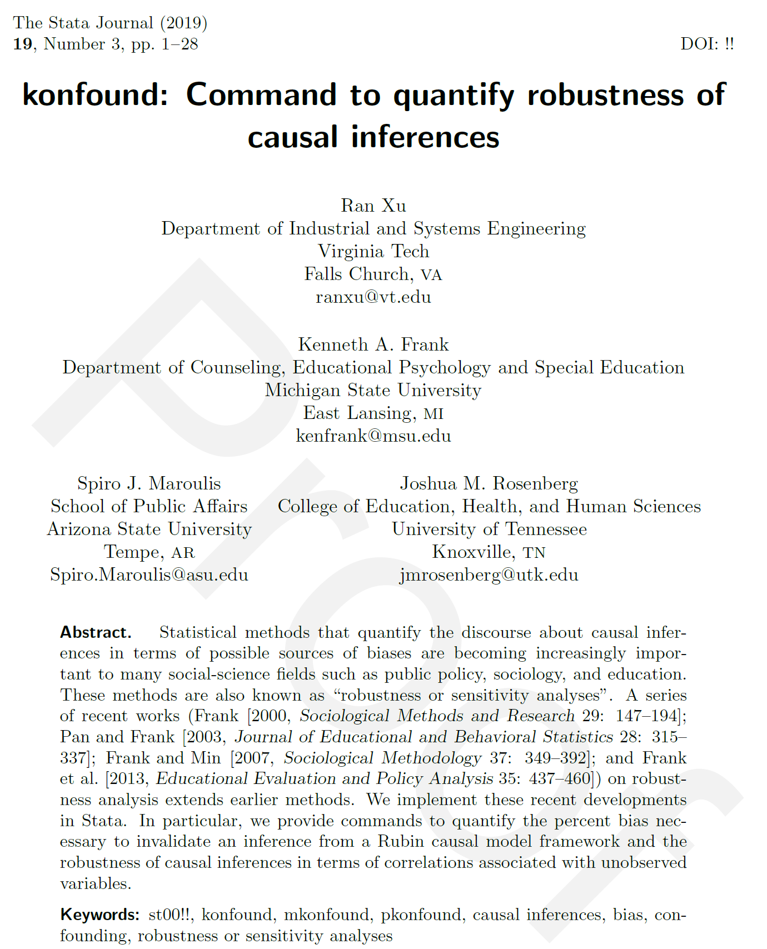

Slide 49
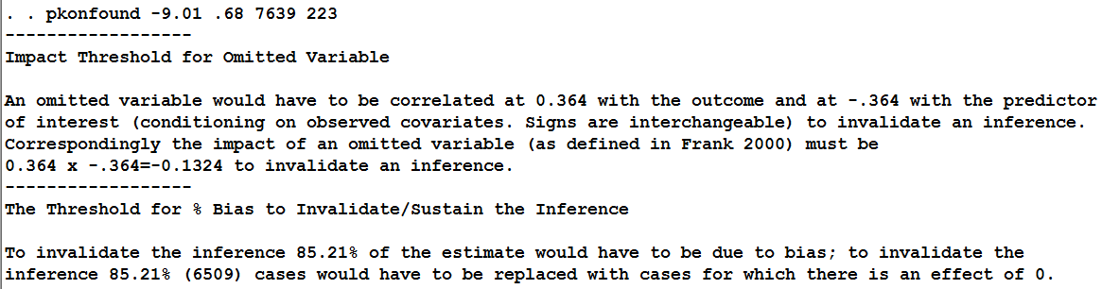
In STATA
. ssc install konfound
. ssc install moss
. ssc install matsort
. ssc install indeplist
. pkonfound -9.01 .68 7639 223
. /* pkonfound estimate standard_error n number_of_covariates */
IGNORE FOR NOW
USE THIS

Slide 50
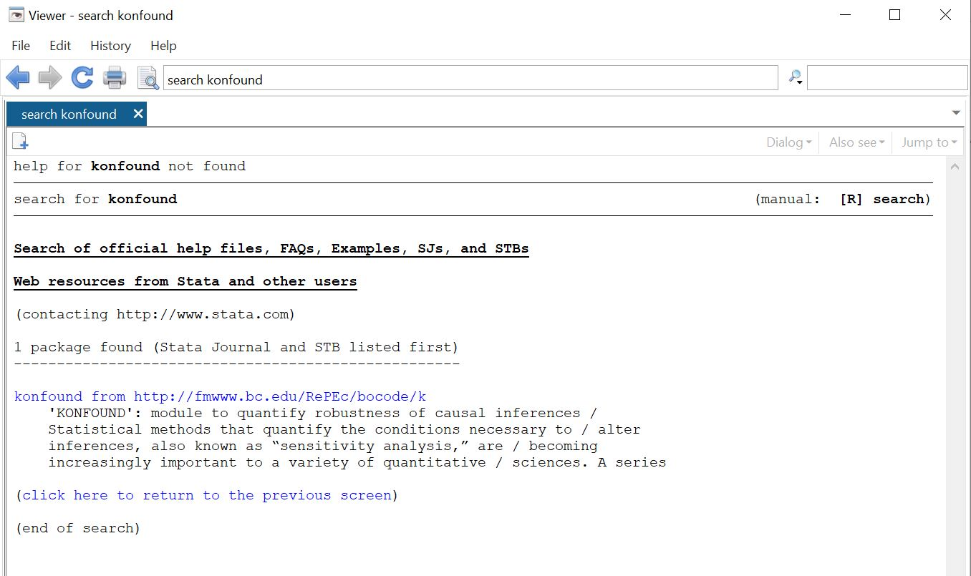
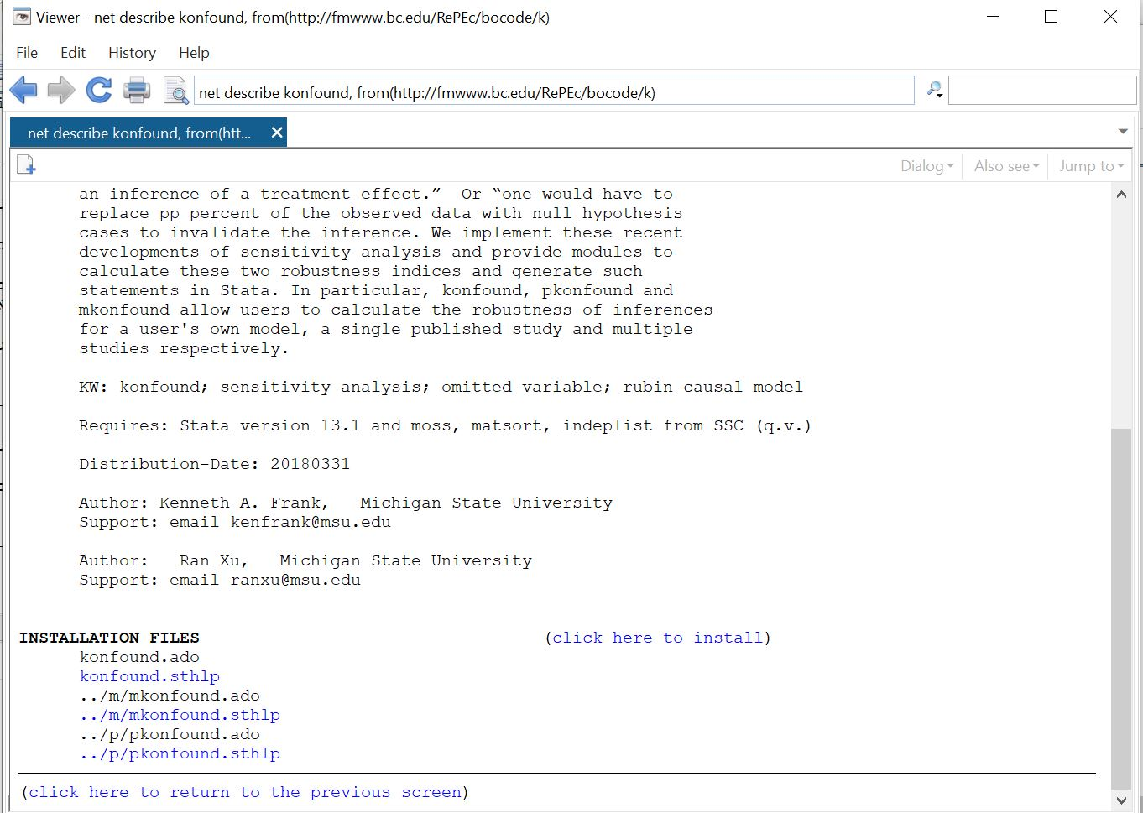
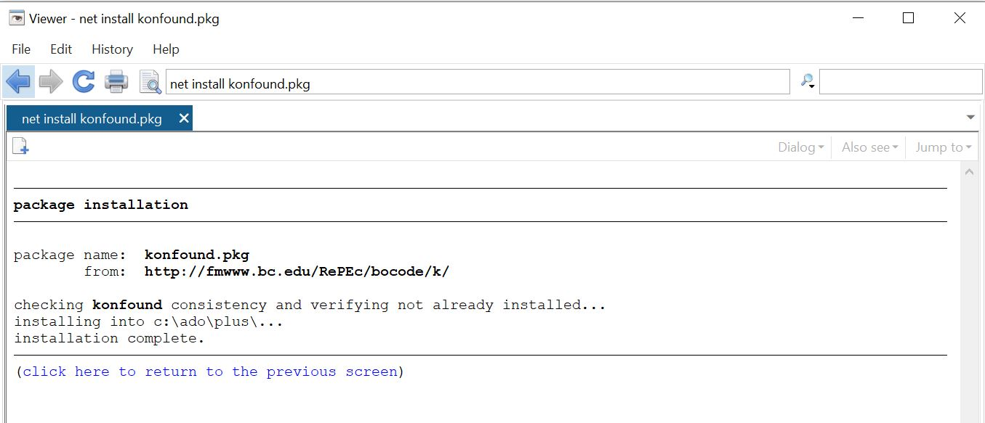
Step 1: search konfound in the Viewer window
Step 2: click on the link, you get this window
Step 3: click “click here to install” to install it!

Slide 51
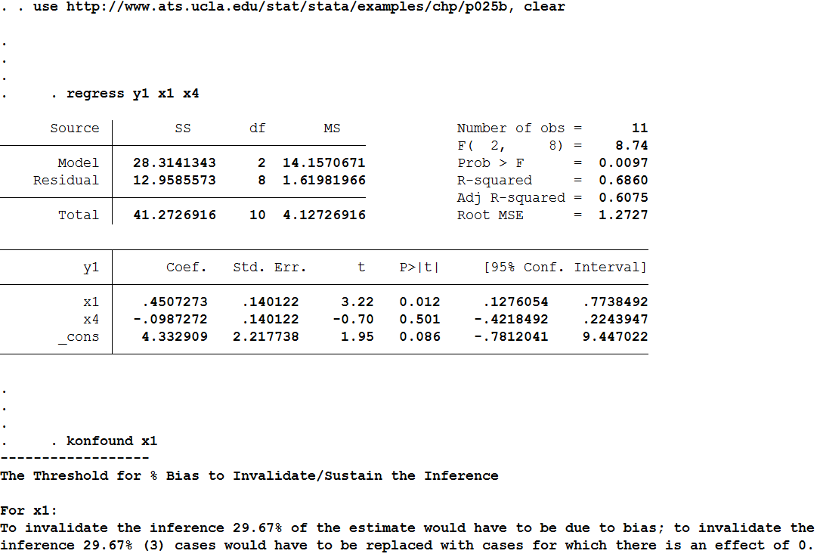
Sensitivity on Regression Run in STATA
. use https://msu.edu/~kenfrank/p025b.dta, clear
. regress y1 x1 x4
. konfound x1

Slide 52
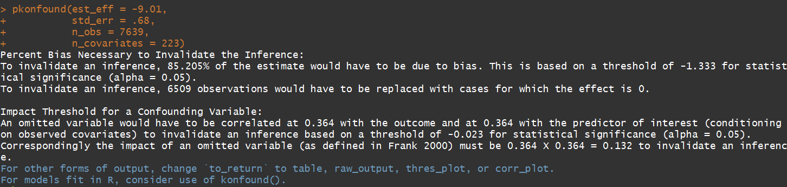
In R: Pkonfound
(published example)
install.packages("konfound")
library(konfound)
pkonfound(est_eff = -9.01, std_err = .68, n_obs = 7639, n_covariates = 223)
USE THIS
IGNORE FOR NOW

Slide 53
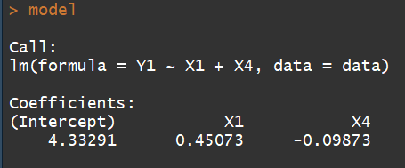
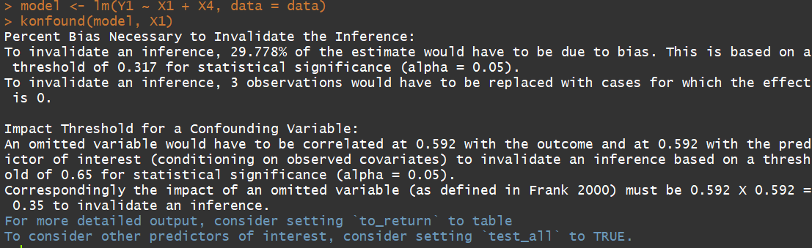
Sensitivity on Regression Run in R: Konfound (data in R)
data <- read.table(url("https://msu.edu/~kenfrank/p025b.txt"), header = T)
model <- lm(Y1 ~ X1 + X4, data = data)
model
konfound(model, X1)
USE THIS
IGNORE FOR NOW

Slide 54
Exercise 1 : % Bias necessary to Invalidate an Inference for Internal Validity
Take an example from an observational study (your own data, the toy example, or a published example) Calculate the % bias necessary to invalidate the inference (using konfound or pkonfound)
[ignore output for correlation based approach with impact]
  Interpret the % bias in terms of sample replacement
  What are the possible sources of bias?
  Would they all work in the same direction?
What happens if you change the
sample size
# of covariates
standard error
Debate your inference with a partner

Slide 55
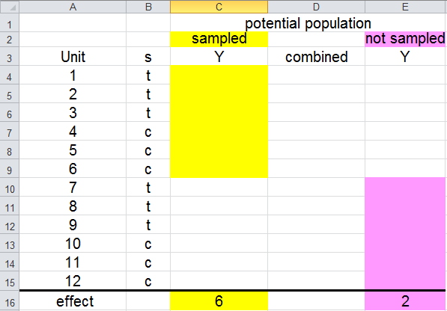
Approximating the Unsampled Population with Observed Data from an RCT (External Validity)
How many cases would you have to replace with cases with zero effect to change the inference?
Assume threshold is: δ# =4:
1- δ# /
=1-4/6=.33 =(1/3)
9
10
11
3
4
5
7
7
7
7
7
7 ´
6
0
4
Texas
Notre Dame

Slide 56
% bias necessary to invalidate the inference
{
}
δ#
To invalidate the inference, replace 33% of cases with cases from unsampled population with zero effect

Slide 57
Application to Randomized Experiment:
Effect of
Open Court Curriculum on Reading Achievement
Open Court “scripted” curriculum versus business as usual
917 elementary students in 49 classrooms
Comparisons within grade and school
Outcome Measure: Terra Nova comprehensive reading score
Borman, G. D., Dowling, N. M., and Schneck, C. (2008). A multi-site cluster randomized field trial of Open Court Reading. Educational Evaluation and Policy Analysis, 30(4), 389-407.

Slide 58
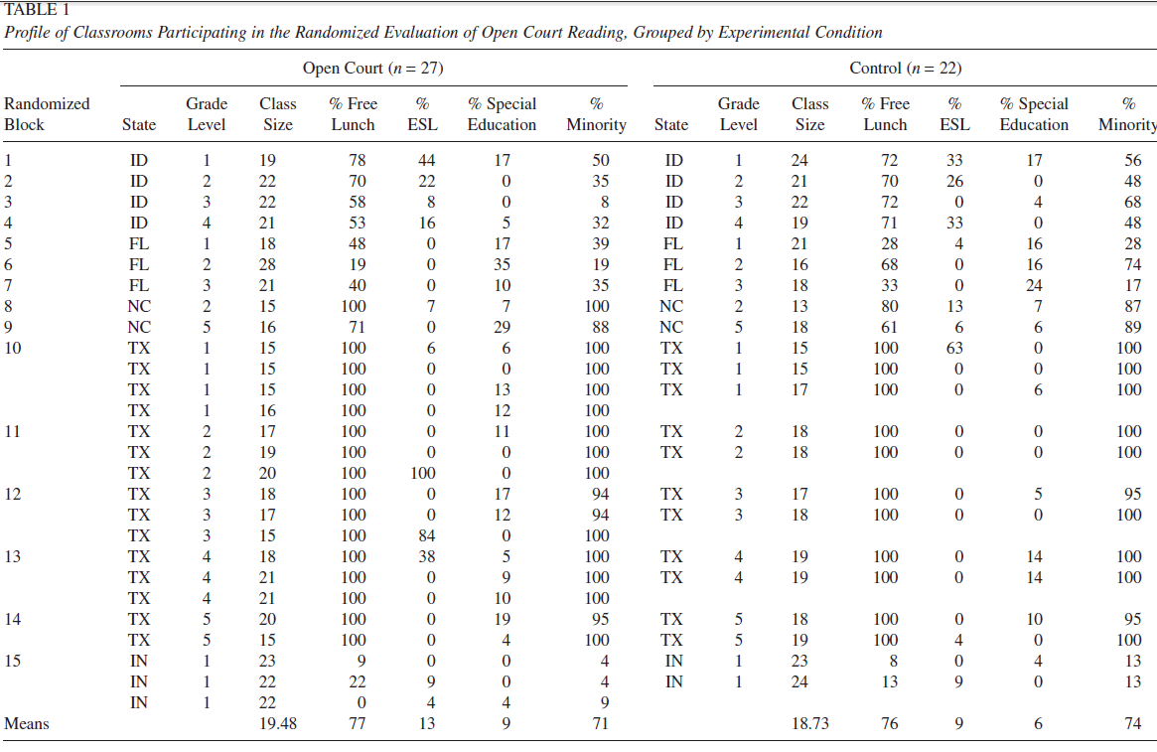
Notes:
Borman, G. D., Dowling, N. M., and Schneck, C. 2008. A multi-site cluster randomized field trial of Open Court Reading. Educational Evaluation and Policy Analysis, 30(4), 389-407.

Slide 59
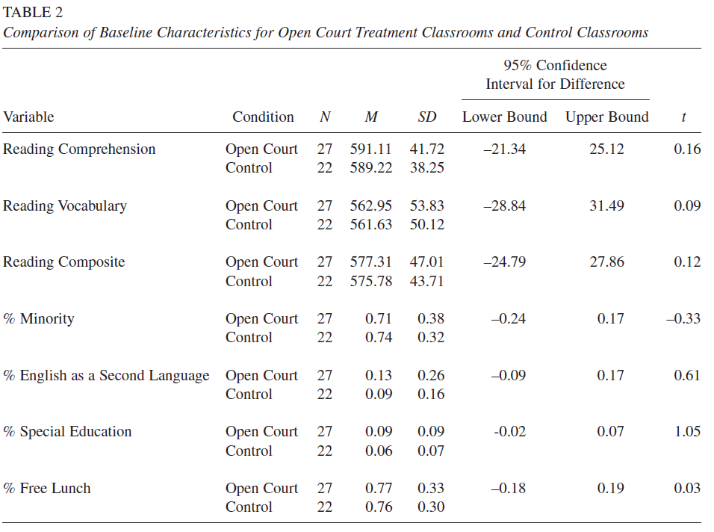

Slide 60
Value of Randomization
Few differences between groups
But done at classroom level
Teachers might talk to each other
School level is expensive (Slavin, 2008)
  Slavin, R. E. (2008). Perspectives on evidence-based research in education-what works? Issues in synthesizing educational program evaluations. Educational Researcher, 37, 5-14.

Slide 61
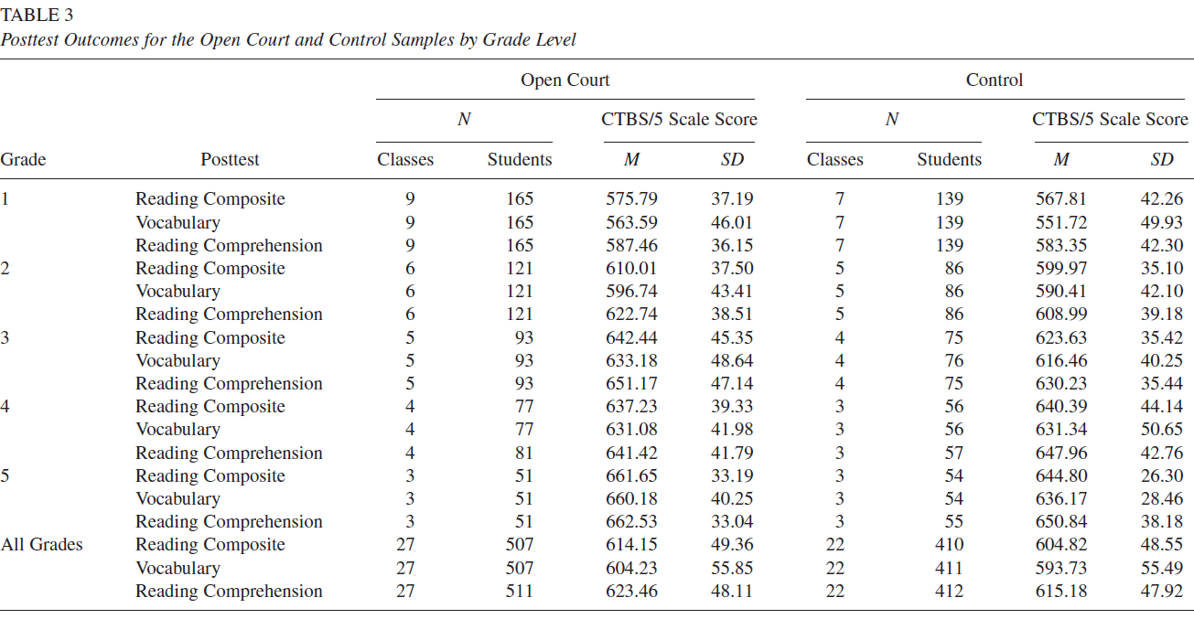
n=27+22=49

Slide 62
Differences between Open Court and Business as Usual
Difference across grades: about 10 units
  7.95 using statistical model
“statistically significant” unlikely (probability < 5%) to have occurred by chance alone if there were really no differences in the population
But is the Inference about Open Court valid in other contexts?

Slide 63
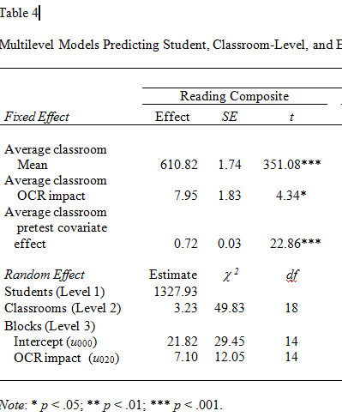
Obtaining # parameters estimated, t critical, estimated effect and standard error
3 parameters
estimated,
Df=n of classrooms-
# of parameters
estimated=
49-3=46.
t critical = t_{.05, df=46}
=2.014
Standard error=1.83
Estimated effect
( ) = 7.95

Slide 64
Quantifying the Discourse for Borman et al:
What would it take to change the inference?
δ =a population effect,
=the estimated effect = 7.95, and
δ # =the threshold for making an inference =
se x t_{critical, df=46} =1.83 x 2.014=3.69
% Bias necessary to invalidate inference =
1- δ #/ =1-3.69/7.95=54%
54% of the estimate must be due to bias to invalidate the inference

Slide 65
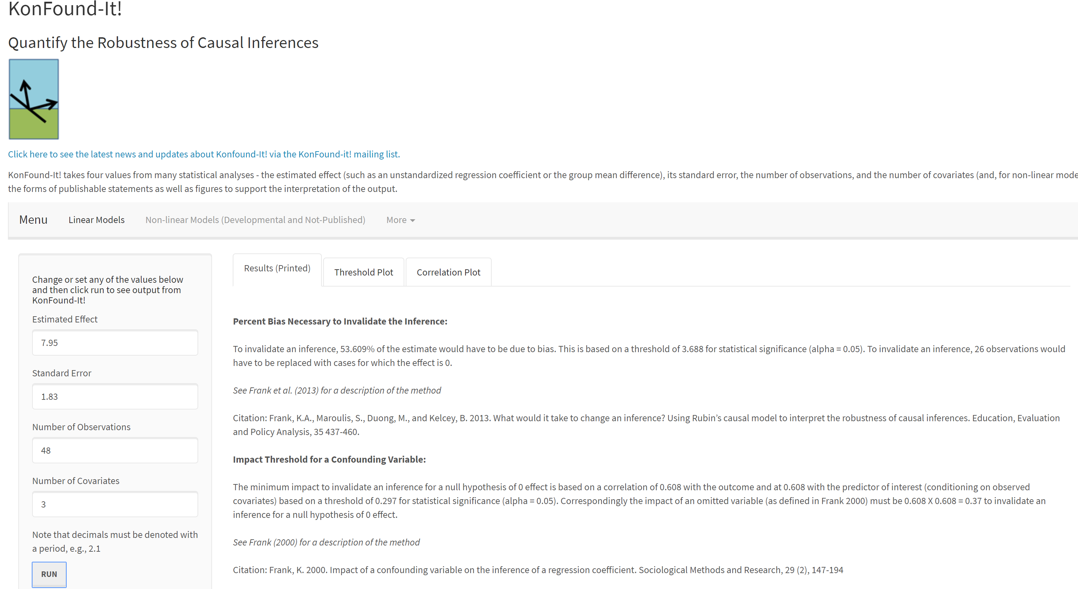
Konfound-it: Borman et al
To invalidate an inference, 53.609% of the estimate would have to be due to bias. This is based on a threshold of 3.688 for statistical significance (alpha = 0.05). To invalidate an inference, 26 observations would have to be replaced with cases for which the effect is 0.
7.95
1.83
48
3

Slide 66
Calculating the % Bias to Invalidate the Inference:
Inside the Calculations in STATA
=the estimated effect = 7.95, standard error =1.83, sample size=49, covariates=3
. pkonfound 7.95 1.83 49 3
------------------
The Threshold for % Bias to Invalidate/Sustain the Inference
To invalidate the inference 53.64% of the estimate would have to be due to bias; to invalidate the inference 53.64% (26) cases would have to be replaced with cases for which there is an effect of 0.

Slide 67
Exercise 2 : % Bias Necessary to Invalidate an Inference for External Validity
Take an example of a randomized experiment in your own data or an article or Borman’s example of Open Court
Calculate the % bias necessary to invalidate the inference
Interpret the % bias in terms of sample replacement
What are the possible sources of bias?
Would they all work in the same direction?
What happens if you change the
sample size
standard error
degrees of freedom
Debate your inference with a new partner

Slide 68
% Exceeding Threshold for Open Court Estimated Effect
}
54 % above threshold=1-3.68/7.95=.54
δ# =3.68
54% of the estimate must be due to bias to invalidate the inference

Slide 69
Interpretation of Amount of Bias Necessary to Invalidate the Inference: Sample Representativeness
To invalidate the inference:
  54% of the estimate must be due to sampling bias to invalidate Borman et al.’s inference
  You would have to replace 54% of Borman’s cases (about 30 classes) with cases in which Open Court had no effect to invalidate the inference
Are 54% of Borman et al.’s cases irrelevant for non-volunteer schools?
We have quantified the discourse about the concern of external validity

Slide 70
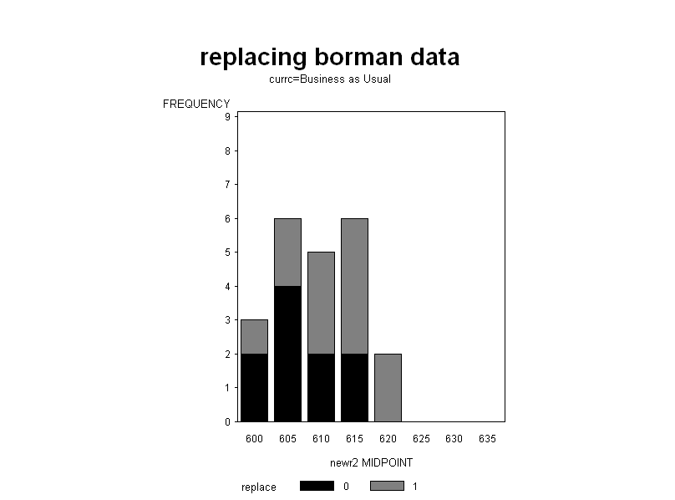
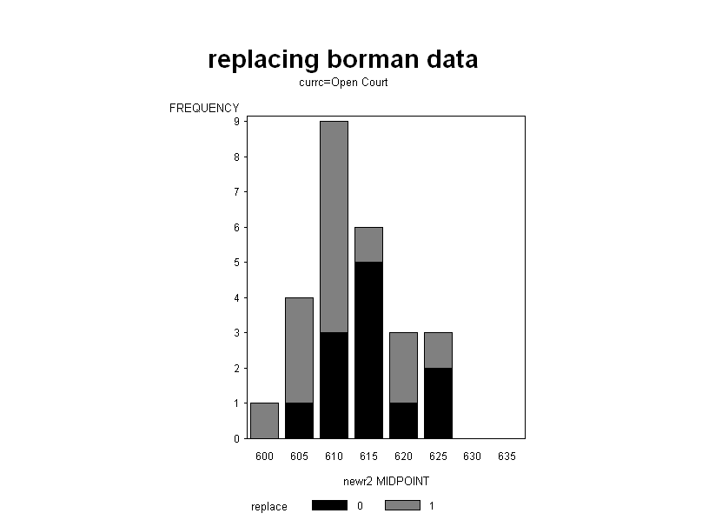
Example Replacement of Cases from Non-Volunteer Schools to Invalidate Inference of an Effect of the Open Court Curriculum
Business as Usual
Unsampled Population:
No effect
Open Court
Original volunteer cases that were not replaced
Replacement cases from non-volunteer schools with no treatment effect
Original distribution for all volunteer cases
Business as Usual

Slide 71


Pragmatism and the Fundamental Problem of External Validity
Pre-experiment population
≠Post -experiment population
Public
Sociology
X
Action
$
Y
Fundamental problem of external validity:
  The more influential a study the more different the pre and post populations, the less the results apply to the post experimental population (Ben-David; Kuhn)
  All the more so if it is due to the design (Burtless, 1995)
Notes:
See: Sampson, R. J. (2010). Gold standard myths: Observations on the experimental turn in quantitative criminology. Journal of Quantitative Criminology, 26(4), 489-500. page 495

Slide 72
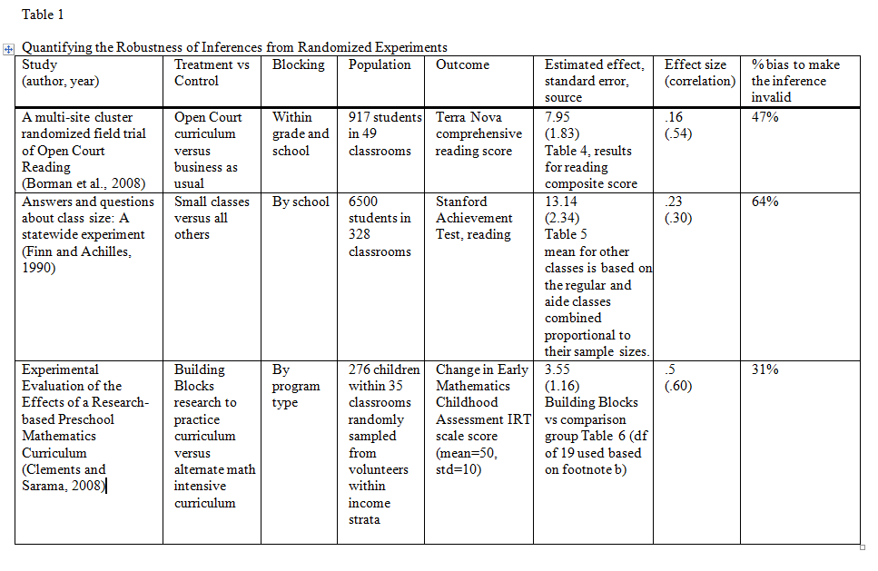
% Bias to Invalidate Inferences across Randomized Experiments
(correlation metric)
47%
64%
31%

Slide 73
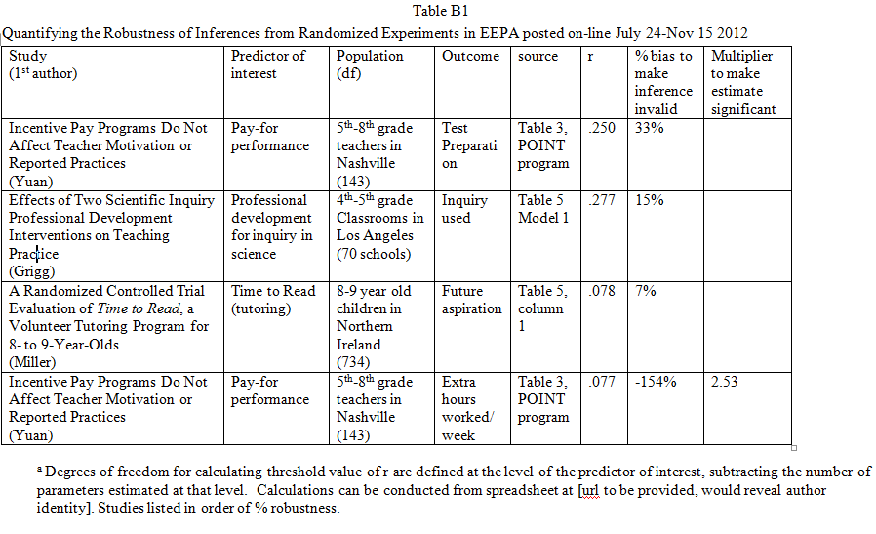

Slide 74
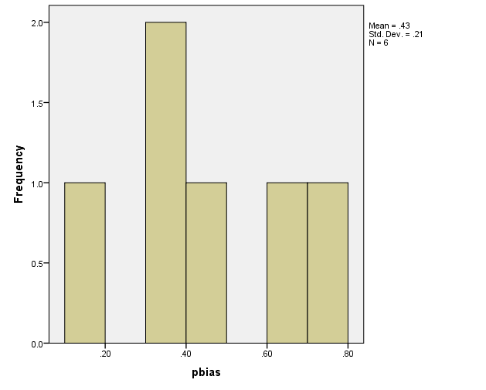
Distribution of % Bias to Invalidate Inference for Randomized Studies EEPA:
On-line Jul 24-Nov 5 2012
Open Court

Slide 75
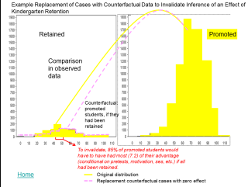
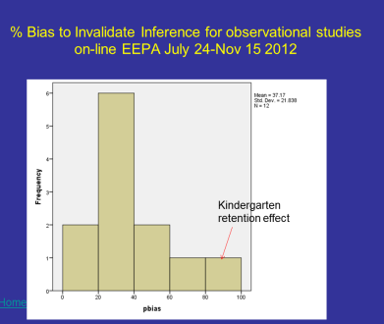
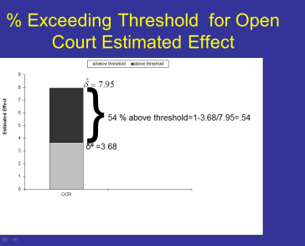
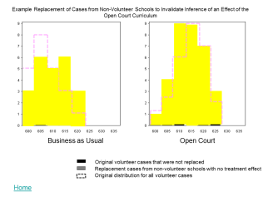
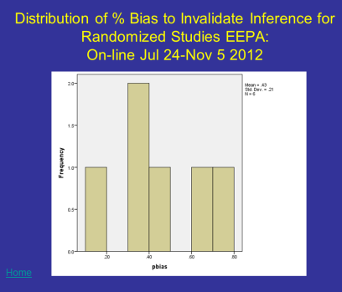
Review & Reflection
Review of applications
  Concern about internal validity: Kindergarten retention (Hong and Raudenbush)
    85% of cases must be replaced counterfactual data (with no effect) to invalidate the inference of a negative effect of retention on reading achievement
      Comparison with other observational studies
  Concern about external validity: Open Court Curriculum
    54% of cases must be replaced with data from unobserved population to invalidate the inference of a positive effect of Open Court on reading achievement in non-volunteer schools
      Comparison with other randomized experiments
  Reflect
  Which part is most confusing to you?
  Is there more than one interpretation?
  Discuss with a partner or two

Slide 76
Case Replacement for Logistic Regression
Replace cases with null hypothesis cases.
What is a null hypothesis case? One in which probability of success is independent of predictor
→ You switch some treatment success cases to treatment failure case

Slide 77
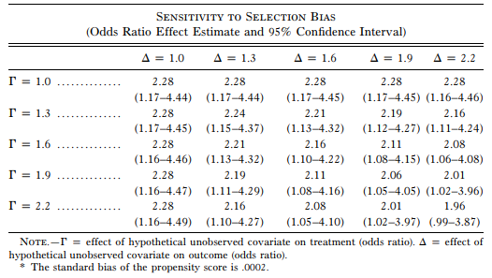
State of the Art: Rosenbaum Bounds
Odds ratio relating treatment to outcome
Odds ratio relating omitted variable to outcome
Increments of Γ matter more as Δ increases. Correlation between Γ Δ and odd ratio is -.96
Odds ratio relating omitted variable to treatment
Harding, D. J. (2003). Counterfactual models of neighborhood effects: The effect of neighborhood poverty on dropping out and teenage pregnancy. American Journal of Sociology, 109(3), 676-719.

Slide 78
Replacement of Cases for Logistic:
Toy Example Observed Data
 | Failure | Success | Total
Control | 15 | 10 | 25
Treatment | 5 | 20 | 25
Total | 20 | 30 | 50
 | Failure | Success | Total
Control | Ꙫ Ꙫ Ꙫ Ꙫ Ꙫ Ꙫ Ꙫ Ꙫ Ꙫ Ꙫ Ꙫ Ꙫ Ꙫ Ꙫ Ꙫ | Ꙫ Ꙫ Ꙫ Ꙫ Ꙫ Ꙫ Ꙫ Ꙫ Ꙫ Ꙫ | Ꙫ Ꙫ Ꙫ Ꙫ Ꙫ Ꙫ Ꙫ Ꙫ Ꙫ Ꙫ Ꙫ Ꙫ Ꙫ Ꙫ Ꙫ Ꙫ Ꙫ Ꙫ Ꙫ Ꙫ Ꙫ Ꙫ Ꙫ Ꙫ Ꙫ
Treatment | Ꙫ Ꙫ Ꙫ Ꙫ Ꙫ | Ꙫ Ꙫ Ꙫ Ꙫ Ꙫ Ꙫ Ꙫ Ꙫ Ꙫ Ꙫ Ꙫ Ꙫ Ꙫ Ꙫ Ꙫ Ꙫ Ꙫ Ꙫ Ꙫ Ꙫ | Ꙫ Ꙫ Ꙫ Ꙫ Ꙫ Ꙫ Ꙫ Ꙫ Ꙫ Ꙫ Ꙫ Ꙫ Ꙫ Ꙫ Ꙫ Ꙫ Ꙫ Ꙫ Ꙫ Ꙫ Ꙫ Ꙫ Ꙫ Ꙫ Ꙫ
Total | Ꙫ Ꙫ Ꙫ Ꙫ Ꙫ Ꙫ Ꙫ Ꙫ Ꙫ Ꙫ Ꙫ Ꙫ Ꙫ Ꙫ Ꙫ Ꙫ Ꙫ Ꙫ Ꙫ Ꙫ | Ꙫ Ꙫ Ꙫ Ꙫ Ꙫ Ꙫ Ꙫ Ꙫ Ꙫ Ꙫ Ꙫ Ꙫ Ꙫ Ꙫ Ꙫ Ꙫ Ꙫ Ꙫ Ꙫ Ꙫ Ꙫ Ꙫ Ꙫ Ꙫ Ꙫ Ꙫ Ꙫ Ꙫ Ꙫ Ꙫ | Ꙫ Ꙫ Ꙫ Ꙫ Ꙫ Ꙫ Ꙫ Ꙫ Ꙫ Ꙫ Ꙫ Ꙫ Ꙫ Ꙫ Ꙫ Ꙫ Ꙫ Ꙫ Ꙫ Ꙫ Ꙫ Ꙫ Ꙫ Ꙫ Ꙫ Ꙫ Ꙫ Ꙫ Ꙫ Ꙫ Ꙫ Ꙫ Ꙫ Ꙫ Ꙫ Ꙫ Ꙫ Ꙫ Ꙫ Ꙫ Ꙫ Ꙫ Ꙫ Ꙫ Ꙫ Ꙫ Ꙫ Ꙫ Ꙫ Ꙫ
Odds ratio=(15x20)/(10x5)=6; Ln(Odds ratio)=ln(6)=1.79
Standard error=(1/15+1/10+1/5+1/20)^{1/2}=.64
Threshold=1.96x.64=1.27
% bias to invalidate=1-1.27/1.79=29%
Replace 29% of treatment successes (n=20)=6 cases

Slide 79
Replacement of 6 Cases with null Hypothesis (p=.6) Cases
 | Failure | Success | Total
Control | 15 | 10 | 25
Treatment | 5 | 20 | 25
Total | 20 | 30 | 50
 | Failure | Success | Total
Control | Ꙫ Ꙫ Ꙫ Ꙫ Ꙫ Ꙫ Ꙫ Ꙫ Ꙫ Ꙫ Ꙫ Ꙫ Ꙫ Ꙫ Ꙫ | Ꙫ Ꙫ Ꙫ Ꙫ Ꙫ Ꙫ Ꙫ Ꙫ Ꙫ Ꙫ | Ꙫ Ꙫ Ꙫ Ꙫ Ꙫ Ꙫ Ꙫ Ꙫ Ꙫ Ꙫ Ꙫ Ꙫ Ꙫ Ꙫ Ꙫ Ꙫ Ꙫ Ꙫ Ꙫ Ꙫ Ꙫ Ꙫ Ꙫ Ꙫ Ꙫ
Treatment | Ꙫ Ꙫ Ꙫ Ꙫ Ꙫ | Ꙫ Ꙫ Ꙫ Ꙫ Ꙫ Ꙫ Ꙫ Ꙫ Ꙫ Ꙫ Ꙫ Ꙫ Ꙫ Ꙫ Ꙫ Ꙫ Ꙫ Ꙫ Ꙫ Ꙫ | Ꙫ Ꙫ Ꙫ Ꙫ Ꙫ Ꙫ Ꙫ Ꙫ Ꙫ Ꙫ Ꙫ Ꙫ Ꙫ Ꙫ Ꙫ Ꙫ Ꙫ Ꙫ Ꙫ Ꙫ Ꙫ Ꙫ Ꙫ Ꙫ Ꙫ
Total | Ꙫ Ꙫ Ꙫ Ꙫ Ꙫ Ꙫ Ꙫ Ꙫ Ꙫ Ꙫ Ꙫ Ꙫ Ꙫ Ꙫ Ꙫ Ꙫ Ꙫ Ꙫ Ꙫ Ꙫ | Ꙫ Ꙫ Ꙫ Ꙫ Ꙫ Ꙫ Ꙫ Ꙫ Ꙫ Ꙫ Ꙫ Ꙫ Ꙫ Ꙫ Ꙫ Ꙫ Ꙫ Ꙫ Ꙫ Ꙫ Ꙫ Ꙫ Ꙫ Ꙫ Ꙫ Ꙫ Ꙫ Ꙫ Ꙫ Ꙫ | Ꙫ Ꙫ Ꙫ Ꙫ Ꙫ Ꙫ Ꙫ Ꙫ Ꙫ Ꙫ Ꙫ Ꙫ Ꙫ Ꙫ Ꙫ Ꙫ Ꙫ Ꙫ Ꙫ Ꙫ Ꙫ Ꙫ Ꙫ Ꙫ Ꙫ Ꙫ Ꙫ Ꙫ Ꙫ Ꙫ Ꙫ Ꙫ Ꙫ Ꙫ Ꙫ Ꙫ Ꙫ Ꙫ Ꙫ Ꙫ Ꙫ Ꙫ Ꙫ Ꙫ Ꙫ Ꙫ Ꙫ Ꙫ Ꙫ Ꙫ
Replace 29% of treatment successes (n=20)=6 cases
Replace with null hypothesis cases (p of success=30/50=.6).
So some of the treatment successes are replaced with other treatment successes
→ Ask instead, how many treatment successes must be switched to treatment failure to invalidate the inference
Ꙫ Ꙫ Ꙫ Ꙫ Ꙫ ?
Replacement Cases,
P(success)=.6

Slide 80
Switching Treatment success to Treatment Failure
Before Switches, from data
 | Failure | Success | Total
Control | 15 | 10 | 25
Treatment | 5 | 20 | 25
Total | 20 | 30 | 50
 | Failure | Success | Total
Control | Ꙫ Ꙫ Ꙫ Ꙫ Ꙫ Ꙫ Ꙫ Ꙫ Ꙫ Ꙫ Ꙫ Ꙫ Ꙫ Ꙫ Ꙫ | Ꙫ Ꙫ Ꙫ Ꙫ Ꙫ Ꙫ Ꙫ Ꙫ Ꙫ Ꙫ | Ꙫ Ꙫ Ꙫ Ꙫ Ꙫ Ꙫ Ꙫ Ꙫ Ꙫ Ꙫ Ꙫ Ꙫ Ꙫ Ꙫ Ꙫ Ꙫ Ꙫ Ꙫ Ꙫ Ꙫ Ꙫ Ꙫ Ꙫ Ꙫ Ꙫ
Treatment | Ꙫ Ꙫ Ꙫ Ꙫ Ꙫ | Ꙫ Ꙫ Ꙫ Ꙫ Ꙫ Ꙫ Ꙫ Ꙫ Ꙫ Ꙫ Ꙫ Ꙫ Ꙫ Ꙫ Ꙫ Ꙫ Ꙫ Ꙫ Ꙫ Ꙫ | Ꙫ Ꙫ Ꙫ Ꙫ Ꙫ Ꙫ Ꙫ Ꙫ Ꙫ Ꙫ Ꙫ Ꙫ Ꙫ Ꙫ Ꙫ Ꙫ Ꙫ Ꙫ Ꙫ Ꙫ Ꙫ Ꙫ Ꙫ Ꙫ Ꙫ
Total | Ꙫ Ꙫ Ꙫ Ꙫ Ꙫ Ꙫ Ꙫ Ꙫ Ꙫ Ꙫ Ꙫ Ꙫ Ꙫ Ꙫ Ꙫ Ꙫ Ꙫ Ꙫ Ꙫ Ꙫ | Ꙫ Ꙫ Ꙫ Ꙫ Ꙫ Ꙫ Ꙫ Ꙫ Ꙫ Ꙫ Ꙫ Ꙫ Ꙫ Ꙫ Ꙫ Ꙫ Ꙫ Ꙫ Ꙫ Ꙫ Ꙫ Ꙫ Ꙫ Ꙫ Ꙫ Ꙫ Ꙫ Ꙫ Ꙫ Ꙫ | Ꙫ Ꙫ Ꙫ Ꙫ Ꙫ Ꙫ Ꙫ Ꙫ Ꙫ Ꙫ Ꙫ Ꙫ Ꙫ Ꙫ Ꙫ Ꙫ Ꙫ Ꙫ Ꙫ Ꙫ Ꙫ Ꙫ Ꙫ Ꙫ Ꙫ Ꙫ Ꙫ Ꙫ Ꙫ Ꙫ Ꙫ Ꙫ Ꙫ Ꙫ Ꙫ Ꙫ Ꙫ Ꙫ Ꙫ Ꙫ Ꙫ Ꙫ Ꙫ Ꙫ Ꙫ Ꙫ Ꙫ Ꙫ Ꙫ Ꙫ
Odds ratio=(15x20)/(10x5)=6; Ln(Odds ratio)=ln(6)=1.79
St error=(1/15+1/10+1/5+1/20)^{1/2}=.64
T ratio=2.27
After Switching 3 treatment success to treatment failure
 | Failure | Success | Total
Control | 15 | 10 | 25
Treatment | 8 | 17 | 25
Total | 20 | 30 | 50
 | Failure | Success | Total
Control | Ꙫ Ꙫ Ꙫ Ꙫ Ꙫ Ꙫ Ꙫ Ꙫ Ꙫ Ꙫ Ꙫ Ꙫ Ꙫ Ꙫ Ꙫ | Ꙫ Ꙫ Ꙫ Ꙫ Ꙫ Ꙫ Ꙫ Ꙫ Ꙫ Ꙫ | Ꙫ Ꙫ Ꙫ Ꙫ Ꙫ Ꙫ Ꙫ Ꙫ Ꙫ Ꙫ Ꙫ Ꙫ Ꙫ Ꙫ Ꙫ Ꙫ Ꙫ Ꙫ Ꙫ Ꙫ Ꙫ Ꙫ Ꙫ Ꙫ Ꙫ
Treatment | Ꙫ Ꙫ Ꙫ Ꙫ Ꙫ Ꙫ Ꙫ Ꙫ | Ꙫ Ꙫ Ꙫ Ꙫ Ꙫ Ꙫ Ꙫ Ꙫ Ꙫ Ꙫ Ꙫ Ꙫ Ꙫ Ꙫ Ꙫ Ꙫ Ꙫ | Ꙫ Ꙫ Ꙫ Ꙫ Ꙫ Ꙫ Ꙫ Ꙫ Ꙫ Ꙫ Ꙫ Ꙫ Ꙫ Ꙫ Ꙫ Ꙫ Ꙫ Ꙫ Ꙫ Ꙫ Ꙫ Ꙫ Ꙫ Ꙫ Ꙫ
Total | Ꙫ Ꙫ Ꙫ Ꙫ Ꙫ Ꙫ Ꙫ Ꙫ Ꙫ Ꙫ Ꙫ Ꙫ Ꙫ Ꙫ Ꙫ Ꙫ Ꙫ Ꙫ Ꙫ Ꙫ | Ꙫ Ꙫ Ꙫ Ꙫ Ꙫ Ꙫ Ꙫ Ꙫ Ꙫ Ꙫ Ꙫ Ꙫ Ꙫ Ꙫ Ꙫ Ꙫ Ꙫ Ꙫ Ꙫ Ꙫ Ꙫ Ꙫ Ꙫ Ꙫ Ꙫ Ꙫ Ꙫ Ꙫ Ꙫ Ꙫ | Ꙫ Ꙫ Ꙫ Ꙫ Ꙫ Ꙫ Ꙫ Ꙫ Ꙫ Ꙫ Ꙫ Ꙫ Ꙫ Ꙫ Ꙫ Ꙫ Ꙫ Ꙫ Ꙫ Ꙫ Ꙫ Ꙫ Ꙫ Ꙫ Ꙫ Ꙫ Ꙫ Ꙫ Ꙫ Ꙫ Ꙫ Ꙫ Ꙫ Ꙫ Ꙫ Ꙫ Ꙫ Ꙫ Ꙫ Ꙫ Ꙫ Ꙫ Ꙫ Ꙫ Ꙫ Ꙫ Ꙫ Ꙫ Ꙫ Ꙫ
Odds ratio=(15x17)/(10x8)=3.19; Ln(Odds ratio)=1.15
Standard error=(1/15+1/10+1/8+1/17)^{1/2}=.59
T ratio=1.958

Slide 81
R code brute force
setwd("C:/Users/user/Dropbox (Personal)/sensitivity for logistics")
rm(list = ls())
A <- 29
B <- 26
C <- 15
D <- 40
x <- matrix(c(A,B,C,D), byrow = TRUE, 2, 2)
# this is the 2 by 2 table we start with
p.CD <- p.value <- chisq.test(x,correct = FALSE)$p.value
N.CD <- 0
while ( p.value <0.05 ) {
C <- C + 1
D <- D - 1
N.CD <- N.CD + 1
x <- matrix(c(A,B,C,D), byrow = TRUE, 2, 2)
print(x)
print(chisq.test(x,correct = FALSE))
p.value <- chisq.test(x,correct = FALSE)$p.value
p.CD <- c(p.CD, chisq.test(x,correct = FALSE)$p.value)
}
A <- 29
B <- 26
C <- 15
D <- 40
x <- matrix(c(A,B,C,D), byrow = TRUE, 2, 2)
p.AB <- p.value <- chisq.test(x,correct = FALSE)$p.value
N.AB <- 0
while ( p.value <0.05 ) {
A <- A - 1
B <- B + 1
N.AB <- N.AB + 1
x <- matrix(c(A,B,C,D), byrow = TRUE, 2, 2)
print(x)
print(chisq.test(x,correct = FALSE))
p.value <- chisq.test(x,correct = FALSE)$p.value
p.AB <- c(p.AB, chisq.test(x,correct = FALSE)$p.value)
}
# so p.AB and p.CD record the p values each time we switch one case
# N.AB = 5 (5 cases needed to be changed from A to B)
# N.CD = 4 (4 cases needed to be changed from D to C)

Slide 82

KonFound-it for Logistic Regression
https://jmichaelrosenberg.shinyapps.io/shinykonfound/

Slide 83

In R: Pkonfound for nonlinear (published example)
install.packages("devtools")
devtools::install_github("jrosen48/konfound")
library(konfound)
pkonfound(2.5, 0.5, 20888, 3, n_trm = 17888, switch_trm=TRUE, non_linear = TRUE)

Slide 84
Extensions
powerpoint for ordered thresholds relative to transaction costs
Specify threshold based on context of value and cost of treatment
powerpoint for alternative scenarios and related techniques
Includes Type II errors, alternative replacement data
powerpoint for new directions
Includes value added, Bayesian, integrated framework
powerpoint for comparison of frameworks [pdf of comparison of frameworks]
Shows algebraic and graphical relationships between comparison of cases and correlation/regression frameworks

Slide 85
Part II: Correlation/regression Framework
Work in terms of partial correlations
How strongly must an omitted variable be correlated with the predictor of interest (e.g., retention) and the outcome (e.g., reading achievement) to invalidate an inference of an effect of retention on achievement?

Slide 86
Estimated Effect of Retention on Reading Scores
(Hong and Raudenbush)

Slide 87
In R Shiny app KonFound-it!
(konfound-it.com/)
-9.01
.68
7639
223
Take out your phone and try it!!!

Slide 88

Impact Threshold for a Confounding variable: Path Diagram
r_{x y}=-.150
r_{x y|cv}=-.023
-.023
r_{cv x}=.36
r_{cv y}=.36
.36 x .36
=.13

Slide 89
How Regression Works:
Partial Correlation
Partial Correlation: correlation between x and y,
where x and y have been controlled for the confounding variable
Impact
Implied by multivariate: Β=[X’X]⁻¹X’Y
Impact=-.075x.203=-.015
 | momed | retention | achievement
momed | 1 | -.075 | .203
retention | -.075 | 1 | -.152
achievement | .203 | -.152 | 1
Notes:
CORRELATIONS
/VARIABLES=y s confound
/PRINT=TWOTAIL NOSIG
/MISSING=PAIRWISE.
proc corr data=one;
var y s confound;
run;

Slide 90
The Impact of a Confounding Variable: Accounting for the Dual Relationships Associated with an Alternative Factor
r_{x∙y}
Retention
X
r_{xy|cv}
Achievement
Y
r_{cv∙x}
Each correlation is weighted in proportion to the size of the other
r_{cv∙x}r_{cv∙y}
r_{cv∙y}
Mother’s education
CV
Notes:
90
Need to modify to show new values

Slide 91
The Impact of a Confounding Variable: Accounting for the Dual Relationships Associated with an Alternative Factor
r_{x∙y}=-.152
Retention
X
r_{xy|cv}=-.140
Achievement
Y
r_{cv∙x}=.203
r_{cv∙y}r_{cv∙x}
=-.075x.203=.015
Each correlation is weighted in proportion to the size of the other
r_{cv∙x}r_{cv∙y}
r_{cv∙y}=-.075
Mother’s education
CV
Notes:
91
Need to modify to show new values

Slide 92
Use the Impact of a Confounding Variable on a Regression Coefficient to Quantify Robustness of Inference
Statements such as:
  An omitted variable must have an impact of qqq to invalidate the inference of an effect of X on Y.
  An omitted variable must be correlated at rrr with X and Y to invalidate an inference of an effect of X on Y.
I call this the Impact Threshold of a Confounding Variable (ITCV).

Slide 93
Quantifying the Robustness of the Inference:
Calculating the Impact Threshold of a Confounding Variable on a Regression Coefficient
Step 1: Establish Correlation Between predictor of interest and outcome
Step 2: Define a Threshold for Inference
Step 3: Calculate the Threshold for the Impact Necessary to Invalidate the Inference
Notes:
Frank, K. 2000. "Impact of a Confounding Variable on the Inference of a Regression Coefficient." Sociological Methods and Research, 29(2), 147-194
http://www.msu.edu/~kenfrank/papers/impact%20of%20a%20confounding%20variable.pdf

Slide 94
Obtain df, Estimated Effect and Standard Error
Estimated effect
( ) = -9.01
Standard
error=.68
n=7168+471=7639; df > 500,
t _{critical}=-1.96
Page 215
From: Hong, G. and Raudenbush, S. (2005). Effects of Kindergarten Retention Policy on Children’s Cognitive Growth in Reading and Mathematics. Educational Evaluation and Policy Analysis. Vol. 27, No. 3, pp. 205–224

Slide 95
Establish Correlation and Threshold for Kindergarten Retention on Achievement
Step 1: calculate treatment effect as correlation
t taken from HLM: =-9.01/.68=-13.25
n is the sample size =7639
q is the number of parameters estimated ( predictor+omitted variable=2)
Step 2: calculate threshold for inference (e.g. statistical significance)
Where t is critical value for df>200
r# can also be defined in terms of effect sizes

Slide 96
Step 3a: Calculate the Impact Necessary to Invalidate the Inference
Assume r_{x∙cv} =r_{y∙cv} (maximizes the difference between r_{xy} and r_{xy|cv} ). Then r_{x∙cv} x r_{y∙cv} = r_{x∙cv} x r_{x∙cv} = r_{y∙cv} x r_{y∙cv} = impact and
Set r_{x∙y|cv} =r# and solve for impact to find the impact threshold
of a confounding variable (ITCV).
ITCV < 0 because rxy < 0
The inference would be invalid if |impact of a confounding variable| > .130.

Slide 97
Step 3b: Component correlations and Interpretation
ITCV=.130
If r_{x∙cv} = r_{y∙cv} =r, then impact= r_{x∙cv} x r_{y∙cv} =r²
An omitted variable must be correlated at .361 with retention and with achievement (with opposite signs) to invalidate the inference of an effect of retention on achievement.
Conceptualize multiple omitted vars
  Latent variable
  Declining conditional impacts

Slide 98
Impact Threshold for a Confounding variable: Path Diagram
r_{x y}=-.150
r_{x y|cv}=-.023
-.023
r_{cv x}=.36
r_{cv y}=.36
.36 x .36
=.13

Slide 99


Look at both Correlations
Impacts above the blue line invalidate the inference
Imbens 2003, page 130; Carnegie Harada and Hill 2016
Smallest impact to invalidate inference: r_{xcv}=ry_{cv}=.361
Imbens, G. W. (2003). Sensitivity to exogeneity assumptions in program evaluation. American Economic Review, 93(2), 126-132.
Carnegie N.B., Harada M., Hill J.L. Assessing Sensitivity to Unmeasured Confounding Using a Simulated Potential Confounder (2016) Journal of Research on Educational Effectiveness, 9 (3) , pp. 395-420.
Notes:
Imbens, G. W. (2003). Sensitivity to exogeneity assumptions in program evaluation. American Economic Review, 93(2), 126-132.

Slide 100
Other Features of Impact Threshold for a Confounding Variable (Frank, 2000)
Covariates already in the model
  can report ITCV as partial or zero-order correlations
  Hazlett and Cinelli Making Sense of Sensitivity: Extending Omitted Variable Bias prefer zero-order to Imbens’ 2003.
Suppression (or type II error for estimate not significant)
Derived initially in terms of estimate and standard error
Can apply to unreliably measured covariate

Slide 101

Absorption: Impacts Before and After Pretests
If k > .109 (or .130 without covariates) then the inference is invalid
After controlling for pre-tests, impact of strongest measured covariate (student approaches to learning) is -.00126 (sign indicates controlling for it reduces estimated effect of retention)
→Impact of unmeasured confound would have to be about 100 times greater than the impact of the strongest observed covariate to invalidate the inference. Hmmm….
The value of controlling for pretests

Slide 102
Effect of Retention on Achievement After Adding each Covariate
Controls | Est | Se | t
School | -21.24 | .63 | -33.49
School+Pre2 (spring Kindergarten) | -12.01 | .45 | -26.48
School+Pre2+(Pre2-Pre1)+ | -12.10 | .47 | -26.28
School+Pre2+(Pre2-Pre1)+ Momed | -12.00 | .47 | -26.26
School+Pre2+(Pre2-Pre1)+ Female | -12.07 | .46 | -25.18
School+Pre2+(Pre2-Pre1)+ 2parent | -12.01 | .46 | -26.27
School+Pre2+(Pre2-Pre1)+ poverty | -12.04 | .46 | -26.16
Hong and Raudenbush (model based) | -9.01 | .68 | -13.27
n=10,065, R² =.40
Note: 1 year’s growth is about 10 points, so retention effect > 1 year growth

Slide 103
Consider Alternate Sample
(External Validity)
Define π as the proportion of the sample that is replaced with an alternate sample.
r_{xy} is correlation in unobserved data
R _{xy} is combined correlation for observed and unobserved data:
R _{xy}=(1-π)r_{xy} + π r _{xy} .
*Frank, K. A. and Min, K. 2007. Indices of Robustness for Sample Representation. Sociological Methodology. Vol 37, 349-392. * co first authors.

Slide 104
Thresholds for Sample Replacement, r _{xy}
Set R _{xy} = r#
r# =(1-π)r_{xy} + π r _{xy}
and solve for r _{xy}:
r _{xy}=[r# +(π-1)r_{xy} ]/ π
If half the sample is replaced (π=.5), original inference is invalid if r _{xy} < 2r#-r_{xy}
Therefore, 2r#-r_{xy} defines the threshold for replacement: TR(π=.5)
Assumes means and variances are constant across samples, alternative calculations available.

Slide 105

Thresholds for Sample Replacement, π
Look familiar?
Set R = r#
r# =(1-π)r_{xy} + π r _{xy}
and solve for π
π=(r_{xy} -r# )/(r _{xy} -r_{xy} )
if r _{xy}=0, inference is altered if π> 1-r#/r_{xy .}
Therefore 1-r#/r_{xy} defines the threshold for replacement TR(r _{xy})=0
Assumes means and variances are constant across samples, alternative calculations available.

Slide 106
Thresholds for Sample Replacement: Toy Example
If half the sample is replaced (π=.5), original inference is invalid if r _{x y} < 2r#-r_{xy}
If r#=.4 and r_{xy} =.6 then inference invalid if
r _{xy} < .2 (2 x .4-.6=.2)
If r _{xy}=0, inference is altered if π> 1-r#/r_{xy}.
If r#=.4 and r_{xy} =.6 then inference invalid if
π> .33 (1-.4/.6=.33)
Assumes means and variances are constant across samples, alternative calculations available.

Slide 107
Interpretation
Replacing cases with null hypothesis cases → % bias to invalidate
How much would you have to replace the data with flat line (null hypothesis) cases to invalidate?
How much would you have to disturb the data to invalidate the inference?

Slide 108
Application to Anything that is Regression Based in its Final Form
Propensity scores
  “Doubly Robust” (implies linear model at final stage)
Diff in Diff
Done with a regression
Regression discontinuity
  Linear model, with proper functional form, in final stage
Comparative interrupted time series
  Confound be associated with pre vs post intervention or with treatment groups

Slide 109

Path Diagram is Fundamentally Sociological

Slide 110
Comparison of Frameworks
Case replacement
  Good for experimental settings (treatments) or linear models
  Think in terms of cases (people or schools)
  counterfactual or unsampled population
  Assume equal effect of replacing any case
  Or weighted cases with weighted replacements
  Good for comparing across studies
Correlational
  Uses causal diagrams (Pearl)
  Linear models only
  Think in terms of correlations, variables
  ITCV good for internal validity, not good for comparing between studies (different thresholds make comparison difficult)

Slide 111

Qinyun Lin
Impact Threshold for a confounding variable
% bias to invalidate

Slide 112
Equating the expressions, evaluating for % mixture of unobserved cases (π)

Slide 113

Can you Prove your Car Will Make it Through?
Is there enough evidence to act?

Slide 114
End here

Slide 115
% Bias Necessary to Invalidate the Inference and Confidence Interval
Lower bound of confidence interval “far from 0” estimate exceeds threshold
by large amount
Confidence Interval
Closer to 0?
}
}
}
0 1 2 3 4 5 6 7 8 9 1 1 1 1
0 1 2 3
δ #
0 1 2 3 4 5 6 7 8 9 1 1 1 1
0 1 2 3
δ #

Slide 116
Case replacement with Spillover for SUTVA Violations
Before replacement
Green:
Original students that were replaced;
Red:
Replacement students that can trigger spillover effects;
Black:
Original students who stay in the class.
Spillover effects
After replacement
Notes:
Let’s look at this figure to illustrate this replacement idea.
We still think about Ashley’s 20 students. The first figure here represents the 20 students’ distribution of gain scores before replacement.
Then we think about replacing the students indicated by the green part with the other students represented by the red part.
These two group of students have comparable gain scores but different background characteristics.
Due to the different characteristics, the new students bring spillover effects to those students who stay in the class. That is why the students indicated by the black move to the right a little bit.
And this is exactly the spiilover effect and also the change in the teacher’s value-added score after the replacement.

Slide 117
Definition of Replacement Cases as Counterfactual:
Potential Outcomes
Definition of treatment effect for individual i:
Fundamental problem of causal inference is that we cannot simultaneously observe

Slide 118
Symbolic: Fundamental Problem of Inference and Approximating the Counterfactual with Observed Data (Internal Validity)
But how well does the observed data approximate the counterfactual?
6?
6?
6?
Y^{t}|X=t
Y^{c}|X=t
Y^{c}|X=c
Y^{t}|X=c

Slide 119
Fundamental Problem of Inference and Approximating the Counterfactual with Observed Data (Internal Validity)
But how well does the observed data approximate the counterfactual?
9
10
11
6?
6?
6?
3
4
5
4.00
6

Slide 120

Kon-Found-it: Basics
% Bias to Invalidate
Estimated effect
( ) = -9.01
Standard
error=.68
n=7168+471=7639
Covariates=223
Specific calculations

Slide 121

Calculating the % Bias to Invalidate the Inference:
Inside the Calculations
δ# =the threshold
for making an inference =
se x t_{critical, df>230} =
.68 x -1.96=-1.33
[user can specify alternative threshold]
% Bias necessary to invalidate inference
= 1-δ#/
=1-1.33/9.01=85%
85% of the estimate must be due to bias to invalidate the inference.
}

