Slide 1
What would it take to Change your Inference? Quantifying the Discourse about Causal Inferences in the Social Sciences: QUICK EXAMPLES
Kenneth A. Frank
Ran Xu; Zixi Chen; I-Chien Chen, Guan Saw
2018
(AERA on-line video – cost is $105)
Welcome to on-line audience, ask questions with microphone
Motivation
Statistical inferences are often challenged because of uncontrolled bias. There may be bias due to uncontrolled confounding variables or non-random selection into a sample. We will answer the question about what it would take to change an inference by formalizing the sources of bias and quantifying the discourse about causal inferences in terms of those sources. For example, we will transform challenges such as “But the inference of a treatment effect might not be valid because of pre-existing differences between the treatment groups” to questions such as “How much bias must there have been due to uncontrolled pre-existing differences to make the inference invalid?”
Approaches
In part I we will use Rubin’s causal model to interpret how much bias there must be to invalidate an inference in terms of replacing observed cases with counterfactual cases or cases from an unsampled population. In part II, we will quantify the robustness of causal inferences in terms of correlations associated with unobserved variables or in unsampled populations. Calculations for bivariate and multivariate analysis will be presented in the spreadsheet for calculating indices [KonFound-it!] with some links to SPSS, SAS, and Stata.
Format
The format will be a mixture of presentation, individual exploration, and group work. Participants may include graduate students and professors, although all must be comfortable with basic regression and multiple regression. Participants should bring their own laptop, or be willing to work with another student who has a laptop. Participants may choose to bring to the course an example of an inference from a published study or their own work, as well as data analyses they are currently conducting.
Notes:
Participants will learn to quantify the robustness of statistical and causal inferences from quantitative analyses. They will learn how to generate statements such as “To invalidate the inference XX% of the estimate must be due to bias” or “To invalidate the inference about the effect of a treatment on an outcome an omitted variable would have to be correlated at ZZ with the treatment and with the outcome.” Participants will learn calculate the specific quantities using the KonFoundit app (konfound-it.com/), Excel spreadsheet or STATA macros. The techniques can be applied to concerns about internal and external validity in participants’ own analyses or to inferences in the literature.

Slide 2
Quick Examples of Quantifying the Robustness to Invalidate an Inference
https://msu.edu/~kenfrank/research.htm
Downloads:
spreadsheet for calculating indices [KonFound-it!©]
quick examples
powerpoint for replacement of cases
powerpoint for correlation framework
powerpoint for comparison of frameworks
The value of controlling for pretests
R Shiny app for sensitivity analysishttp://konfound-it.com. R Shiny app KonFound-it
The whole package is at: https://cran.r-project.org/web/packages/konfound/
STATA:
. ssc install konfound
. ssc install moss
. ssc install matsort
. ssc install indeplist
Commands are
konfound for a procedure you ran in stata
Pkonfound for published example
Mkonfound for multiple analyses

Slide 3
Motivation
Inferences uncertain
it’s causal inference not determinism
Do you have enough information to make a decision?
Instead of “you didn’t control for xxx”
Personal: Granovetter to Fernandez
What would xxx have to be to change your inference
Promotes scientific discourse
Informs pragmatic policy

Slide 5
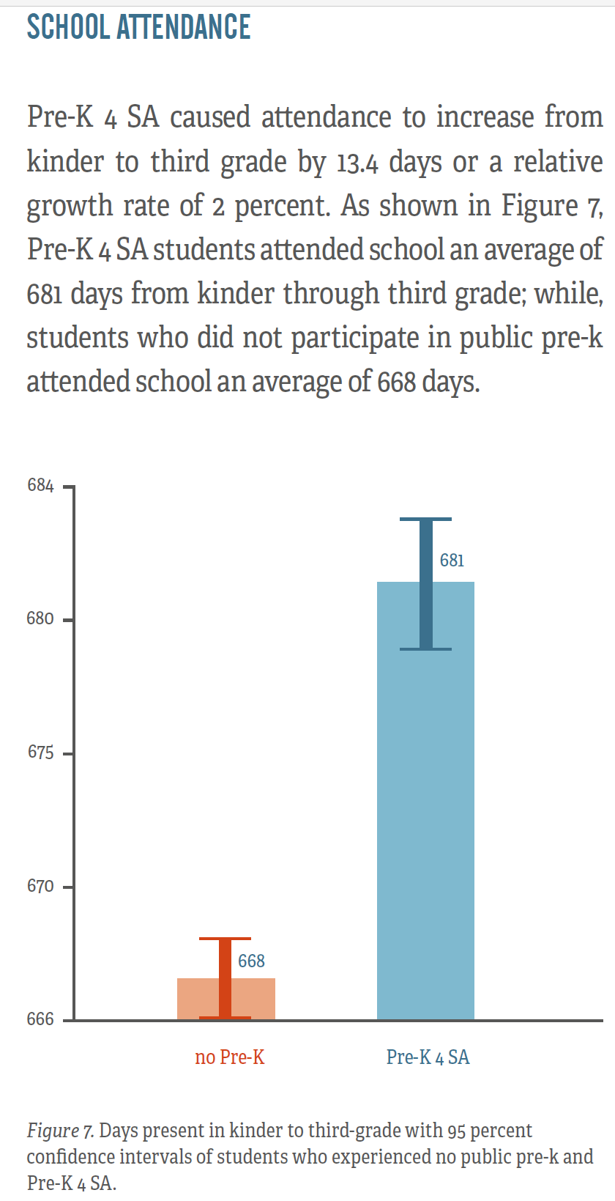

Slide 6
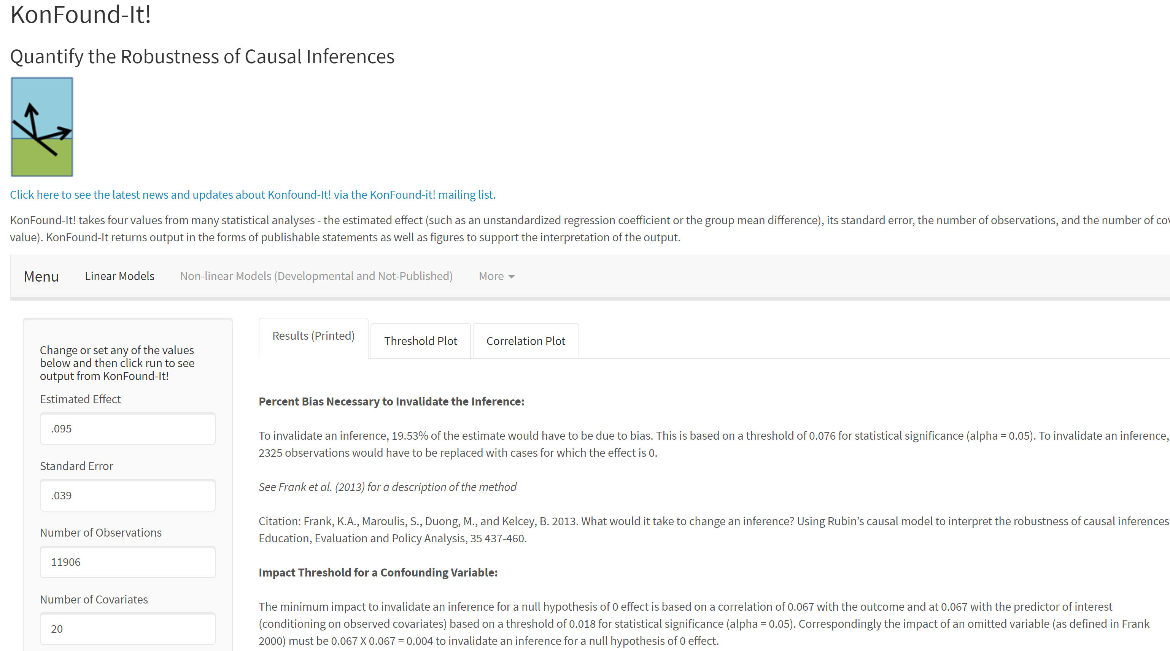
Effect of prekindergarten on math
To invalidate an inference, 19.53% of the estimate would have to be due to bias. This is based on a threshold of 0.076 for statistical significance (alpha = 0.05). To invalidate an inference, 2325 observations would have to be replaced with cases for which the effect is 0.
Run

Slide 7
% bias to invalidate
19.5%
26%
80%
11%
2%
25%*

Slide 8
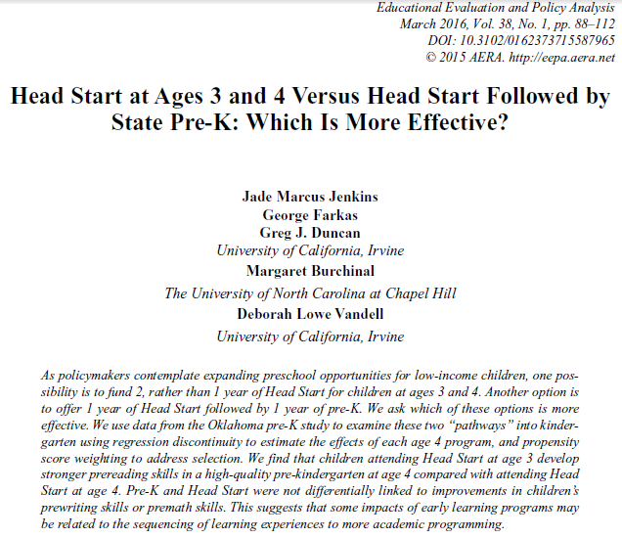

Slide 9
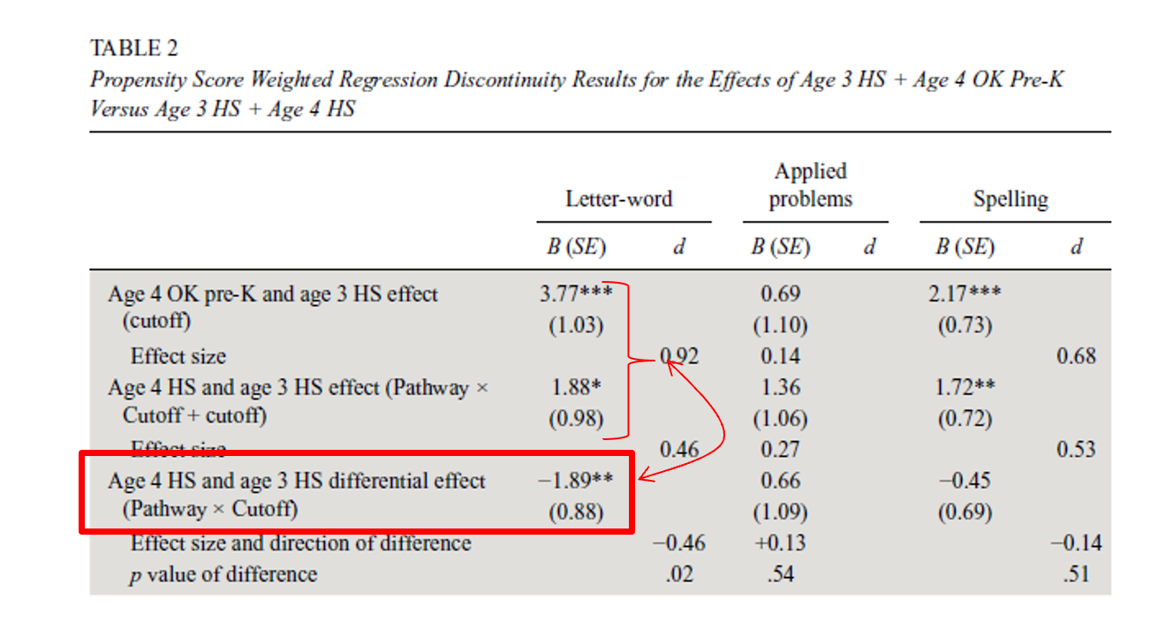
Quantifying the Robustness: Head start year 4 vs public year 4

Slide 11
In R Shiny app KonFound-it! (konfound-it.com/)
Estimated effect
Standard error
Number of observations
Number of covariates

Slide 12
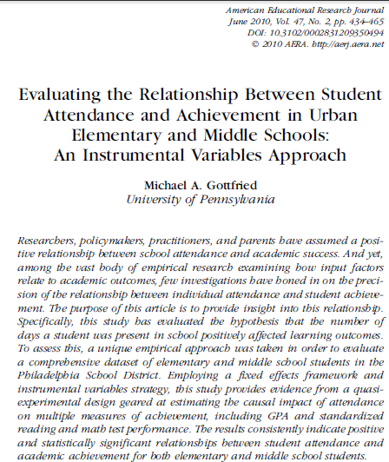

Slide 13
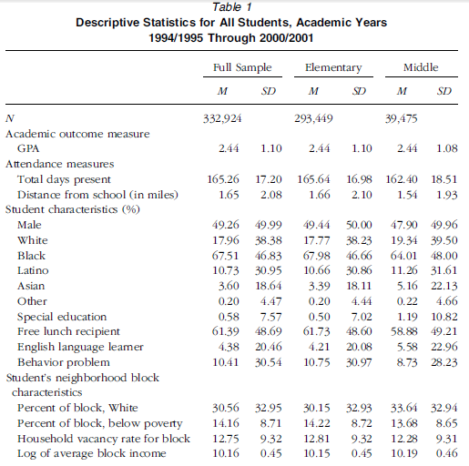
Quantifying the Robustness: Days present on GPA: Descriptives
Used for correlational framework

Slide 14
Quantifying the Robustness: Days present on GPA: Inputs
OLS includes Value added in Table 4
R²=.37 (Table 4)
N=18,830 (Table 4)
# of Covariates=
10 in model+
5 for years + 222 for schools=237

Slide 15
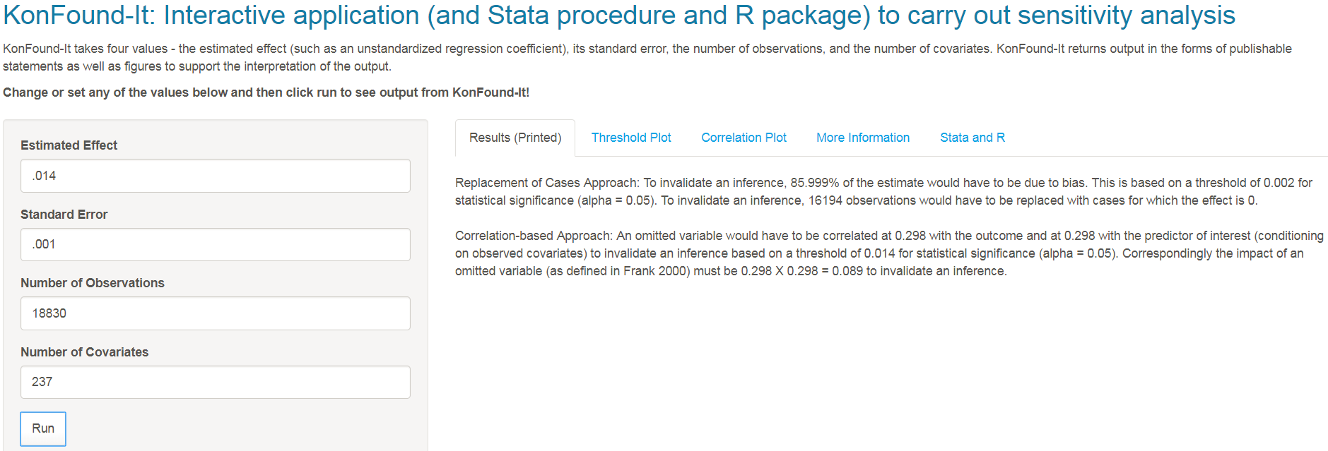
In R Shiny app KonFound-it! (konfound-it.com/)
Estimated effect
Standard error
Number of observations
Number of covariates

Slide 16
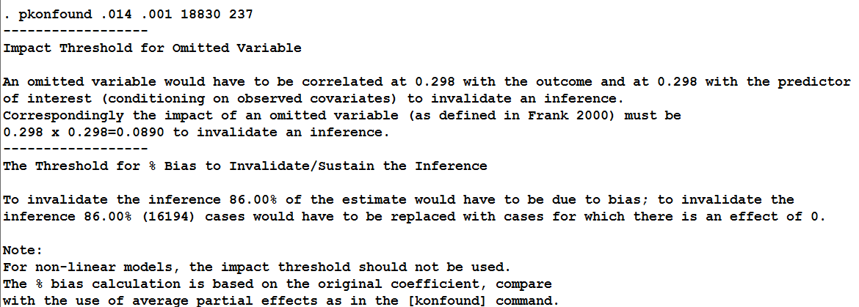

Slide 17
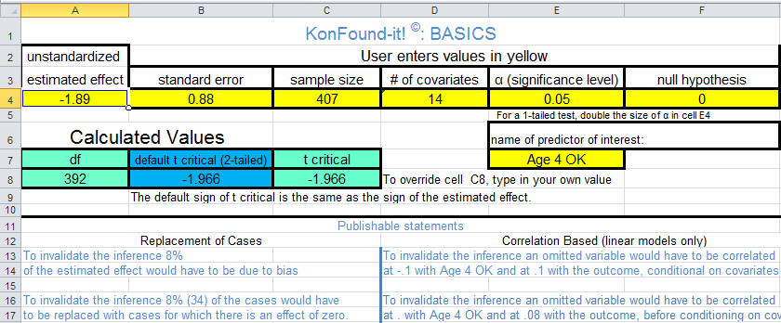
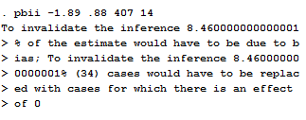
Quantifying the Robustness: Head start year 4 vs public year 4 KonFound-it!

Slide 18
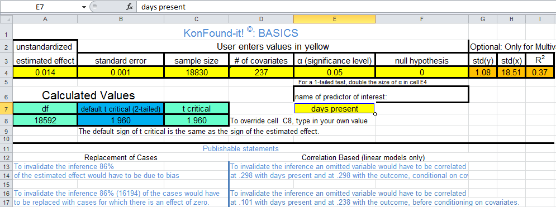
Quantifying the Robustness: Days present on GPA: KonFound-it!

Slide 19
Example of Internal Validity from Observational Study : The Effect of Kindergarten Retention on Reading and Math Achievement (Hong and Raudenbush 2005)
1. What is the average effect of kindergarten retention policy? (Example used here)
Should we expect to see a change in children’s average learning outcomes if a school changes its retention policy?
Propensity based questions (not explored here)
2. What is the average impact of a school’s retention policy on children who would be promoted if the policy were adopted?
Use principal stratification.
Hong, G. and Raudenbush, S. (2005). Effects of Kindergarten Retention Policy on Children’s Cognitive Growth in Reading and Mathematics. Educational Evaluation and Policy Analysis. Vol. 27, No. 3, pp. 205–224
Notes:
Hong, G. and Raudenbush, S. (2005). Effects of Kindergarten Retention Policy on Children’s Cognitive Growth in Reading and Mathematics. Educational Evaluation and Policy Analysis. Vol. 27, No. 3, pp. 205–224
See page 208.

Slide 20
Data
Early Childhood Longitudinal Study Kindergarten cohort (ECLSK)
US National Center for Education Statistics (NCES).
Nationally representative
Kindergarten and 1st grade
observed Fall 1998, Spring 1998, Spring 1999
Student
background and educational experiences
Math and reading achievement (dependent variable)
experience in class
Parenting information and style
Teacher assessment of student
School conditions
Analytic sample (1,080 schools that do retain some children)
471 kindergarten retainees
10,255 promoted students

Slide 21
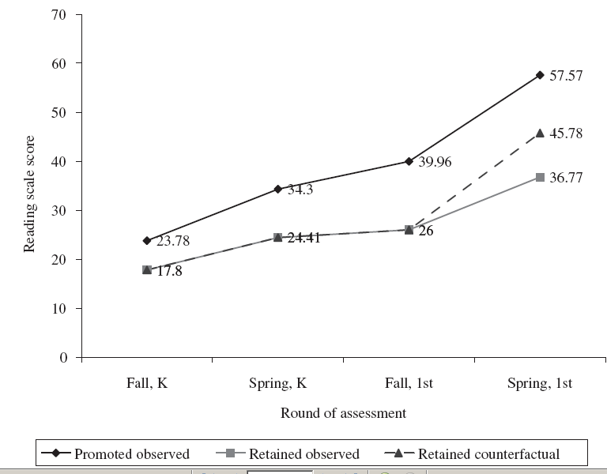
Effect of Retention on Reading Scores (Hong and Raudenbush)

Slide 22
Possible Confounding Variables (note they controlled for these)
Gender
Two Parent Household
Poverty
Mother’s level of Education (especially relevant for reading achievement)
Extensive pretests
measured in the Spring of 1999 (at the beginning of the second year of school)
standardized measures of reading ability, math ability, and general knowledge;
indirect assessments of literature, math and general knowledge that include aspects of a child’s process as well as product;
teacher’s rating of the child’s skills in language, math, and science

Slide 23
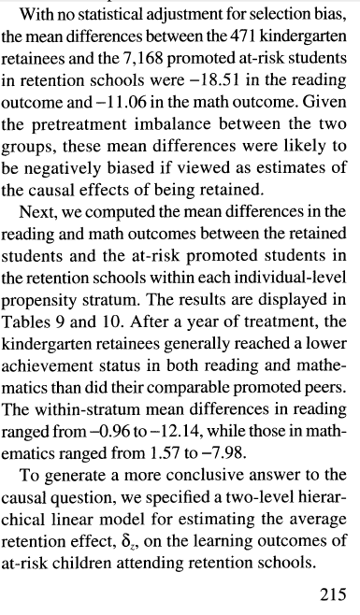
Obtain t critical, estimated effect and standard error
Estimated effect
( ) = -9.01
Standard
error=.68
n=7168+471=7639;
df > 500,
t _{critical}=-1.96
From: Hong, G. and Raudenbush, S. (2005). Effects of Kindergarten Retention Policy on Children’s Cognitive Growth in Reading and Mathematics. Educational Evaluation and Policy Analysis. Vol. 27, No. 3, pp. 205–224

Slide 24
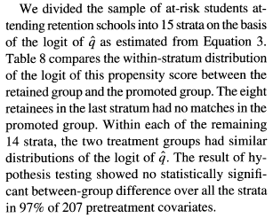
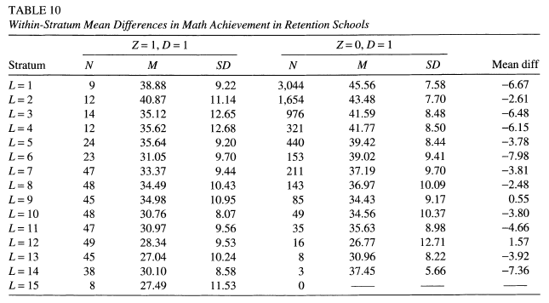
covariates
Page 215
Df used in model=207+14+2=223
Add 2 to include the intercept and retention

Slide 25
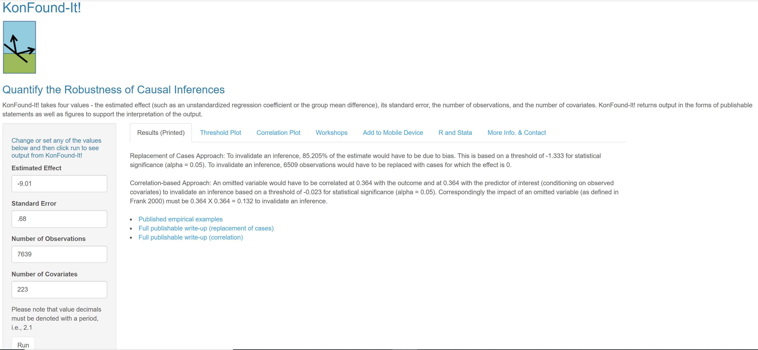
In R Shiny app KonFound-it! (konfound-it.com/)
Take out your phone and try it!!!

Slide 26
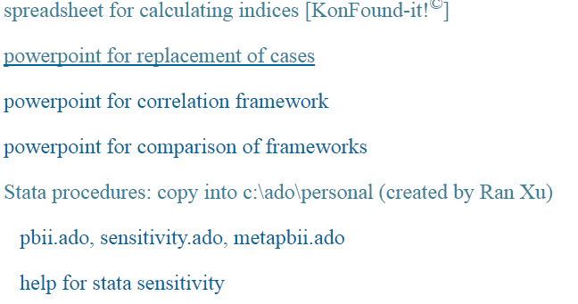
Calculating the % Bias to Invalidate the Inference: Obtain spreadsheet
https://www.msu.edu/~kenfrank/research.htm#causal
spreadsheet for calculating indices [KonFound-it!©]

Slide 27
Kon-Found-it: Basics

Slide 28
Kon-Found-it: Basics % Bias to Invalidate
Estimated effect
( ) = -9.01
Standard
error=.68
n=7168+471=7639
Covariates=223
Specific calculations

Slide 29
In stata
. ssc install konfound
. ssc install moss
. ssc install matsort
. ssc install indeplist

Slide 31
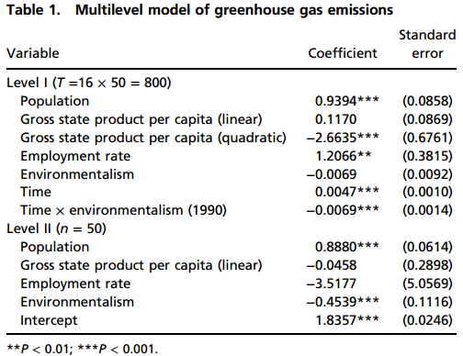
Main Table

Slide 32
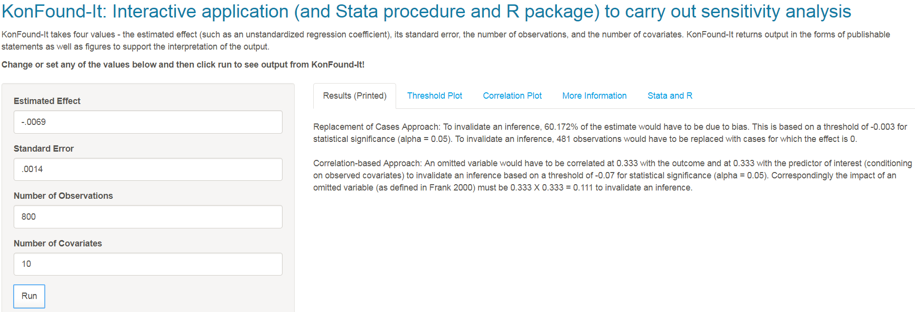
In R Shiny app KonFound-it! (konfound-it.com/)
Estimated effect
Standard error
Number of observations
Number of covariates

Slide 33
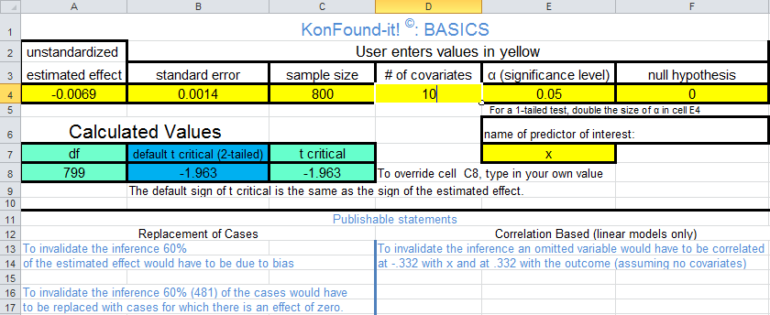
Quick Sensitivity Analysis
spreadsheet for calculating indices [KonFound-it!©]
STATA
. ssc install konfound
. ssc install moss
. ssc install matsort
. ssc install indeplist
pkonfound -.0069 .0014 800 10
The Threshold for % Bias to Invalidate/Sustain the Inference
To invalidate the inference 60.17% of the estimate would have to be due to bias; to invalidate the
inference 60.17% (481) cases would have to be replaced with cases for which there is an effect of 0.

Slide 34
Stata example

Slide 35
These are odds ratios,
need standard errors

Slide 37
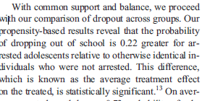
Juvenile Arrest and Collateral Education Damage
No standard errors for main effects.

Slide 38
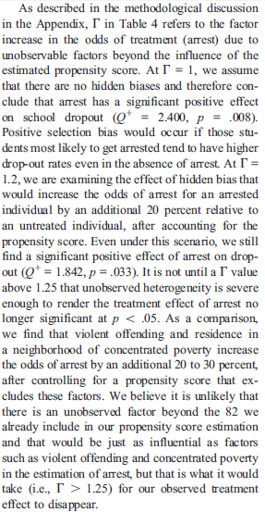
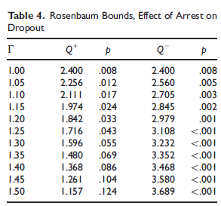
Rosenbaum Bounds: Compare with Correlational Framework

Slide 39
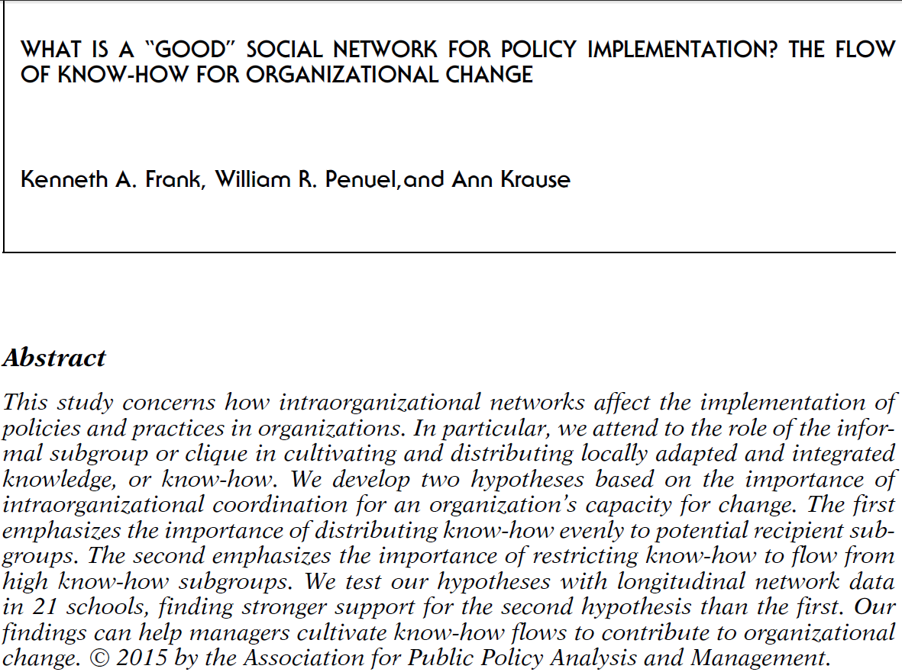
Frank, K.A., Penuel, W.R., Krause, A (2015). What is a “Good” Social Network for Policy Implementation?: The Flow of Know-How for Organizational Change. Journal of Policy Analysis and Management. Early view: http://onlinelibrary.wiley.com/doi/10.1002/pam.21817/abstract

Slide 40
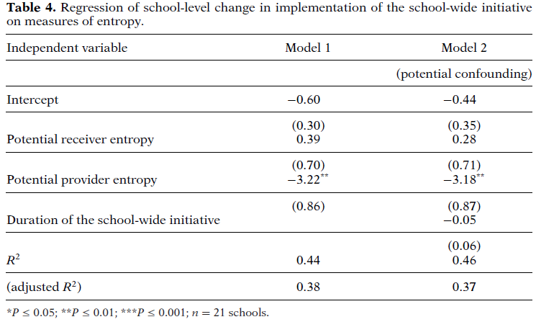
Quantifying What it Would take to Invalidate and Inference: What is a Good Network?: Results

Slide 41
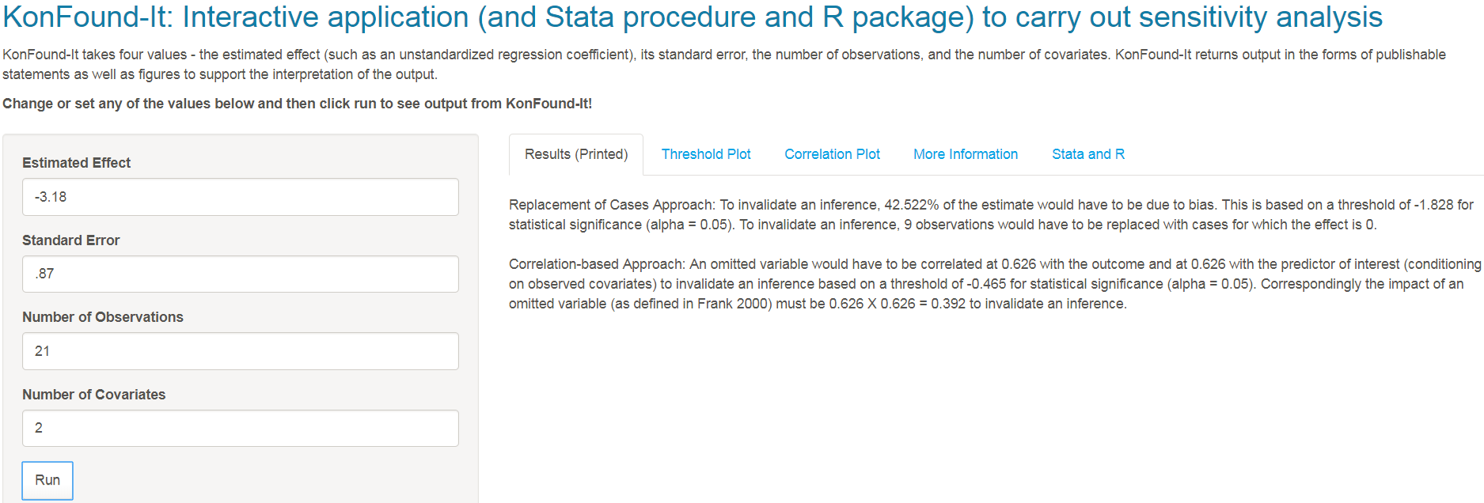
In R Shiny app KonFound-it! (konfound-it.com/)
Estimated effect
Standard error
Number of observations
Number of covariates

Slide 42
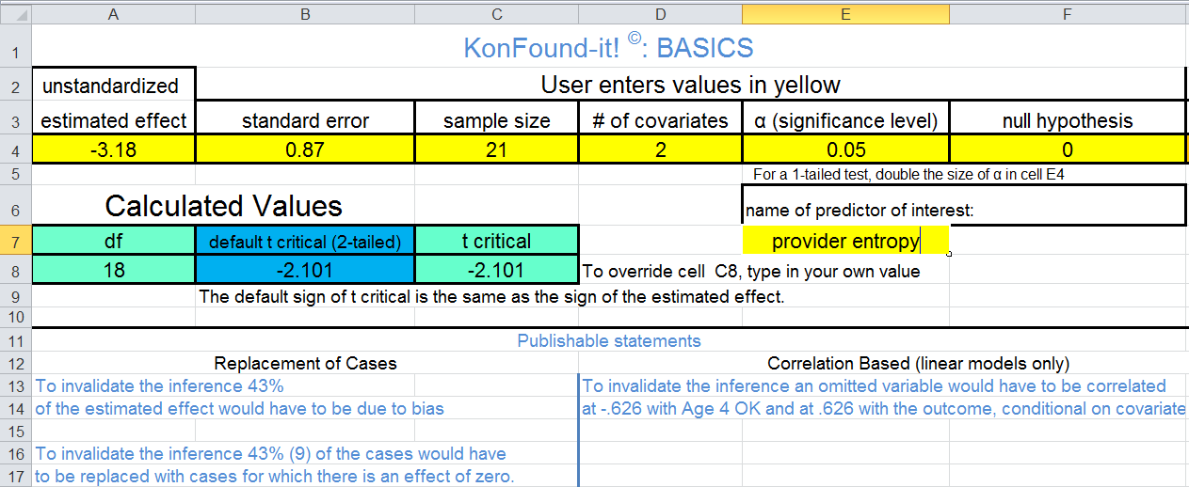
Quantifying What it Would take to Invalidate and Inference: What is a Good Network?: KonFound-it!

Slide 43
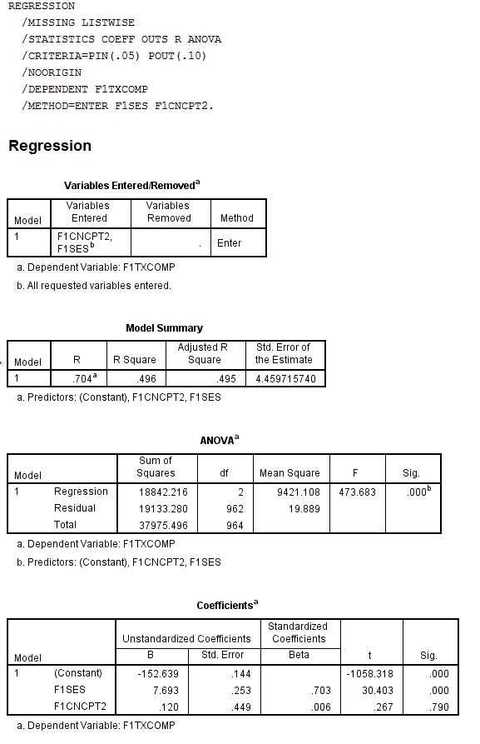
Regression: Achievement = self concept + ses
spreadsheet for calculating indices [KonFound-it!©]

Slide 44
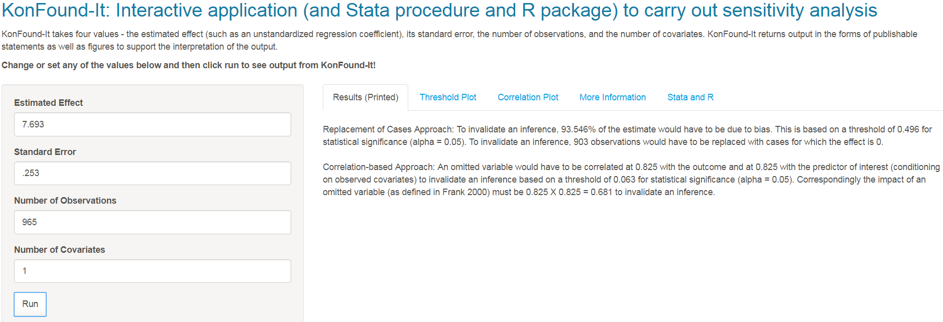
In R Shiny app KonFound-it! (konfound-it.com/)
Estimated effect
Standard error
Number of observations
Number of covariates

Slide 45
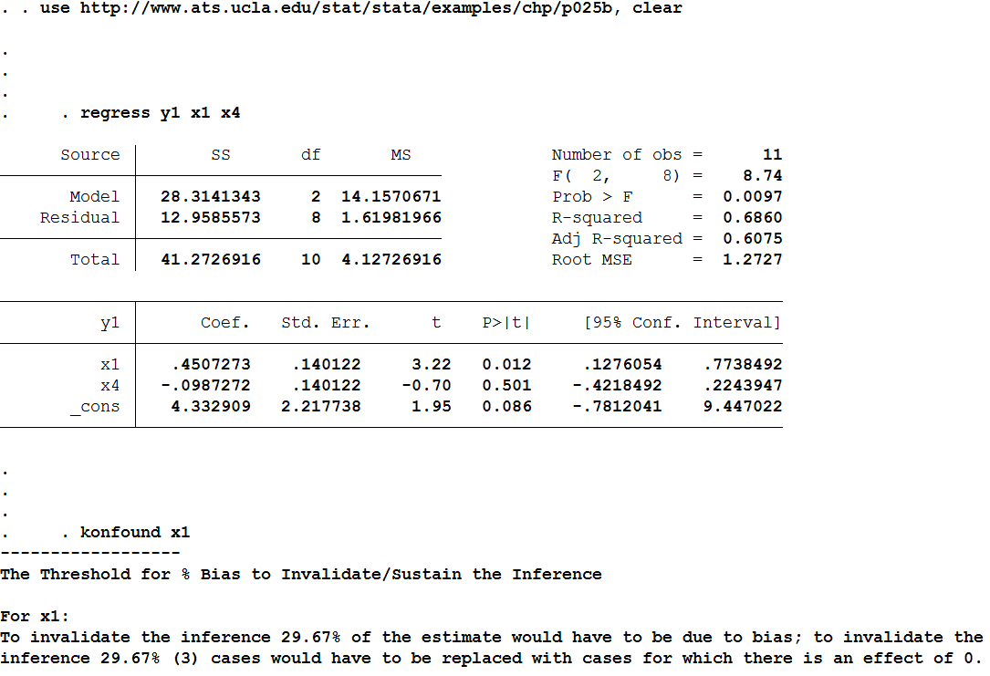
Sensitivity on Regression Run in Stata
. use http://www.ats.ucla.edu/stat/stata/examples/chp/p025b, clear
. regress y1 x1 x4
. konfound x1

Slide 46
Exercise 1 : % Bias necessary to Invalidate an Inference for Internal Validity
Take an example from an observational study in your own data or an article
Calculate the % bias necessary to invalidate the inference
Interpret the % bias in terms of sample replacement
What are the possible sources of bias?
Would they all work in the same direction?
What happens if you change the
sample size
standard error
degrees of freedom
Debate your inference with a partner

Slide 47
The debate
You say: I infer X has an effect on Y
They say: you did this from a regression. Regression is not a strong basis for a causal inference.
You say: regression works if you have the right variables in the model, especially pretests
They say. Yes, but you may not have the right variables. You must do something fancier like propensity score matching or instrumental variables
You say: propensity scores are not better than the variables that go in them, and typically work no better than regression with pretests. Instrumental variables assume there is a variable that predicts the treatment but not directly the outcome, and that treatments can be strongly manipulated. Instead, lets talk about what it would take to change my inference…
Notes:
Quote from From page 5 of Morgan, Stephen L. and Christopher Winship. 2012. "Bringing Context and Variability Back in to Causal Analysis." Pp. 319-54 in Harold Kincaid, ed., Oxford Handbook of the Philosophy of Social Science. New York: Oxford University Press. See page 10 & 132 of morgan & winship, 2007.
Heckman, J. (2005). The Scientific Model of Causality. Sociological Methodology, 35, 1-99.
Morgan, S. L. & Harding, D. J. (2006). Matching estimators of causal effects: Prospects and pitfalls in theory and practice. Sociological Methods and Research 35, 3-60.
Rosenbaum, P. 2002. Observational Studies. New York: Springer.
(Shadish, Cook, & Campbell, 2002)
Shadish, W. R., Cook, T. D., & Campbell, D. T. (2002). Experimental and Quasi-Experimental Designs for Generalized Causal Inference. Boston, NY: Houghton Mifflin.

Slide 48
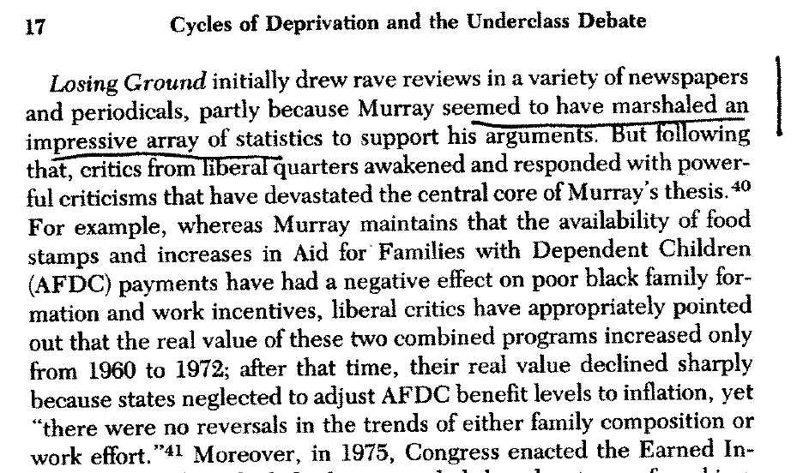
Direct, Quantitative Evidence Pushes Back on an Argument

Slide 49
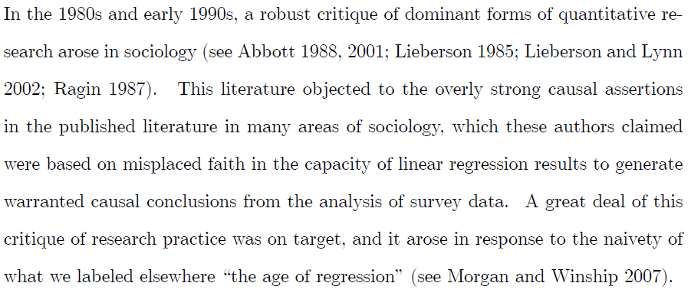
Pretests are Counterpoint to Morgan and Winship
From page 5 of Morgan, Stephen L. and Christopher Winship. 2012. "Bringing Context and Variability Back in to Causal Analysis." Pp. 319-54 in Harold Kincaid, ed., Oxford Handbook of the Philosophy of Social Science. New York: Oxford University Press.
See page 10 & 132 of morgan & winship, 2007.

Slide 50
When Regression Doesn’t Work
Instrumental variables?
Alternative assumptions, may be not better
Exclusion restriction
Strong instrument
Large n
Propensity scores?
No better than the covariates that go into it
Heckman, 2005; Morgan & Harding, 2006, page 40; Rosenbaum, 2002, page 297; Shadish et al., 2002, page 164);
How could they be better than covariates?
Propensity=f(covariates).
Paul Holland says:
PAUL ROSENBAUM
Notes:
Heckman, J. (2005). The Scientific Model of Causality. Sociological Methodology, 35, 1-99.
Morgan, S. L. & Harding, D. J. (2006). Matching estimators of causal effects: Prospects and pitfalls in theory and practice. Sociological Methods and Research 35, 3-60.
Rosenbaum, P. 2002. Observational Studies. New York: Springer.
(Shadish, Cook, & Campbell, 2002)
Shadish, W. R., Cook, T. D., & Campbell, D. T. (2002). Experimental and Quasi-Experimental Designs for Generalized Causal Inference. Boston, NY: Houghton Mifflin.

Slide 51
Use of Sensitivity Analysis
Second most frequently cited paper from EEPA from 2013:
Frank, K.A., Maroulis, S., Duong, M., and Kelcey, B. 2013. What would it take to Change an Inference?: Using Rubin’s Causal Model to Interpret the Robustness of Causal Inferences. Education, Evaluation and Policy Analysis. Vol 35: 437-460. http://epa.sagepub.com/content/early/recent
Cited more than 200 times (sociology, accounting, finance, education)
Frank, K. 2000. "Impact of a Confounding Variable on the Inference of a Regression Coefficient." Sociological Methods and Research, 29(2), 147-194

Slide 52
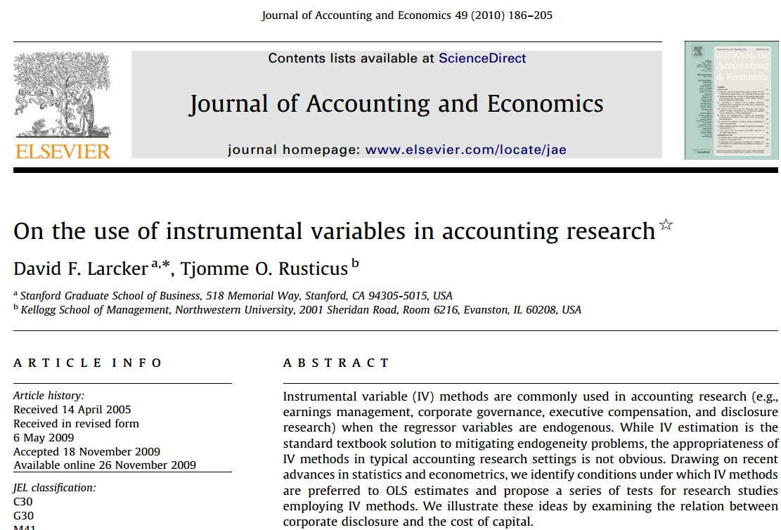

Slide 53
