Slide 1

Using Student-Level Social and Emotional Learning Data to Develop a “Loved, Challenged, and Prepared” Measure
Delaware ● District of Columbia ● Maryland ● New Jersey ● Pennsylvania
SREE: March 13, 2020
Tim Kautz, Mathematica
Kathleen Feeney, Mathematica

Slide 2
Project purpose and partnership with the District of Columbia Public Schools (DCPS)

Slide 3
Why care about social and emotional learning (SEL) competencies?
They rival academic achievement in predicting success for many life outcomes.¹
They appear to be malleable in grades K to 12 and can be improved through interventions.²
They are key outcomes of DCPS’s current strategic priority to “educate the whole child.”³
Source: DCPS, 2017.
¹ Heckman & Kautz, 2012. ² Kautz et al., 2014. ³ DCPS, 2017.
Notes:
Social and emotional learning competencies, such as perseverance, self-management, and self-efficacy, are related to success both inside and outside of school. For many important life outcomes, such as educational attainment, health, earnings, and employment, the predictive power of SEL competencies is similar to or higher than that of available measures of cognitive skills.
Luckily, these competencies appear to be malleable during the K-12 years, and can be developed through interventions
Inspired by this type of evidence, the DC Public Schools Strategic Plan for 2017-2022 highlights SEL readiness and competencies as key outcomes of their strategic priority to “educate the whole child”
One of the ambitious goals outlined in the plan is the district wants 100 percent of students to feel loved, challenged, and prepared

Slide 4
Tracking progress toward strategic goals
DCPS administered a new district-wide survey to measure SEL competencies.¹
  But little formal guidance exists on how districts can use data to inform policies and practices.
DCPS wants to know how it could best use the data to do the following:
  Identify students who need additional supports.
  Track progress in students, schools, and the district as a whole.
  Evaluate SEL-related practices and programs.
¹ The survey was developed by Panorama Education.
Notes:
Competencies included perseverance, self-management, self-efficacy, rigorous expectations, sense of belonging

Slide 5
Primary goal of the project and partnership
Develop an index of the extent to which students feel “loved, challenged, and prepared” (LCP)
DCPS partnered with Mathematica through a Regional Educational Laboratory Mid-Atlantic coaching task to explore the properties of the district’s survey data.
Index priorities
  Useful: DCPS will understand how to use the index to track progress now and in the future.
  Transparent: DCPS can provide clear information to stakeholders.
Notes:
Involving DCPS in all conversations about our business rules to make sure the Index was useful and transparent to stakeholders
Provide code on our processes and reasoning behind the steps we recommended or considerations taken to build DCPS’s capacity

Slide 6
Research questions
Is the survey reliable and valid for DCPS students?
What business rules should we use to construct an index that is transparent and captures DCPS’s constructs of LCP?
How sensitive is the index to decisions about the rules?

Slide 7
Survey administered to DCPS students in grades 3 to 12
It covered SEL competencies (for example, perseverance) and SEL supports (for example, rigorous expectations).
It asked students the extent to which they agree to questions such as the following:
“If you fail at an important goal, how likely are you to try again?”
The response rate was 72 percent (n = 20,030).¹
Complementary teacher and parent surveys were also administered but not used for building the index.
Not at all likely | Slightly likely | Somewhat likely | Quite likely | Extremely likely
¹ DCPS, 2018b.
Notes:
Paper and web versions administered during the school day
Will discuss topics more in-depth later

Slide 8
Methods and findings

Slide 9
Step 1: Validate the survey
Validation helps ensure that the survey items are appropriate for inclusion in summary measures.
Though Panorama analyzed validity of their surveys, additional analyses helped ensure that the survey is valid for DCPS’s students.
  DCPS modified the original survey.
  DCPS students might differ from students in previous validation analyses.
Notes:
-As a first step, the team wanted to confirm the reliability and validity of the survey
-Although Panorama has validated the survey in the past, it was important to explore the psychometric properties for this use, because DCPS updated the survey and the population differed relative to the original validation analyses.

Slide 10
Summary of validation exercise
Statistic | Criterion | DCPS’s results | Panorama validation
Cronbach’s alpha | > 0.70 (Bland & Altman, 1997) | > 0.73 for all scales | > 0.68 for all scales
Root mean square error of approximation | < 0.05 (Browne & Cudeck, 1992) | 0.04 | Model “fit well” for all scales
Comparative fit index | > 0.90 (Brown, 2015; Bentler, 1990) | 0.92 | Model “fit well” for all scales
Tucker-Lewis index | > 0.90 (Brown, 2015; Bentler, 1990) | 0.90 | Not reported
Factor loading for each item | > 0.40 (Stevens, 2012) | > 0.40 for all items | Not reported
Notes:
-The initial survey scales met all criteria without additional revisions
- Panorama’s validation efforts found an average Cronbach’s alpha of .78, and a minimum of .68 (source: https://panorama-www.s3.amazonaws.com/files/sel/SEL-Validity-Report.pdf)

Slide 11
Step 2: Approach to mapping survey topics to LCP components
Topic | LCP alignment
Sense of belonging (e.g., connections to adults at school and respect from other students) | I feel loved
Rigorous expectations (e.g., teacher expectations and encouragement) | I feel challenged
Perseverance (e.g., focusing on a goal and overcoming problems when reaching a goal) | I feel prepared
Self-management (e.g., follow directions in class and not waiting until the last minute to do work) | I feel prepared
Self-efficacy (e.g., confidence in ability to understand concepts and complete assigned work) | I feel prepared
Notes:
Examined theoretical mapping between measures and topics
Considered literature on SEL skills
Consulted experts in the field

Slide 12
Step 3: Developing business rules for creating the LCP index
Calculate average response within each component.
For each component (separately), determine whether the component exceeds 3.5, which represents a positive outcome.
Define a student to be LCP if they have positive outcomes for each component.
Average across students to determine the district-level LCP index.
Key consideration: Defining the overall LCP index using separate indices makes it possible to consider each separately and helps identify high priority areas for improvement.
Notes:
-A set of business rules is needed to specify how the LCP Index will be created, in order to address issues of validity and reliability and to provide a blueprint for creating an index consistently over time so trends and progress can be measured.
-The team specified an initial set of business rules that would meet face validity considerations and be interpretable to stakeholders
-Confirmed those rules by conducting additional analyses

Slide 13
Step 4: Providing evidence to inform key decisions

Slide 14
How do we weight aspects of preparedness?
Question: Should the three component scales in the Preparedness Index (perseverance, self-management, and self-efficacy) be weighted differently?
Are the components equally important?
Evidence:
Survey data: Contemporaneous correlations between scales and student outcomes showed that self-management and self-efficacy were better predictors than perseverance.
Literature: Perseverance is the best predictor of long-term outcomes.
Decision: Weight each component equally.
Notes:
-Our earlier steps allowed us to map each survey scale to a component of the LCP index. However, three survey scales mapped to Preparedness, begging the question of how to weight each of these three scales.

Slide 15
How do we account for nonresponse bias?
Question: Should the district-level index include nonresponse weights?
The usefulness of the LCP index depends on whether it represents all students.
If only a select type of student responds, the resulting LCP index could be misleading.
Evidence: Examine sensitivity of results to nonresponse
Some evidence of differential response rates
Overall index is not sensitive to using weights
Limited low-effort responses
Decision: Weight all respondents equally
Increased transparency to stakeholders
Notes:
-Although the response rates on the student survey were relatively high, we considered how non-response bias could affect the index.

Slide 16
What we found

Slide 17
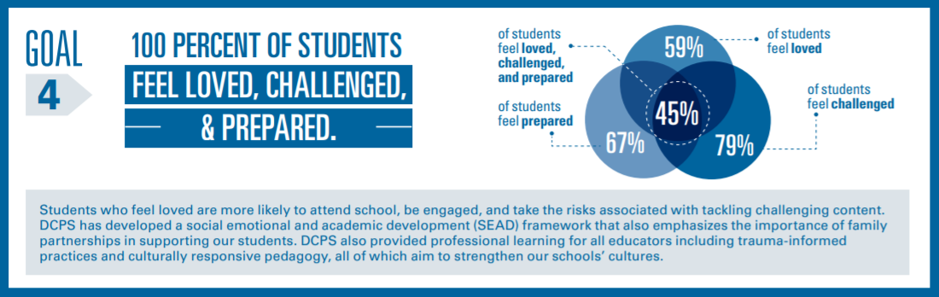
Results and DCPS’s dissemination
Source: DCPS, 2018a.
Notes:
We were successful in creating a valid index
Shown here is how DCPS disseminated the high level findings from the LCP index for 2018, and they released similar results for the spring 2019 survey data since we had coached them on the code

Slide 18
Complementary past and future activities
Previous coaching activities included the following:
  Exploring properties of the teacher survey
  Using natural language processing techniques to highlight themes in parent open-ended responses
A future study will explore other uses of the SEL data to support DCPS in tracking progress toward its 2022 strategic goals.
  It will study how SEL competencies predict key educational outcomes, such as grade transition and graduation.
  It will investigate the extent to which reports of SEL skills change across grades.
Notes:
The coaching model set us up to help DCPS explore other areas of interest

Slide 19
Contact information
Tim Kautz
TKautz@mathematica-mpr.com
Kathleen Feeney
KFeeney@mathematica-mpr.com

Slide 20
Disclaimer
This work was funded by the U.S. Department of Education’s Institute of Education Sciences (IES) under contract ED-IES-17-C-0006, with REL Mid-Atlantic, administered by Mathematica Policy Research. The content of the presentation does not necessarily reflect the views or policies of IES or the U.S. Department of Education, nor does mention of trade names, commercial products, or organizations imply endorsement by the U.S. government.

Slide 21

Questions?

Slide 22
References
Bentler, P. M. (1990). Comparative fit indexes in structural models. Psychological Bulletin, 107(2), 238–246.
Bland, J. M., & Altman, D. G. (1997). Cronbach’s alpha. BMJ, 314(7080), 572.
Brown, T. A. (2015). Confirmatory factor analysis for applied research. Guilford Publications.
Browne, M. W., & Cudeck, R. (1992). Alternative ways of assessing model fit. Sociological Methods Research, 21(2), 230–258.
District of Columbia Public Schools (DCPS). (2017). DCPS strategic plan – A capital commitment 2017-2022. https://dcps.dc.gov/sites/default/files/dc/sites/dcps/publication/attachments/DCPS%20Strategic%20Plan%20-%20A%20Capital%20Commitment%202017-2022-English_0.pdf
District of Columbia Public Schools (DCPS). (2018a). A capital commitment 2017-2022 – year 1 update. https://dcps.dc.gov/sites/default/files/dc/sites/dcps/publication/attachments/A%20Capital%20Commitment%202017-2022%20-%20Year%201%20Update.pdf
District of Columbia Public Schools (DCPS). (2018b). DCPS 2018 Panorama survey results. https://dcps.dc.gov/sites/default/files/dc/sites/dcps/page_content/attachments/2018PanoramaSurveyReport_0.pdf
Heckman, J. J., & Kautz, T. (2012). Hard evidence on soft skills. Labour Economics, 19(4), 451–464.
Kautz, T., Heckman, J. J., Diris, R., ter Weel, B., & Borghans, L. (2014). Fostering and measuring skills: Improving cognitive and non-cognitive skills to promote lifetime success (OECD Education Working Papers No. 110). OECD Publishing.
Stevens, J.P. (2012). Applied multivariate statistics for the social sciences (5th ed.). Routledge.

Slide 23
Appendix

Slide 24
Overview of the student topics used in building the index
Topic | # of items
 | Grades 3 to 5 | Grades 6 to 12
Sense of belonging* - connections to adults at school and respect from other students | 4 | 5
Rigorous expectations* - teacher expectations and encouragement | 5 | 5
Perseverance - focusing on a goal and overcoming problems when reaching a goal | 4 | 5
Self-management - follow directions in class and not waiting until the last minute to do work | 5 | 5
Self-efficacy - confidence in ability to understand concepts and complete assigned work | 5 | 5
Notes:
Covered SEL competencies and SEL supports and environments (* = non-SEL)
Some items for grades 3-5 were edited for reading level

Slide 25
Steps for validating survey
Prespecify validity criteria.
Calculate Cronbach’s alpha (a measure of reliability) and conduct analyses to estimate the number of underlying factors per scale.
  Ensure that each scale reliably captures a single factor.
Conduct an initial confirmatory factor analysis.
  Assess overall fit.
  Investigate whether scales capture distinct factors.
Revise scales as needed based on results.
Confirm that final scales meet prespecified criteria.
  Distinct factors (discriminant validity)
Notes:
-The team followed a series of prespecified steps to validate the student survey.

Slide 26
How do we adjust the index for low-effort respondents?
Question: How do we identify low-effort respondents and their resulting impact or bias on the results?
Straightlining
Rapid completion
Evidence: Examine straightlining patterns.
The overall index is not sensitive to excluding them (difference is 0.4 out of 100).
Decision: Include students who straightline in the index.
Some students might be providing sincere responses.
Notes:
-We also explored the possibility that some students exhibited low-effort, thereby making their responses invalid. We developed a set of rules for identifying such respondents and determined that they did not comprise a large proportion of the student population.

Slide 27
Research Partnerships on Using Kindergarten Entry Assessments to Track City Progress in Promoting Reading Proficiency
Delaware ● District of Columbia ● Maryland ● New Jersey ● Pennsylvania
SREE: March 13, 2020
Jessica F. Harding, Mathematica
Mariesa Herrmann, Mathematica
Kristyn Stewart, School District of Philadelphia
Katherine Mosher, School District of Philadelphia
Elias Hanno, Burning Glass Technologies
Christine Ross, Mathematica

Slide 28

Purpose of the project
To help the School District of Philadelphia (SDP) track the progress of entering kindergarteners in reading proficiently by the end of grade 3
Kindergarten entry assessments have informed policymakers’ decisions about early learning systems and identified children’s skills to guide teaching (Regenstein et al., 2017).¹
This project addresses a high-leverage need for using kindergarten entry assessments to track progress for later reading proficiency.
Our partnership included the following:
  Research to help select a threshold on Pennsylvania’s Kindergarten Entry Inventory (KEI) for measuring whether kindergarteners are on track for reading proficiency in grade 3
  Coaching the district on selecting a threshold and providing code
¹ Regenstein, E., Connors, M., Romero-Jurado, R. I. O., & Weiner, J. (2017). Uses and misuses of kindergarten readiness assessment results. Chicago: The Ounce of Prevention Fund.
Notes:
Kindergarten entry assessments have the potential to be important measures of children’s outcomes because they are often the first state-wide data collection of young children’s skills
Kindergarten entry assessments have been used to inform policymakers’ decisions about early learning systems and to identify children’s skills to guide teaching.
This paper presents another potential use for kindergarten entry assessments.
The early learning department of the School district of Philadelphia wanted to track progress towards increasing the percentage of students who can read on grade level in grade 3, but they would have to wait a long time to figure out if they were making progress. So, SDP wanted to identify an indicator based on the Pennsylvania Kindergarten Entry Inventory (which I will call the KEI), the first assessment given to students, to track the percentage of entering kindergarteners on track to be proficient.

Slide 29
Research questions
Primary:
What is the relationship between scores on the KEI and the grade 3 Pennsylvania System of School Assessment (PSSA) in English language arts (ELA)?
What threshold score on the KEI most accurately predicts ELA proficiency on the grade 3 PSSA for the cohort?
  What threshold score on the KEI has a prediction rate of at least 90 percent for the individual students who were not proficient on the PSSA?
Exploratory:
How do AIMSweb Reading scores in the spring of kindergarten to grade 3 relate to scores on the KEI and grade 3 PSSA in ELA? 3 PSSA scores?

Slide 30
Data for children who entered kindergarten in 2014–2015
KEI dimension scores (Emerging Academic Competencies and Learning Engagement Competencies)
PSSA reading scores and proficiency level
Enrollment records on school, gender, race and ethnicity, free and reduced price lunch, Individualized Education Program, English learner students
AIMSweb assessment scores and performance tiers
Notes:
We have four sources of data from SDP.

Slide 31
Sample and methods
Sample of kindergartners with both KEI and PSSA scores needed for analysis
  58 percent of kindergarteners had KEI scores
  65 percent of kindergarteners with KEI scores also had PSSA scores
Weights were developed to make the sample with KEI and PSSA scores similar to the sample with KEI scores
Data randomly split into two samples for analyses:
  Sample used to select threshold
  Sample used to test threshold
RQ3: Predict proficiency
Notes:
To be included in analysis, students have to have both the KEI and PSSA scores. Ideally we would have KEI and PSSA scores for all students, and the closer we are to that, the more likely our sample is representative of the population of interest. However, only about 58% of kindergarteners had KEI scores; this was the first year of administration for the KEI in Philadelphia, so some teachers may not have administered the assessment. Only 65% of those with KEI scores also had PSSA scores; children may not have PSSA scores because they leave the district, enroll in charter schools, or are absent on the day of the assessment.
Moving forward, SDP will apply the threshold to students who have KEI scores to determine the proportion predicted to be proficient. We used weights to make the analysis sample similar to students with KEI scores based on demographic characteristics and KEI scores.
It is common for predictive type analyses to use one subset of data to select a predictive threshold and to use the other subset of data to test the threshold because it helps check that results aren’t unique to the sample that was used.
Any questions about the sample?

Slide 32
Results: Research question 1
EAC received greater weight in an index based on the two dimensions
What is the relationship between scores on the KEI and the grade 3 PSSA in ELA?
 | Findings from logistic regression that includes both dimensions
KEI dimensions | Coefficients | Average marginal effects
Emerging Academic Competencies (EAC) | 1.147*** | 0.24***
Learning Engagement Competencies (LEC) | 0.108 | 0.02
Statistical significance level: *** < .001 Number of students = 3,521
Notes:
Here, we predict PSSA proficiency based on both KEI dimensions. What we find is that only Emerging Academic competencies predicts PSSA proficiency when both dimensions are included together, this is likely because Emerging Academic Competencies includes literacy and math skills whereas Learning Engagement Competencies includes behavioral skills. The average marginal effects column means that for every 1-point increase in Emerging Academic Competencies, the probability of proficiency increases on average 24 percent and for every 1-point increase in Learning Engagement Competencies, the probability of proficiency increases 2 percent on average. The coefficients column shows the coefficients that we used to construct the index of both KEI dimensions, as some folks who were here for the first presentation might recall.

Slide 33
Results: Research question 2
EAC and index based on both EAC and LEC correctly predict proficiency for similar percentages of students
What threshold score on the KEI most accurately predicts reading proficiency on the grade 3 PSSA in ELA for the cohort?
Perfect prediction
Random Chance
Random chance
Notes:
We then assess how accurate the different models are in predicting students who are or who are not proficient. The diamond shapes shows perfect prediction – if we could accurately guess whether every student was proficient or not.
The black dashed line shows what we would get if we guessed randomly.
Each point on the lines shows the accuracy of predicting proficient and not proficient students for a certain threshold. By setting a low threshold, we could accurately predict 100% of the proficient students, but none of the not proficient students – there’s always a tradeoff between predicting proficient and not proficient students.
So, overlaying these curves for each model shows that LEC is slightly less accurate at predicting proficiency than EAC. It is further from perfect prediction and closer to random chance at all points.
In contrast, the EAC model (blue line) and the combined model (dashed line) are virtually identical in their predictive power at all different thresholds so there was no empirical basis to choose one or the other.

Slide 34
Results: Research question 2
Threshold of 6 accurately predicted the actual grade 3 proficiency rate of students
Performance of threshold of 6 on KEI index of two dimensions
Data | Actual proficiency (percentage) | Predicted proficiency (percentage) | Difference between actual and predicted proficiency (percentage points) | Number of students
Used to set the threshold (in-sample) | 37.2 | 36.6 | 0.6 | 3,521
Not used to set the threshold (out of sample) | 36.9 | 36.7 | 0.2 | 1,508
Notes:
We then selected a threshold that matched the actual percentage of children who were proficient to the predicted percentage who were proficient for the cohort of kindergarteners. 37 of the sample were proficient so we selected a threshold that meant 37 percent of students were above the threshold, and thus predicted to be proficient, matching the percentage who were actually proficient.
We used one set of data to develop the threshold and we then tested this in data that was not used to set the threshold. This provides the first test of whether the selected threshold is accurate in data that was not used to develop the threshold, which provides some indication of whether it can work in future cohorts of data. The threshold performed well in data that was not used to set the threshold – matching the 37 percent proficient rate.

Slide 35
Results: Research question 2
Threshold of 6 correctly predicted overall proficiency rate but made some errors in predictions for individual students
Notes: Data were aggregated to smooth out the distribution, so no data are displayed at exactly 1 or 10. Number of students = 3,521.

Slide 36
Results: Research question 2
Threshold of 7 made correct predictions for 91 percent of students who were not proficient but only 29 percent of proficient students
Number of students = 3,521
Note: Data were aggregated to smooth out the distribution, so no data are displayed at exactly 1 or 10.
Notes:
This graph shows the percentage of students on the y-axis and their KEI scores on the x-axis. Students shown in blue were proficient and students shown in orange were not proficient.
This shows what happens when we use the selected threshold of 6 to predict that everyone above that threshold was proficient. 37 percent of students were above the threshold, and thus predicted to be proficient (dark blue and light orange areas), matching the percentage who were actually proficient (light blue and dark blue areas).
However, the threshold was not that accurate at predicting individual student’s proficiency. The threshold selected to make predictions for the cohort of kindergarten students made correct predictions for 53 percent of proficient students and 73 percent of students who were not proficient.

Slide 37
Results: Research question 3
AIMSweb scores in later grades had higher correlations with PSSA scores in grade 3
How do AIMSweb Reading scores in the spring of kindergarten through grade 3 relate to children’s scores on the KEI and grade 3 PSSA in ELA?
Notes: Correlations for spring AIMSweb scores were not weighted. Number of students with KEI correlations = 5,321. Number of students with AIMSweb correlations = 3,697 to 5,266, depending on whether students had scores on the AIMSweb in the grade and the PSSA. Statistical significance levels: *** < .001.
Notes:
Talking points – show correlations between AIMSweb scores in each grade and PSSA scores in grade 3. Also looked at correlations between AIMSweb scores and KEI scores, but not showing here due to time constraints

Slide 38
Limitations
A sample with both KEI and PSSA scores might not represent the sample with KEI scores, even with weights.
KEI threshold might not yield the same predictive power when applied to future cohorts if assessments or demographics of cohorts change.
The study relies on the two validated dimensions of the KEI, but other KEI items or alternative assessments could have stronger relationships with PSSA proficiency.
Notes:
To account for students who were missing scores on the PSSA when calculating whether kindergarteners are on-track, the study reweighted the analyses based on students’ KEI scores and demographic characteristics. This assumes that students who were missing PSSA scores in grade 3 would have received the same scores as those with similar KEI scores and background characteristics in kindergarten. However, students who were missing PSSA scores in grade 3 might have had different scores than assumed. For example, students who moved out of SDP might have characteristics that were not measured in the data (such as family instability), which could reduce their achievement by grade 3. For students who were missing KEI scores, limited data (only background characteristics) were available for extrapolating their likely proficiency in reading in grade 3. Thus, the study’s main analyses did not make predictions for students who are missing KEI scores.
The threshold might or might not yield the same accuracy when predicting grade 3 reading proficiency of future cohorts of students in SDP, who may have more complete data on KEI scores and will take the PSSA in a different school year. The study also does not include students in Philadelphia charter and private schools, or students from other districts in Pennsylvania, so the accuracy of the threshold might also differ for these groups of students. Also, changes in KEI administration or instruction and supports for students between kindergarten and grade 3 could generate different relationships than those described.
Third, this study only analyzed the two dimensions of the Pennsylvania KEI— Emerging Academic Competencies and Learning Engagement Competencies—for which the study team received data. These dimensions were validated in a study of the KEI (Howard et al., 2017). However, it is possible that particular KEI items within these dimensions (for example, early reading skills in the Emerging Academic Competencies dimension) or items outside of these dimensions (for example, language comprehension skills) might have even stronger correlations with grade 3 PSSA scores. Alternative assessments, such as the fall kindergarten AIMSweb used by SDP or kindergarten entry assessments used by other states, might have different relationships with reading proficiency in grade 3.

Slide 39
Implications and next steps
KEI, particularly Emerging Academic Competencies, is related to PSSA:
  Possible to set a threshold that accurately predicts the cohort proficiency rate
  Different threshold might be more appropriate for identifying individual students who need supports
SDP plans to conduct additional analyses using data on more recent cohorts of kindergartners:
  Reassess the accuracy of or update the KEI threshold
  Assess the accuracy of thresholds on different measures
States or districts might be able to use kindergarten entry assessments to do the following:
  Track progress toward later reading proficiency across cohorts of kindergartners
  Target supports to schools and students at risk of not reading proficiently
Notes:
The KEI, particularly Emerging Academic Competencies is related to grade 3 proficiency
It is possible to set a threshold that accurately predicts the proficiency rate of the kindergarten cohort. SDP can use this cohort to track progress towards increasing school readiness among children rather than waiting until grade 3 to do this. For example, improvements in the percentage of children predicted to be proficient might reflect efforts of citywide investments in early childhood education from birth to age 5.
A different threshold could be used to identify 90% of those who were predicted to not be proficient.

Slide 40
For more information
Contact: JHarding@mathematica-mpr.com
Harding, J. F., Herrmann, M. A., Hanno, E. S., & Ross, C. (2019). Using kindergarten entry assessments to measure whether Philadelphia’s students are on-track for reading proficiently. Washington, DC: U.S. Department of Education, Institute of Education Sciences, National Center for Education Evaluation and Regional Assistance, Regional Educational Laboratory Mid-Atlantic.

Slide 41


Disclaimer
This work was funded by the U.S. Department of Education’s Institute of Education Sciences (IES) under contract ED-IES-17-C-0006, with REL Mid-Atlantic, administered by Mathematica. The content of the presentation does not necessarily reflect the views or policies of IES or the U.S. Department of Education, nor does mention of trade names, commercial products, or organizations imply endorsement by the U.S. government.
https://ies.ed.gov/ncee/edlabs/regions/midatlantic/

Slide 42

Questions?

Slide 43
Students’ characteristics differ slightly for those with and without KEI/PSSA data
Student characteristics | K enrollment sample | KEI sample | KEI and PSSA sample
Number of students | 9,317 | 5,398 | 3,521
Female | 48% | 48% | 49%
Non-Hispanic Black | 49% | 48% | 46%ª
Hispanic | 21% | 20% | 22%^{b}
Non-Hispanic White | 14% | 16%ª | 15%
Other race or ethnicity | 16% | 17% | 17%
Free or reduced-price lunch | 66% | 68% | 68%
English learner | 10% | 10% | 11%
Special education | 8% | 8% | 5%^{a, b}
EAC | - | 2.40 | 2.44^{b}
LEC | - | 2.52 | 2.55^{b}
ª Substantially different (> 0.05 SD) relative to K enrollment sample. ^{b} Substantially different (> 0.05 SD) relative to KEI sample.
Because SDP is interested in predicting proficiency for children enrolled in kindergarten, we weight the analysis samples to reflect the characteristics of the K enrollment sample.

Slide 44
Weights make samples more similar
Student characteristics | Unweighted K enrollment sample | Weighted KEI sample | Weighted KEI and PSSA sample
Number of students | 9,317 | 5,398 | 3,521
Female | 48% | 48% | 48%
Non-Hispanic Black | 49% | 48% | 48%
Hispanic | 21% | 20% | 20%
Non-Hispanic White | 14% | 16% | 16%
Other race or ethnicity | 16% | 17% | 16%
Free or reduced-price lunch | 66% | 68% | 68%
English learner | 10% | 10% | 10%
Special education | 8% | 8% | 8%
EAC | - | 2.40 | 2.40
LEC | - | 2.52 | 2.52
None of the differences relative to the kindergarten enrollment sample or relative to the KEI sample were substantially different (> 0.05 SD).

Slide 45
Results: Research question 3, robustness check
AIMSweb findings were similar among sample of students who had scores on all of the assessments
Spring AIMSweb
Notes: Correlations for AIMSweb scores were not weighted. Number of students = 2,359. Statistical significance levels: *** < .001.

Slide 46
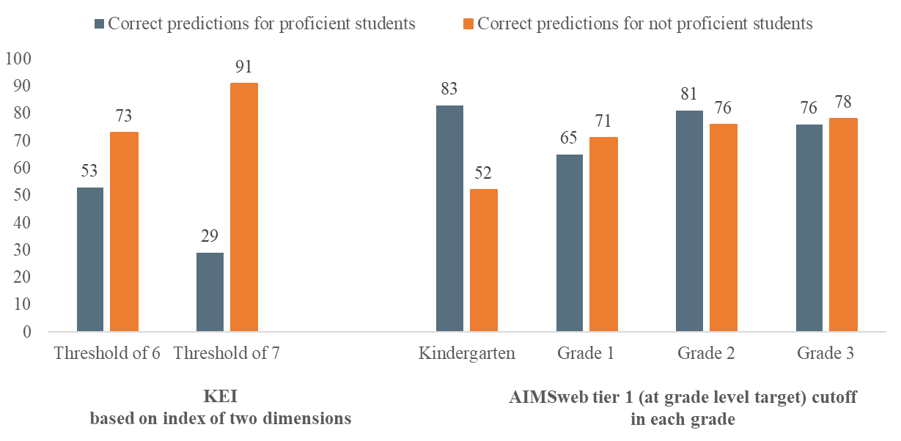
Results: Research question 3
AIMSweb tier 1 cutoff correctly predicted more than 52 percent of the students who were not proficient
Notes: Analyses for spring AIMSweb scores were not weighted. Number of students with KEI correlations = 5,321. Number of students with AIMSweb correlations = 3,697 to 5,266 depending on whether students had scores on the AIMSweb in the grade and the PSSA.

Slide 47
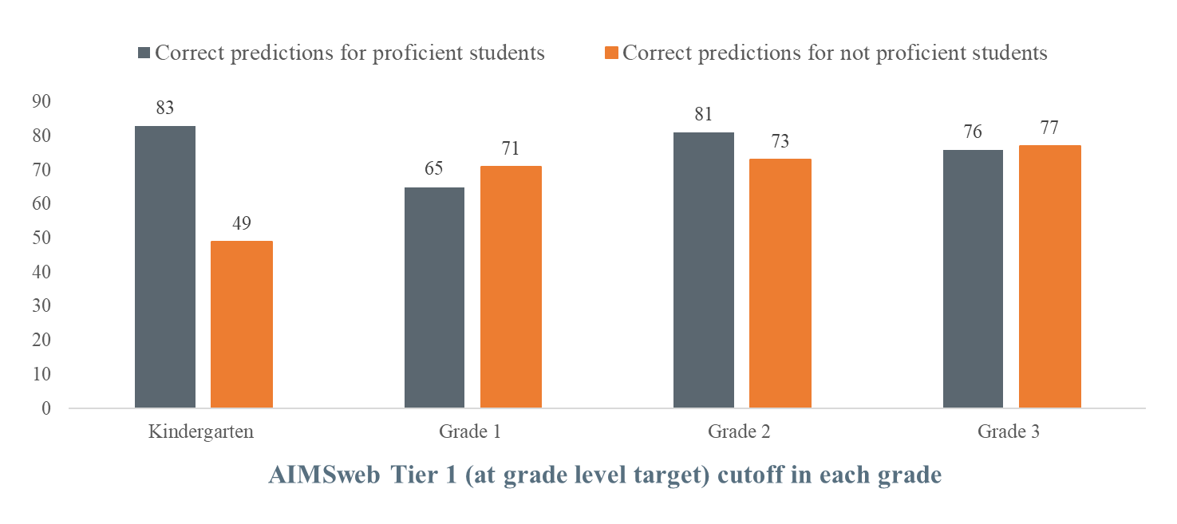
Results: Research question 3, robustness check
AIMSweb findings were similar among sample of students who had scores on all assessments
Notes: Analyses for spring AIMSweb scores were not weighted. N = 2,358.

Slide 48
Results: Research question 3, supplementary findings
AIMSweb tier 1 cutoff was less accurate than KEI threshold for predicting overall proficiency rate
Assessment and threshold | Actual proficiency (percentage) | Predicted proficiency (percent) | Absolute difference between actual and predicted proficiency (percentage points) | Number of students
KEI index threshold (fall of kindergarten)
6.00 | 37 | 37 | 1 | 3,521
7.00 | 37 | 17 | 21 | 3,521
AIMSweb tier 1 cutoff (spring of each grade)
Kindergarten | 37 | 61 | 23 | 4,696
Grade 1 AIMSweb tier 1 | 36 | 42 | 6 | 4,174
Grade 2 AIMSweb tier 1 | 37 | 45 | 8 | 5,027
Grade 3 AIMSweb tier 1 | 37 | 42 | 5 | 5,266
Notes: The difference between actual and predicted proficiency might not equal the difference between the actual and predicted proficiency because of rounding. Correlations for AIMSweb scores were not weighted.

Slide 49
Measuring School Performance for Early Elementary Grades in Maryland
Delaware ● District of Columbia ● Maryland ● New Jersey ● Pennsylvania
SREE: March 13, 2020
Dallas Dotter, Mathematica Lisa Dragoset, Mathematica Cassandra Baxter, Mathematica
Elias Walsh, Mathematica

Slide 50
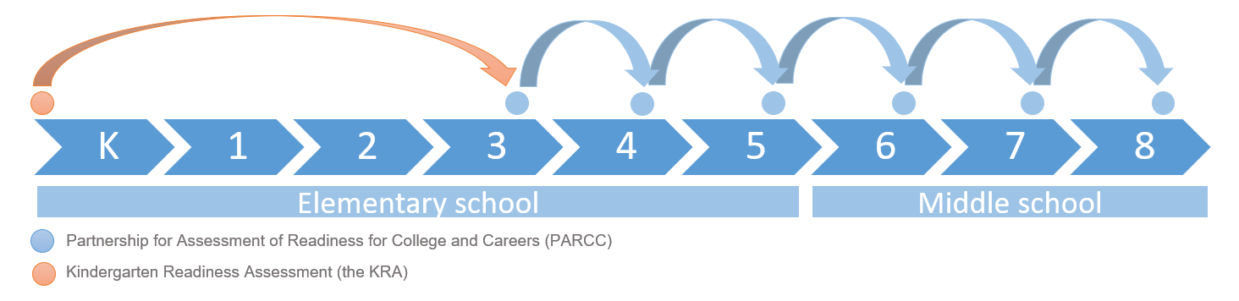
Why this study?
Maryland wanted to add academic growth in early grades to its accountability framework.
The Kindergarten Readiness Assessment (KRA) provides an opportunity to measure growth from kindergarten entry to the end of grade 3.
Maryland State Department of Education (MSDE) partnered with the REL to study the feasibility of measuring schools’ contributions to academic growth in reading and math from K to 3.
Notes:
Academic growth is one of many measures against which schools are evaluated for accountability purposes under ESSA.
But, it is a critical one: it accounts for one-quarter of a school’s accountability points (the largest of all measures)
Yet, Maryland lacks an academic growth measure for students from kindergarten to grade 3.
Maryland needs information about how schools are contributing to student academic growth in these critical early years.
Based on spring PARCC exams, Maryland currently measures schools’ contributions to student learning in grades 4 through 8.
In 2014, the KRA was administered to every kindergartener.
The first KRA cohort completed the grade 3 PARCC exams in 2017/18, presenting the first opportunity to measure K-3 growth (for students with a 2014/15 KRA score and a 2017/18 grade 3 PARCC score).

Slide 51



Study sample and student growth percentile (SGP) model
Students with valid 2014–2015 KRA scores and 2017–2018 grade 3 PARCC scores:
  54,393 for math and 54,397 for reading (86 percent of all students with a KRA score)
914 schools were used to explore the statistical properties of the estimates.
SGPs were estimated separately for grade 3 reading and math using scaled scores and aggregated to the school level by calculating the mean SGP.
  Students who transferred schools between K to 3 partially contribute to estimates for each school attended
  Estimates account for KRA measurement error (ranked SIMEX method)
Notes:
Students. Excluded students with non-normal grade progression and students with significant cognitive disabilities (who took the MSAA). Accounts for 86% of students with a KRA score and 68% of all students observed in the 2014/15 Kindergarten to 2017/18 grade 3 cohort; that is, they attended a Maryland public school in at least one of these grades in the appropriate year.
Deviation #1:
The study calculated mean SGPs, rather than median SGPs, for two reasons:
mean SGPs are more precise than median SGPs, and
prior research using simulations has shown that mean SGPs are less biased than median SGPs (Castellano & Ho, 2015; Castellano & McCaffrey, 2017).
Given that medians rely on less information than means, this study found that the width of confidence intervals for schools’ and districts’ growth estimates was larger for median SGPs than for mean SGPs. In particular, average confidence interval widths for median SGPs were more than 50 percent larger than those for mean SGPs.
Deviation #2:
For later grade estimates, Maryland doesn’t account for student movement (schools’ estimates are based on the students who were in enrolled as of the last day of the school year). This study accounted for student movement because the estimate spans nearly four years, as opposed to one, so the opportunity for student movement is larger.
Deviation #3:
MSDE requested that we account for measurement error in the KRA. The model does not account for measurement error in the PARCC (neither do MSDE’s later grade estimates)

Slide 52
Key research questions
Does the growth model perform better using particular KRA subscore combinations?
Are schools’ K–3 growth estimates valid and precise relative to estimates used for accountability in later grades?
  Validity: Is student academic performance, as measured by the two assessments, related?
  Precision: Will estimates vary over time, holding assessments and schools’ performance constant?
How does school size affect the precision of K–3 growth estimates?
How would administering the kindergarten assessment to a random subsample of students affect the precision of the growth estimate?
KRA overall score | Language and literacy subscore | Mathematics subscore | Social foundations subscore | Physical well-being and motor development subscore
Notes:
To assess the feasibility of using these K–3 growth estimates for accountability purposes, the study explored 4 key research questions:
1. The KRA assesses readiness across four domains—language and literacy, mathematics, social foundations, and physical well-being and motor development. We examined whether the KRA overall score, certain subscores from the four domains, or a specific combination of domain subscores was most appropriate.
2. To understand the statistical properties of the K–3 SGP estimates, the study drew on an additional sample of 359,619 students with scores on grade 3-6 PARCC exams between 2014/15 and 2017-18 (specifically, students with scores on any of the 2014/15 to 2016/17 grade 3, 2014/15 to 2017/18 grade 4 and 5, or 2015/16 to 2017/18 grade 6 PARCCs).

Slide 53
Overall score is a practical KRA score for baseline measure
Estimated correlations between students’ grade 3 PARCC scores and different combinations of their KRA subscores
Weights estimated using cross-validation, regressing students’ grade 3 scores on KRA subscores
Overall KRA scores and weighted combinations of subscores perform about as well in predicting grade 3 achievement
KRA score | Correlations: 2014–2015 KRA and 2017–2018 grade 3 PARCC scores
 | Math | Reading
Overall scaled score | 0.53 | 0.53
Same-subject domain score | 0.53 | 0.48
Weighted average: math and reading scores | 0.55 | 0.54
Weighted average: all domain scores | 0.56 | 0.55
Source: Administrative data provided by the Maryland State Department of Education.
Notes:
We examined 4 versions of the scaled score:
Overall score
Same-subject domain score (that is the math domain score for the math SGP and the reading domain score for the reading SGP)
Weighted average of the math and reading domain scores
Weighted average of all domain scores
Where the weights were obtained by regressing the domain scores on grade 3 PARCC scores, so that domains more closely aligned with grade 3 scores receive greater weight.
We correlated each version of the KRA score with grade 3 PARCC scores, separately for reading and math, to assess determine which version of students’ KRA scores best predicted their grade 3 PARCC scores (as indicated by the highest correlation).
The weighted average of all domain scores performed the best, followed by the weighted average of math and reading scores, the overall scaled score, and the same-subject domain score. However the differences were slight.
The overall score was slightly less correlated with grade 3 scores than the weighted averages (statistically different by 0.03 for math and 0.02 for reading). However, the overall score has the advantage of being a straightforward measure that can be easily used and explained.
The marginally improved predictive power of the weighted average is likely offset by the work required to replicate the score and explain to teachers and parents how and why the score (that is, the weights applied to each domain) may change year-to-year.

Slide 54
Modest relationship between students’ KRA and PARCC scores
Correlations between KRA and grade 3 scores are significantly lower than correlations between students’ grades 3 and 4 scores
  Also true comparing grades 3 and 6 scores, which have similar time between assessments
Other studies comparing performance on kindergarten assessments and later achievement find similar correlations:
  Duncan et al., 2007: Range between 0.10 to 0.68; ECLS-K shows 0.68 for math, 0.56 for reading
  Hanno et al., 2019: 0.43 reading competency; 0.32 reading engagement
Grades and school years | Correlation coefficient between students’ assessment scores
 | Math | Reading
K–3; 2014–2015 to 2017–2018 | 0.53 | 0.53
3–4; 2014–2015 to 2015–2016 | 0.86 | 0.82
3–4; 2016–2017 to 2017–2018 | 0.87 | 0.85
3–6; 2014–2015 to 2017–2018 | 0.82 | 0.77
Source: Administrative data provided by Maryland State Department of Education.
Notes:
The validity of schools’ K–3 growth estimates hinges on whether students’ baseline achievement levels as measured by the KRA are related to grade 3 measures of achievement in mathematics and ELA as measured by the PARCC.
To assess validity, the study compared the strength of the relationship between students’ KRA scores and grade 3 PARCC scores to the strength of the relationships between:
students’ grade 3 and grade 4 PARCC scores, and
students’ grade 3 and grade 6 PARCC scores (which involve a longer gap between assessments, as do the K–3 growth estimates).
The correlation between students’ KRA and grade 3 scores is lower than the correlations between students’ grade 3–4 (data were available for 3 cohorts) and students’ 3–6 scores (data were available for 1 cohort).
~28 percent of variation in grade 3 scores is explained by KRA scores (compared to ~60 percent of variation in grade 6 scores explained by grade 3 scores).
Note: For each subject (math and reading), the study tested whether (1) the correlation between kindergarten and grade 3 scores (shown in the first row of the table) differed from the correlation between grade 3 and grade 4 scores (this test was run separately for each of the grade 3–4 cohorts, shown in the second through fourth rows of the table), (2) the correlation between grade 3 and grade 4 scores differed from the correlation between grade 3 and grade 6 scores shown in the last row of the table (this test was run separately for each of the grade 3–4 cohorts, shown in the second through fourth rows of the table), and (3) the correlation between kindergarten and grade 3 scores differed from the correlation between grade 3 and 6 scores. All of these tests were statistically significant at the 5 percent significance level.
These results are perhaps unsurprising since both (a) assessments are administered 4 years apart, and (b) different tests.
Students entering kindergarten have the widest range of competencies of any grade level. Would expect lower correlation even if scores from a kindergarten version of the same assessment (PARCC) were available.

Slide 55
Schools’ K–3 and grade 3–4 mean SGPs are equally precise
Bootstrap procedure used to estimate within-school variance of mean SGP
  Nested bootstrap: Sample students with replacement within schools
  Re-estimate student SGPs
  Construct new mean SGPs for schools
95 percent confidence intervals for schools’ SGP constructed from bootstrapped distribution
  Confidence interval widths virtually identical between school-level K–3 and grades 3–4 SGP
Grade and school year | Average confidence interval width (percentile points)
 | Math | Reading
K–3 SGP (2017/18) | 12 | 13
Grades 3–4 SGP (2017/18) | 13 | 13
Source: Administrative data provided by the Maryland State Department of Education.
Notes:
To examine precision, the study team calculated a 95 percent confidence interval around each school’s K–3 and 3–4 growth estimates to assess the precision of the K–3 estimate relative to an existing growth measure in Maryland’s accountability system.
To calculate confidence intervals, the study team used a method called bootstrapping in which the team iteratively calculated schools’ and districts’ growth estimates using random samples of students from the original data, and then examined the distribution of growth estimates calculated from those many samples (see appendix A for more details on this method).
Precision is driven largely by sample size, that is, the number of students in a school. Thus, it is perhaps not surprising that K–3 and grade 3–4 growth estimates have similar levels of precision, as they are based on similar numbers of students.
The cohort of students who were in grade 3 in 2016/17 and grade 4 in 2017/18 are considered the primary cohort for analysis, for two reasons: (1) they are the closest in age to the cohort for the K–3 growth analysis (they are one year older), and (2) they took the PARCC in the same year that the K–3 cohort did (2017/18), so any changes to the PARCC in that year should not affect the comparison of the K–3 results with the grade 3–4 results. The results for the other 2 cohorts examined are the same.

Slide 56
K–3 growth measure provides information complementary to growth in higher grades
Grades and school years | Correlation coefficient: Schools’ K–3 and grade 3-4 growth estimates
 | Math | Reading
Grades 3-4 SGP (2015–2016) | 0.45 | 0.52
Grades 3-4 SGP (2016–2017) | 0.37 | 0.41
Grades 3-4 SGP (2017–2018) | 0.40 | 0.37
K–3 growth measure is moderately correlated with growth measure for 3–4
Moderate correlation suggests that the information about K–3 growth is complementary to existing information, rather than redundant:
  Schools showing strong growth in upper elementary grades do not necessarily show strong growth in early elementary grades
Source: Administrative data provided by the Maryland State Department of Education.

Slide 57
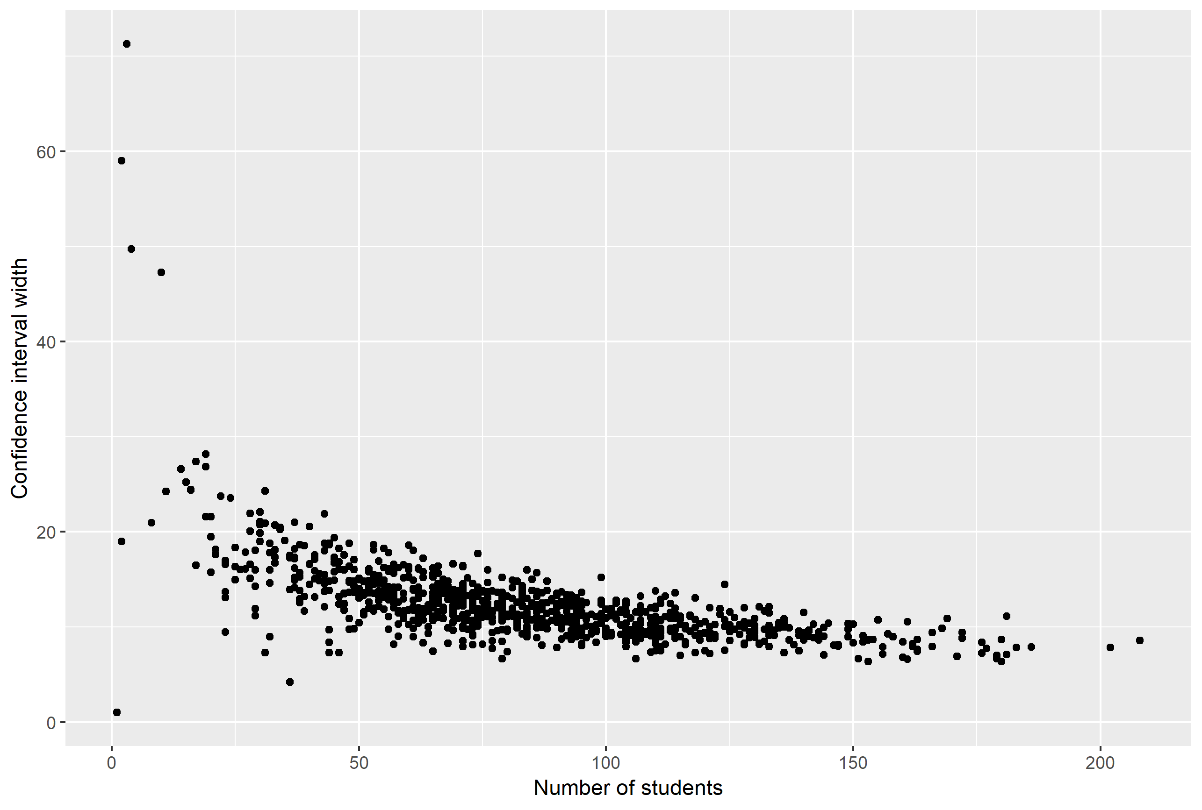
Estimates much less precise for some smaller schools
Note: Figure shows the relationship between school size (number of students contributing to a school’s K–3 growth estimate) and the confidence interval width for schools’ K–3 math growth estimates. Each dot represents a school.
Notes:
Each point is a school; figure shows the relationship between the number of students contributing to the school’s growth estimate and the CI width.
Precision begins to decline dramatically around a school size of 40 students. Precision levels off around 100 students, when additional students are not markedly improving precision.

Slide 58
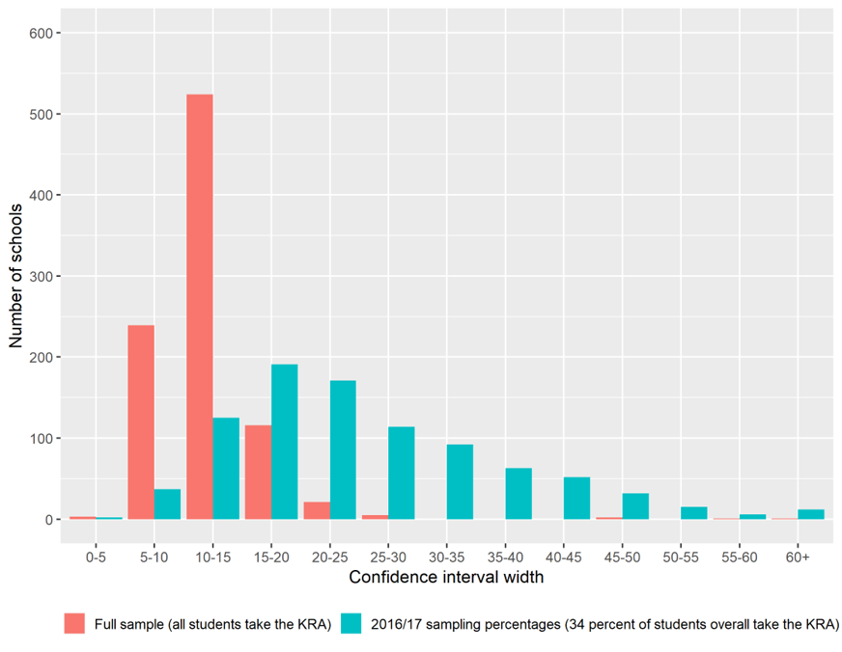
Partial KRA administration reduces precision
Average confidence interval widths, by KRA sampling proportion
Distribution of schools’ confidence interval widths, by KRA administration
Sampling percentage | Average confidence interval width (percentile points)
 | Math | Reading
Full sample (all students take KRA) | 12 | 13
2016–2017 KRA sampling: 34 percent | 25 | 26
2017–2018 KRA sampling: 35 percent | 24 | 24
2018–2019 KRA sampling: 39 percent | 23 | 23
Source: Administrative data provided by the Maryland State Department of Education.
All students take KRA
34 percent of students take KRA
Notes:
The number of districts using a census administration as been increasing the last 3 years. 14 out of 24 used a census administration in 2018/19, up from 8 in 2016/17; MSDE could build on this progress
2016/17 2017/18 2018/19
Census administration 8 12 14
Partial-cohort administration 16 12 10
Reducing the sample by two-thirds doubled the confidence interval.
Many more schools are in the right tail of the distribution under the partial KRA administration, having CI widths > 30 percentile points.

Slide 59
Limitations of the study
Findings and conclusions reflect only the students included in the analysis.
  14 percent of students with KRA scores did not have a valid grade 3 score
  There are no KRA scores for grade 3 students entering Maryland public schools after kindergarten
Reliability for schools’ K–3 growth estimates could not be studied.
  This analysis could be conducted in future years (as data become available)
Unobserved student movement within school year could introduce bias.
  Could be avoided if data were maintained on all schools attended by students each school year
Maryland will replace the PARCC with new statewide assessments.
  A similar study can examine how the validity and precision of the estimates change
Notes:
1. 86% of students who took the KRA in 2014/15 and 67% of all students observed in kindergarten in 2014/15, grade 1 in 2015/16, grade 2 in 2016/17, or grade 3 in 2017/18. There are differences between the students included in the model and those excluded in terms of achievement (PARCC data is limited) and student characteristics.
2. A stable measure can help increase schools’ confidence in the estimates.

Slide 60
Implications and next steps
K–3 growth measure using KRA can provide new information on growth in early grades.
There is an opportunity for states with comprehensive kindergarten assessments to also understand how schools’ early grade levels contribute to students learning.
The measure should be used with appropriate caution:
  Relatively low correlations suggest K–3 growth estimates less valid than estimates for grades 3–4
  Growth estimates are much less precise for smaller schools
  Precision is also a concern for schools in which the KRA is administered to only a portion of kindergartners
Findings are informing Maryland discussions about future use of K–3 growth measures.

